Slide 1

ADVISING UPDATES

Slide 2


Introducing new professional staff advisor Emily Cole
EMILY COLE
PROFESSIONAL STAFF ADVISOR
will predominantly be working with first- and second-year students and can assist with:
  general education requirements
  course registration
  degree progress
  academic supports
  resources at UConn
  and more!
As always, students will continue to meet with their faculty advisors at least once a semester for course selection and advising before the class enrollment period begins. faculty advisors need to lift advising holds after this meeting.

Slide 3



APPOINTMENT SCHEDULING
AMANDA WILDE
DIRECTOR OF ADVISING
EMILY COLE
ACADEMIC ADVISOR
S.UCONN.EDU/MEETWITHAMANDA
S.UCONN.EDU/MEETWITHEMILY

Slide 4






FORM SIMPLIFICATION
EXCESS CREDIT REQUEST
ADD AN
SFA MINOR
COURSE SUBSTITUTION
EARLY
ALERT
STUDENT SUBMITS FORM
FACULTY SUBMITS FORM
FACULTY ADVISOR OR MINOR COORDINATOR APPROVES
DEPT HEAD APPROVES
AMANDA REVIEWS
DEPT HEAD APPROVES
AMANDA REVIEWS
CONNECTIONS MADE
AMANDA PROCESSES
DEGREE AUDIT PROCESSES

Slide 5
FORM LINKS
EXCESS CREDIT REQUEST
S.UCONN.EDU/SFAEXCESSCREDITFORM
ADD AN
SFA MINOR
S.UCONN.EDU/SFAMINORFORM
COURSE SUBSTITUTION
s.uconn.edu/sfasubform
EARLY
ALERT
S.UCONN.EDU/SFAEARLYALERTFORM

Slide 6

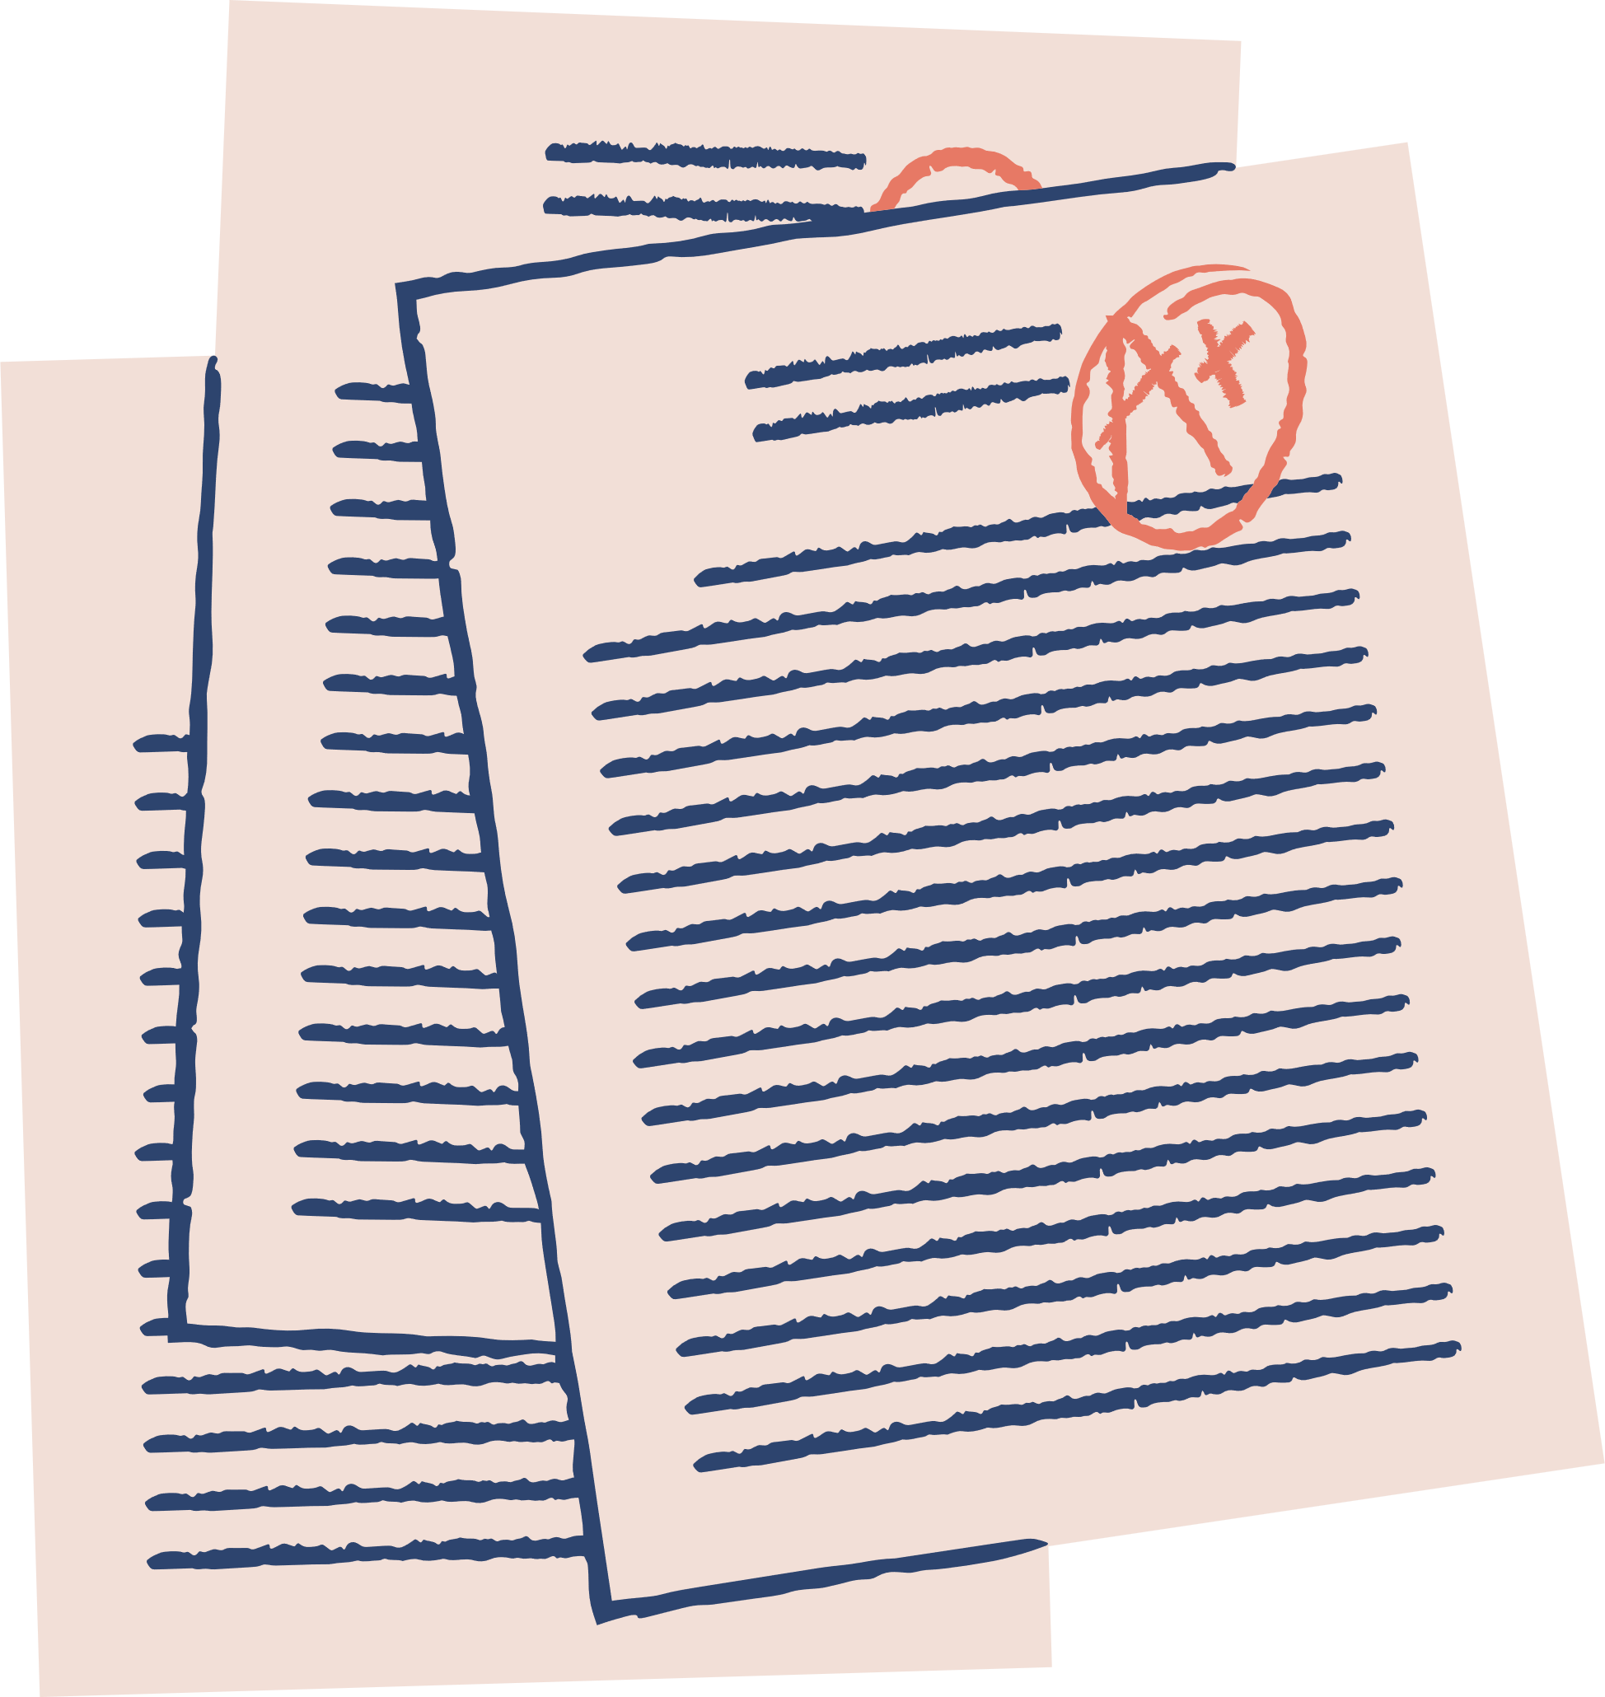




MID-SEMESTER GRADES
FRI., FEB. 28-FRI., MAR. 14
University Senate By-Laws state that instructors of 1000 and 2000-level courses must submit mid-semester grades for all enrolled students through the Student Administration System during the mid-semester grading period which spans the sixth through eighth week of the semester.
  students & faculty advisors can view available mid-semester grades in Student admin for a limited time
  faculty advisors can view mid-semester grades in nexus until the end of the semester
  faculty advisors should discuss mid-semester grades with advisees during advising appointments
  sfa advising will reach out to students who have earned a “C-“ or lower in any course to offer support
WHAT
NEXT?

Slide 7


VISIT OUR BREAKOUT ROOM

