Slide 1
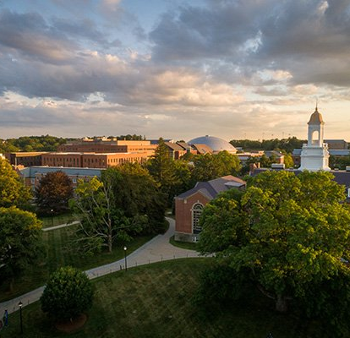
School of Fine Arts and the UConn Foundation

Slide 2
UConn Foundation SFA Team
Laura Frye
Director of Development, School of Fine Arts
Emily Auger Murray
Senior Director Alumni Relations
Neag and Fine Arts

Slide 3
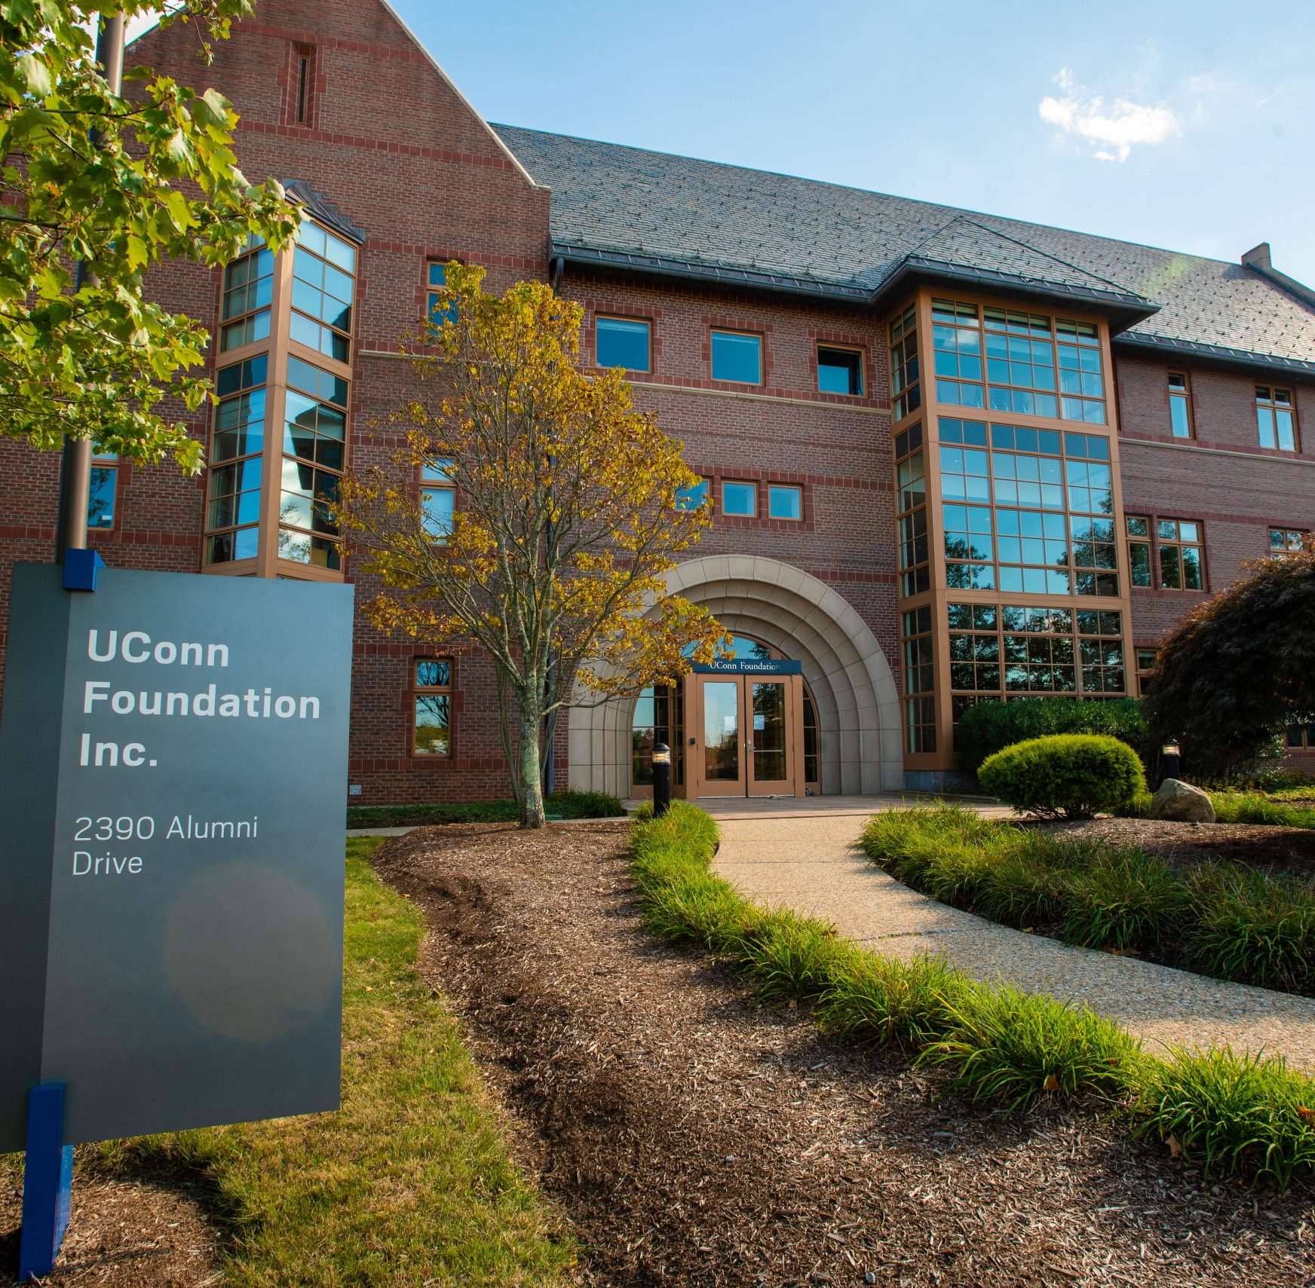
Foundation Role
Foundation’s sole purpose is to support UConn and UConn Health by advancing their educational, scientific, cultural, and research objectives missions.
Foundation Departments and Staff:
Alumni Engagement
Gift and Pledge Management
Research and Prospect Management
Fund Administration and Disbursements
Annual Fund donations
Corporate & Foundation Relations
Major and Principal Gift Fundraising
General Counsel
Finance
Investments
and more!

Slide 4
Director of Development Role
Laura is responsible for a “caseload” of donors
  Assigned alumni, donors, and friends
    Some are current donors, some are prospective donors
    All Major Gift prospects
  Individual metrics include number of meetings, solicitations, and money raised
  An external-facing role
Do you have a question about a scholarship? The Annual Fund? Something else Foundation-related?
  I will try to answer or put you in contact with the correct Foundation staff member. BUT Please Remember: I may not be able to share information due to Foundation’s privacy policies.

Slide 5
The Donor Cycle and why it takes a long time to raise money
Identify
Cultivate
Solicit
Steward
Identify:
  Are they connected to UConn?
  What is their interest?
  Are they philanthropic?
Cultivate:
  Build trust-based Relationship
  Learn about philanthropic passions
  Do their passions match our need?
Solicit:
  Partnership
  Ask and agree on philanthropic gift
Steward:
  Thank, engage, keep informed

Slide 6

How Can Faculty & Staff Help
You know your students, programs, and school best!
Connect us to a student who has a great story to share
Keep us posted on alumni success
Participate in UConn Gives – April 21 & 22
Speaking to a donor? Keep us in the conversation

Slide 7

What to do if someone wants to make a donation
Celebrate! And connect with Laura or Em
Do you already have the money?
  Give donations to Laura or Em, include:
    Donor Name
    Purpose of the donation (what fund)
    Paperwork that came with donation, including envelope
  A donor cannot receive anything that has a monetary value as a thank you. (There are specific tax rules)
    Example: Cannot receive an instrument because they gave a donation
Don’t have the money yet?
  Visit: www.foundation.uconn.edu/send-your-gift/
  Talk to Laura or Em

Slide 8
Two main types of funds
Endowed
Provide University support in perpetuity- like an investment account
$50,000 to open a new account*
Non-Endowed
Money is fully spendable – like a checking account
$2,000 to open a new account*
Annual foundation fee
One-time foundation fee
*Some type of naming opportunities may have a larger minimum. For example, Professorship position is $1.5M

Slide 9
What if a donor wants to start a new fund? There will be questions
Named Fund? (Professorship, Program, Scholarship)
Does it meet the minimum funding requirement?
Is it being named by the donor, or in honor/memory of donor?
Donation Secured?
Yes: who is the donor?
What is the purpose of the fund?
Is there already a similar fund established?
How restrictive is the fund?
Endowed or non-endowed fund?
Support in perpetuity, or fully spendable?
$50,000 minimum vs $2,000 minimum*
No: how will money be raised?
*There are recommended gift minimums for naming opportunities that may exceed amount shown above. Please see Laura for specific amounts.

Slide 10
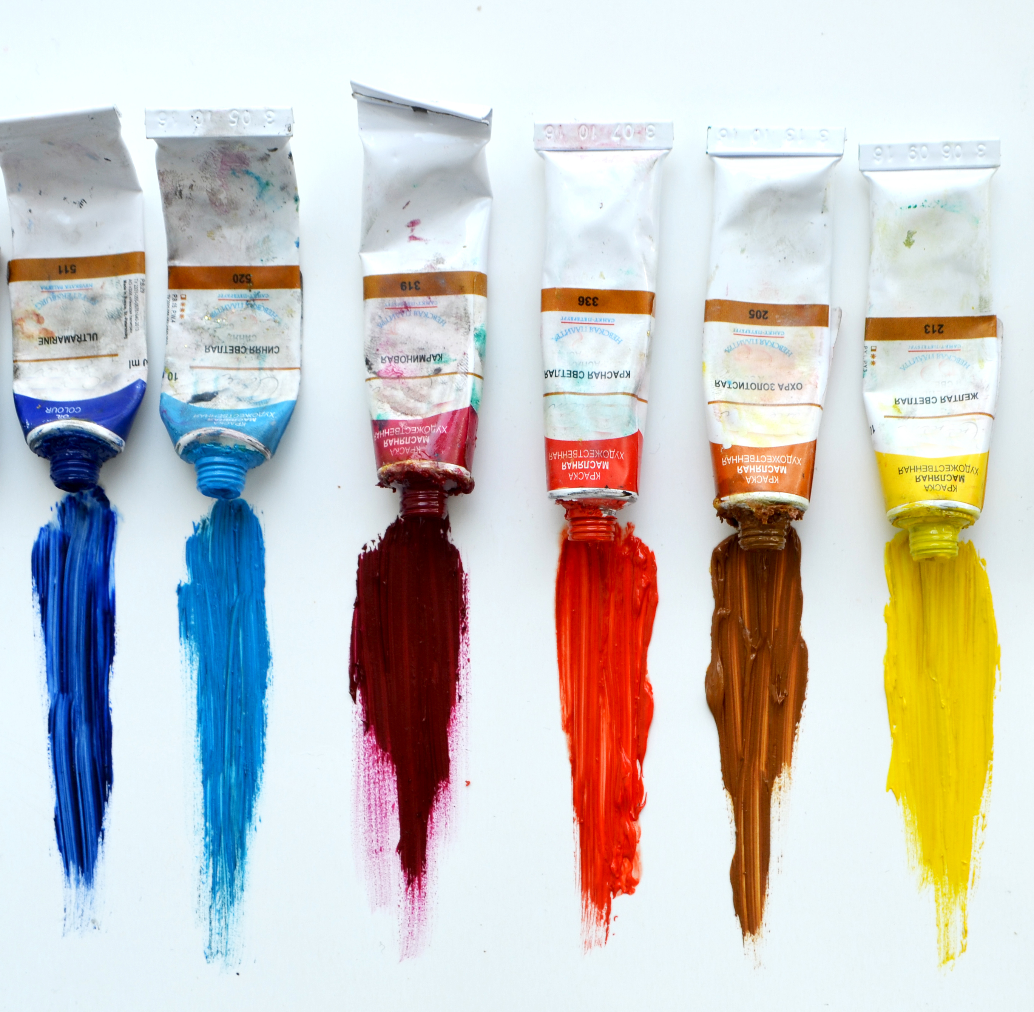
The Blue Paint Fund (an example)
Donor studied painting in France and fell in love with a brand of blue paint.
To support UConn students, they want to make a donation so the UConn can purchase this specific brand of blue paint.
This could cause some issues in the future. Let’s discuss!

Slide 11
New Fund Process
New Fund is approved by Department Head
Laura to complete Foundation’s New Fund Form
Fund approved by Dean Fitzgerald
Department Head to bring Fund to Laura Frye
Fund opened
This process may take up to four weeks to complete

Slide 12
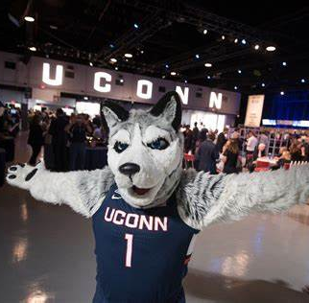
THANK YOU!
Laura Frye
Lfrye@foundation.uconn.edu
860-576-6828

