Slide 1


School of Fine Arts
Operational Updates
JIRA Service Management – Request Workflow System
2025 SFA All Faculty & Staff Meeting
Colleen K. Bridgeman
Assistant Dean & Chief Operating Officer

Slide 2
Project Goals –
JIRA Service Management Long Term Strategy
JIRA Service Management – Request Workflow System
Easier to Access & Use
Web-based Platform
Improved Workflow & Approval Process
Requestor Status Updates
Reporting & Metrics
Service level intake forms
Web-based portal
Workflow automation
Status tracking
Reporting

Slide 3
JIRA Service Management – Request Workflow System
Implementing a New & Improved Form

Slide 4
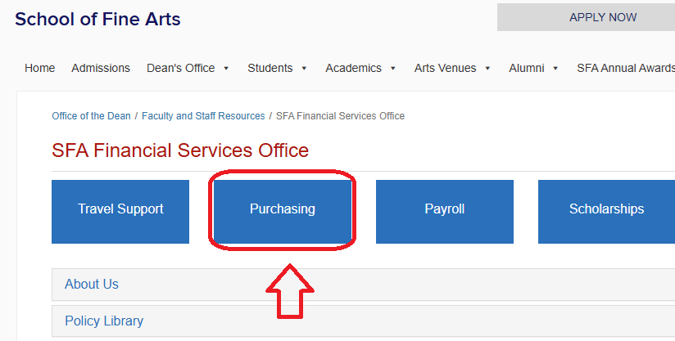
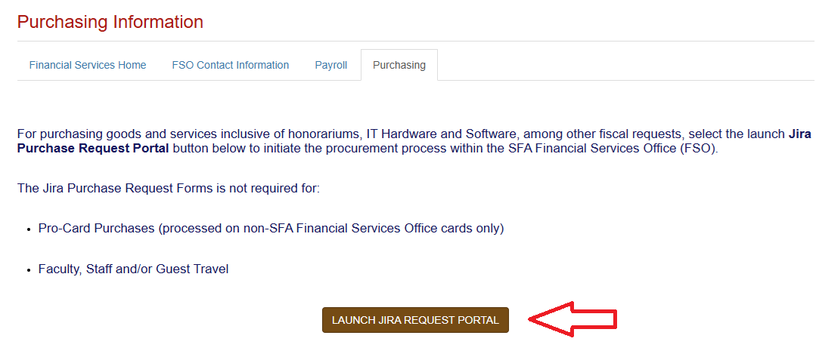
JIRA Service Management – Request Workflow System
Implementing a New & Improved Form

Slide 5

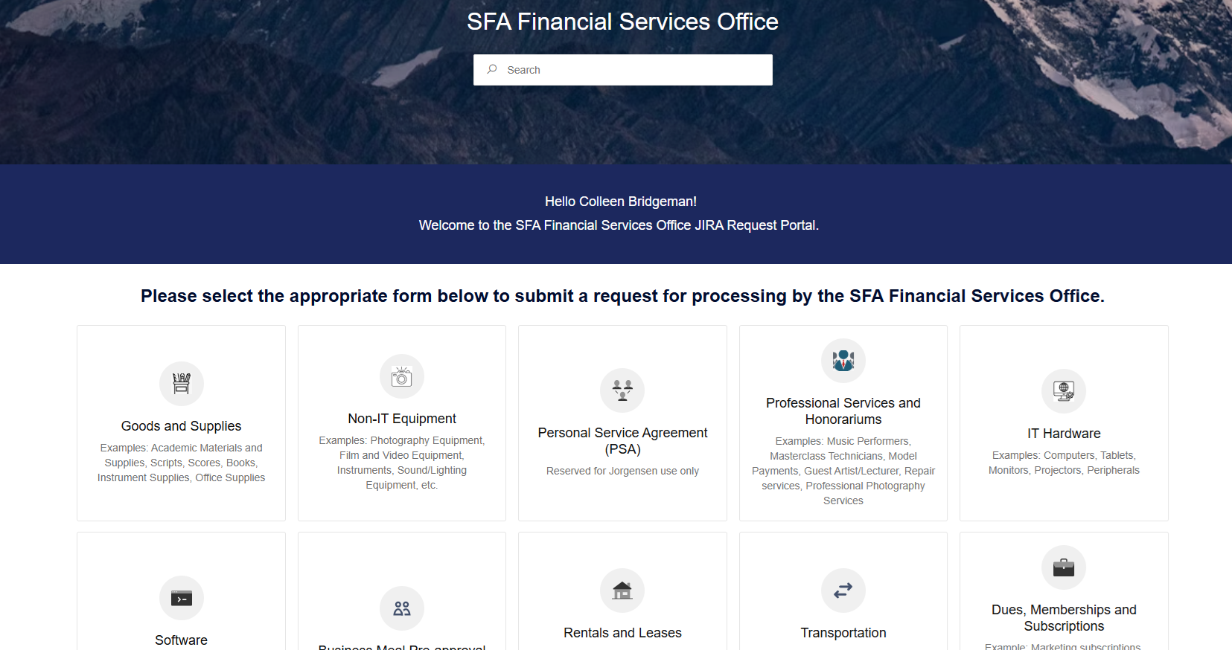
SFA Financial Services Office JIRA Request Portal Demonstration
JIRA Service Management – Request Workflow System
Implementing a New & Improved Form

Slide 6
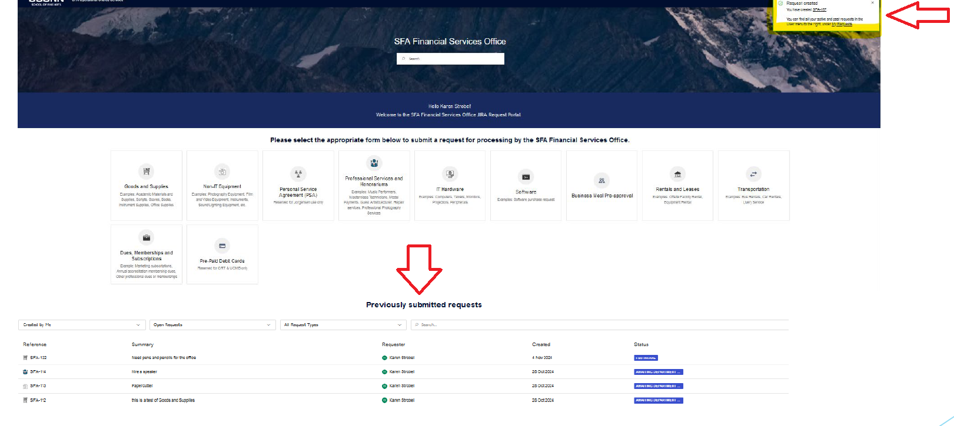
JIRA Service Management – Request Workflow System
Implementing a New & Improved Form

Slide 7
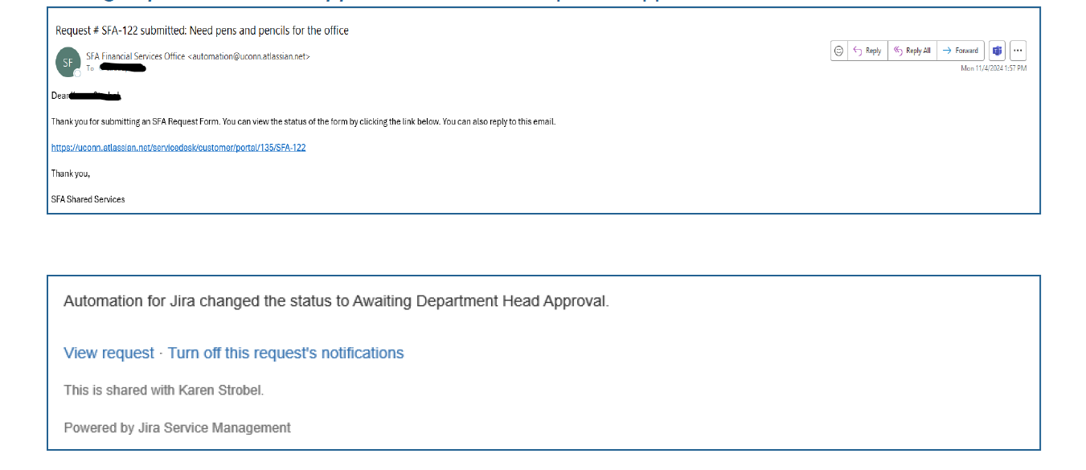
JIRA Service Management – Request Workflow System
Implementing a New & Improved Form

Slide 8
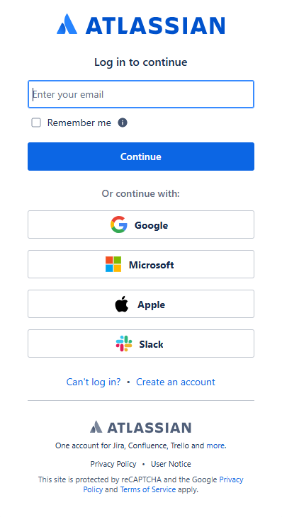
JIRA Service Management – Request Workflow System
Implementing a New & Improved Form
If logging in for the first time, please be sure to enter your UConn.edu email through the Atlassian (Jira) site and then log in with your NetID and Password credentials

Slide 9
JIRA Service Management – Request Workflow System
Implementing a New & Improved Form
Q: What browsers are supported for Jira?
A: Jira works best on the latest versions of Chrome, Firefox, Safari, and Edge.
Q: What information do I need to include in my request?
A: Required fields are indicated with *
  Be sure to include:
  A Request header – this will be used in all email correspondence so use something descriptive and unique to the request
  A clear Description of the item or service
  Amount
  A quote or a link for the item/service
  Supplier details (Name required for all requests. On Professional Services & Honorariums, the Supplier Email is required as well.)
  Supporting documents, if necessary

Slide 10
JIRA Service Management – Request Workflow System
Q: Can I track the history of my requests?
A: Yes, you can view all your submitted requests and their statuses under your profile circle in the upper-right of the of the Jira Portal. See "My requests".

Slide 11
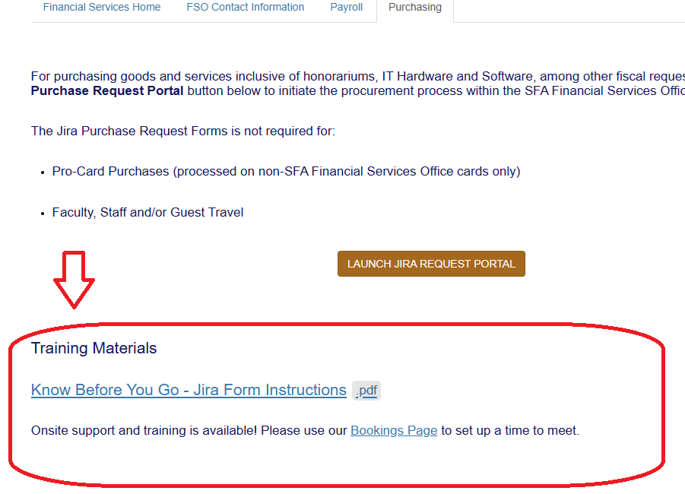
JIRA Service Management – Request Workflow System
Implementing a New & Improved Form

