Slide 1
Travel Overview
Dylan DelMastro & Cindy Caron
September 6, 2024

Slide 2
Travel Cards
Need A Travel Card?
If you do, here are the steps for applying for one
Travel Card Training & Travel Card Request Form
The University backed Travel card and Pro-Card programs provide a payment avenue for UConn employees and students and are both reconciled via Concur.
Travel Card - The main use of the UConn Travel Card is for purchasing and paying for expenses directly related to Travel, such as airfare, car rental, hotel etc., this also includes virtual conference registration fees.
Pro-Card - The UConn Pro-Card is an extremely efficient and effective method of purchasing and paying for goods and services with a value less than $4,999.99 and is designed to more efficiently meet your purchasing needs and those of the University.
Approved Uses - The following are examples of the types of items that may be purchased with the Travel Card and the Pro-Card.
Notes:
Cindy: I'm not going to spend too much on this slide vs the next one. At this point, everyone should apply for a travel card because the process does take a month or so to complete so don't be stuck in a position where you want to travel but don't have a card and you're waiting for one to be issued.

Slide 3
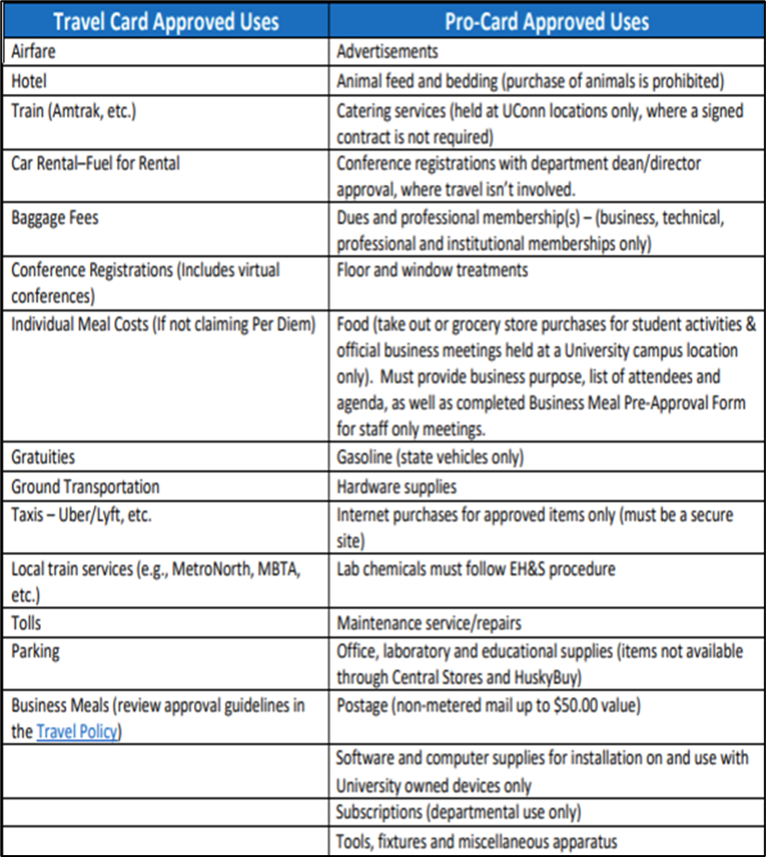
Travel Card vs Pro-Card
Notes:
Cindy: Here is a break down of what is approved on a travel vs pro card. As you can see, conference registration should go on a travel card, especially if you are traveling to said conference. As a helpful tip, we will add this presentation to our website for you to always be able to access.

Slide 4
Pre-Travel – Best Practices For Airfare
Travel & Entertainment Policy
Review your itinerary within 24 hours (window for voiding without penalty) of booking on Concur or on the phone with your UConn designated travel agency. Immediately notify UConn’s designated travel agency of any discrepancies found once you receive your email confirmation.
2. Whenever possible, avoid changing your reservation once it has been ticketed. Airline change fees can substantially increase the overall cost of the ticket.
3. Always cancel any ticket prior to the departure of the outbound flight if you won’t be using it. If this is not done, in most cases, the ticket retains no value for future use.
4. Make reservations 6-8 weeks prior to travel if possible. This enables you to take advantage of lower fares, as well as increases the possibility of getting your preferred seat assignment.
5. When making reservations, choose the least expensive nonrefundable fare. Refundable fares are
often double or triple the nonrefundable rate.
Notes:
Dylan

Slide 5
Pre-Travel – Best Practices For Airfare
6. If possible, use the same airline for the entire trip. Changing airlines usually results in one-way tickets,
which are generally more expensive.
7. Whenever possible, combine business trips. Several stops on one trip or visiting multiple
clients/recruits/etc. In the same city will generally be less costly than two round trips.
8. When possible, schedule midday meetings. This often enables you to avoid peak times at airports.
9. Based on the possibility for flight delays, make sure you have extra time between your flight arrival and
you're meeting or event. It is advisable to book one flight earlier than your intended arrival time so there is
a backup flight in case of delays or cancellations.
Notes:
Dylan

Slide 6
Pre-Travel – Best Practices For Hotels
If you need to cancel your room after you have made your reservation, be sure to cancel it prior to the cancellation deadline to avoid penalties. Hotels will usually charge a minimum one-night room penalty (sometimes more than one night) for “no-shows”.
Nonrefundable prepaid hotel stays may be lower in cost, however, because changes may occur with travel, we do not recommend you book this type of rate as this would result in the total loss of the repaid amount.
Some hotels will include a complimentary breakfast with your room stay. Take advantage of this if
possible as it can be an easy and convenient option.
4. Business hotels usually offer transportation shuttles to major business areas, or they can assist
travelers with securing taxis if you decide not to book a car rental.
Notes:
Dylan

Slide 7
Pre-Travel – Best Practices For Car Rentals
UConn’s preferred car rental company is Enterprise/National. The contract Loss Damage Waiver (LDW) and Liability coverage in the rate.
GPS systems are helpful but cost approximately an additional $10 to $20 per day. You may need prior
approval from your department before you request it. (Most cell phones have a Maps app you can use
instead.)
3. Car rentals are based on a 24-hour clock. For example, if you pick up your vehicle at 9:00 a.m. on Monday
and return it at 10:30 a.m. on Tuesday, you’ll usually be charged for two full days.
4. Before you drive away from the pickup station, inspect the car carefully for body damage. Be sure the lights
and turn signals are working properly and check the mileage odometer.
5. Always fill the tank yourself before returning the vehicle, so you're only paying for the gas you used.
6. An extra fee is usually charged if a car is returned to a different location than where it was picked up. Make
sure you are aware of any drop-off charges.
Notes:
Dylan

Slide 8
Per-Diem vs. Actual
We have seen an increase in the number of travelers attempting to claim Per Diem reimbursement in combination with Individual Actual Meals on the same expense report. Travelers must choose to use either the Per Diem or Actuals method for meal expenses on a single trip.
What are the Actuals and Per Diem methods?
Actuals
The maximum reimbursement for actual meal costs, including tax and tips.
Each meal expense is added to a Concur expense report under the expense type of Individual actual Meals.
Receipts are required for expenses over $25.00 out of pocket or over $50.00 if purchased using the UConn travel card.
The allowable amount is calculated daily and is not aggregated over the entire period of the trip.
Per Diem
Daily allowances paid to employees to cover meal costs incurred while on a UConn business trip. The Daily allowance or Meal Per diem is added to the Concur expense report via creation of a Travel Allowance Itinerary. Travelers using this method would NOT be eligible to use their travel card for individual meal purchases on the same trip.
Note: When using either method the amount may not exceed the daily limits, based on the meal per diem rates published by the GSA the allowance applicable to the first and last day of travel will be 75% of the full day Per Diem.
Notes:
Dylan

Slide 9
SFA Travel Policy Updated
SFA Travel Policy
POLICY
It is the responsibility of the traveler to consult and follow the applicable University and SFA travel policies. We recommend all travelers apply for a University Travel Card to reduce their out-of-pocket expenses.
Please be sure to always reference the most up to date University Travel Policy located at on the Travel Office’s Website. In addition to adhering to the University Travel Policy and any applicable COVID guidance available at the time, travelers utilizing SFA funding must also follow the SFA per diem guidelines below based on the duration of their trip.
Travel lasting 14 days or longer in one location
Lodging should be arranged in long-term style housing with a kitchen to help reduce both food and lodging costs. | Requires written preapproval, including a proposed budget for the trip. Please submit your request to your Department Head and Assistant Dean/COO prior to securing travel arrangements and include the SFA Travel Reimbursement Budget Worksheet to itemize your budget.
Lodging reimbursement will be capped at 75% of the location’s daily GSA rate. | Food reimbursement requests will be capped at either the daily receipted total or 75% of location’s daily GSA rate.
Notes:
Cindy

Slide 10
Receiving an AAUP/OVPR Travel Award
Faculty Travel Funding Guidelines
Receiving an AAUP/OVPR Travel Award does not infer that such travel has been approved by the University, only that the awardee has travel funding available to reimburse expenses from approved travel. Before traveling or making travel arrangements:
All Faculty must obtain approval from their department or unit head, per the AAUP contract (per UConn AAUP contract).
Faculty traveling internationally must obtain approval from Global Affairs.
Global Affairs if traveling internationally to a Level 3 or 4 destination
Faculty traveling to embargoed regions (currently Cuba, Iran, Syria, North Korea, and Crimea) must seek approval from OVPR Export Control.
embargoed regions
Notes:
Dylan

Slide 11
Receiving an AAUP/OVPR Travel Award
Receiving an AAUP/OVPR Faculty Travel Award does not infer that such travel has been approved by the University, only that the awardee has funding available to reimburse expenses from approved travel.
Failure to follow appropriate policies and procedures related to University travel may result in unreimbursed out-of-pocket expenses for individuals.
Reminder:
Any activity related to your faculty position for which you receive outside compensation, honorarium, or other form of payment (including payment of expenses) may require review and approval by the Faculty Consulting Office. Travel or other Professional Development costs relating to or overlapping with outside consulting activities are not eligible for reimbursement under the AAUP/OVPR Faculty Travel Funding Program.
Common Request Portal
One trip per request
Submit at least 10 days prior to departure to ensure adequate processing time.
Requests submitted fewer than 10 days before departure may not be processed before your travel begins.
Requests cannot be funded once travel has commenced.
Notes:
Dylan

Slide 12
Receiving an AAUP/OVPR Travel Award
Post-Trip Requirements – Reimbursement Process
Please collaborate with your department’s staff to request reimbursement of expenses upon completion of
travel.
All awards are for reimbursement of travel expenses only.
Reimbursements from OVPR award funds must include evidence of active participation.
See also “Covered Expenses”.
Requests for reimbursement must be submitted within 60 days of travel ending. This mirrors
UConn Travel policy.
Awards expire after 90 days
Reminder: Per updated UConn Travel Policy.pdf "reimbursements submitted over 120 days after
travel is complete will not be reimbursed even with the approval from a Dean, Director, or Department Head."
Notes:
Dylan

Slide 13
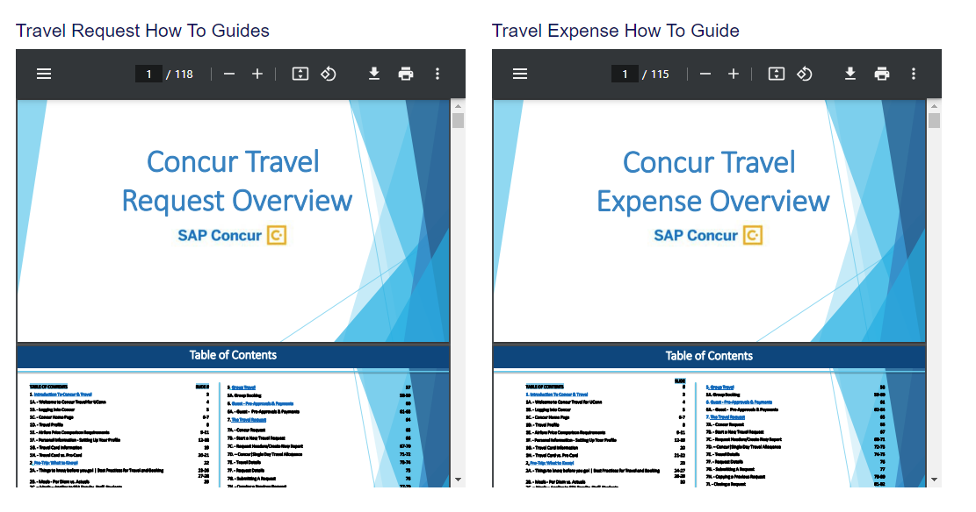
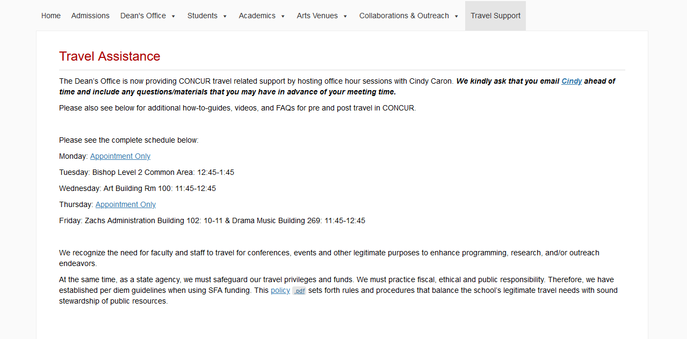
New Website!
SFA Travel Website
Notes:
Dylan

Slide 14
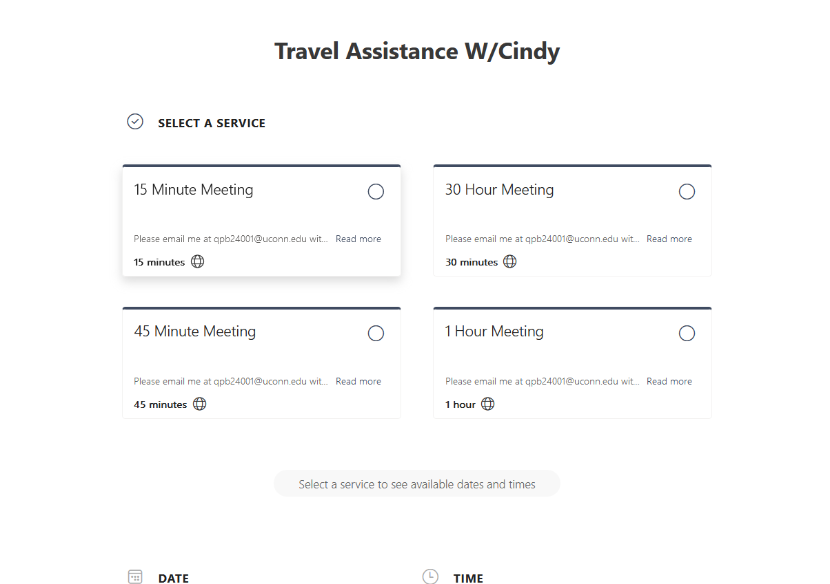
Travel Assistance with Cindy
Time Schedule: Starting 9/16/24 however appointments start week of 9/9.
Monday: Appointment Only
Tuesday: Bishop 12:45-1:45 In the Common Area Level 2
Wednesday: Art Building 11:45-12:45 In 100
Thursday: Appointment Only
Friday: Music 10:00-11:00 In ZFA 102 Drama Music 12-1 in 269
To schedule a one-on- one appointment:
Bookings Page
Notes:
Cindy

