Slide 1
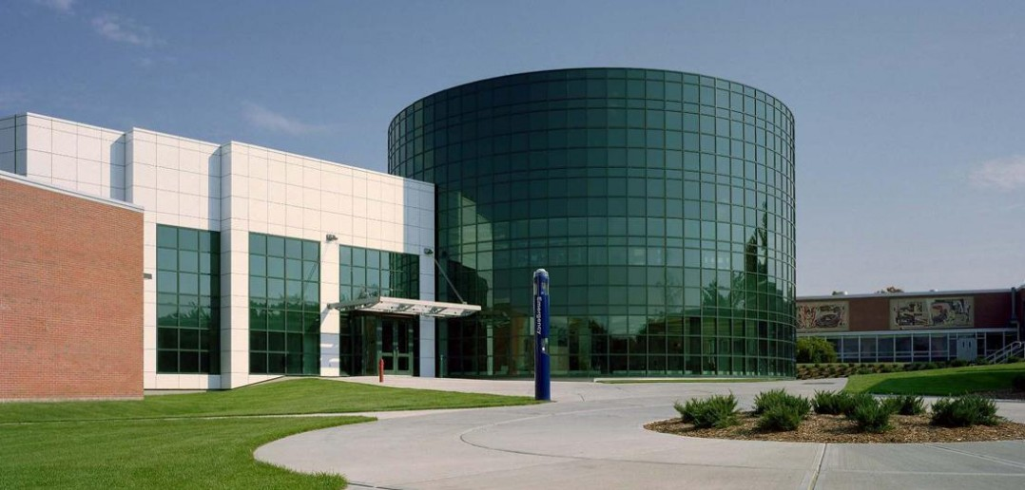
JIRA Breakout Session
Fine Arts Retreat
September 6th, 2024
Rick O’Toole & James Ouellette

Slide 2
SFA Operational Shared Services Landing Page

Slide 3
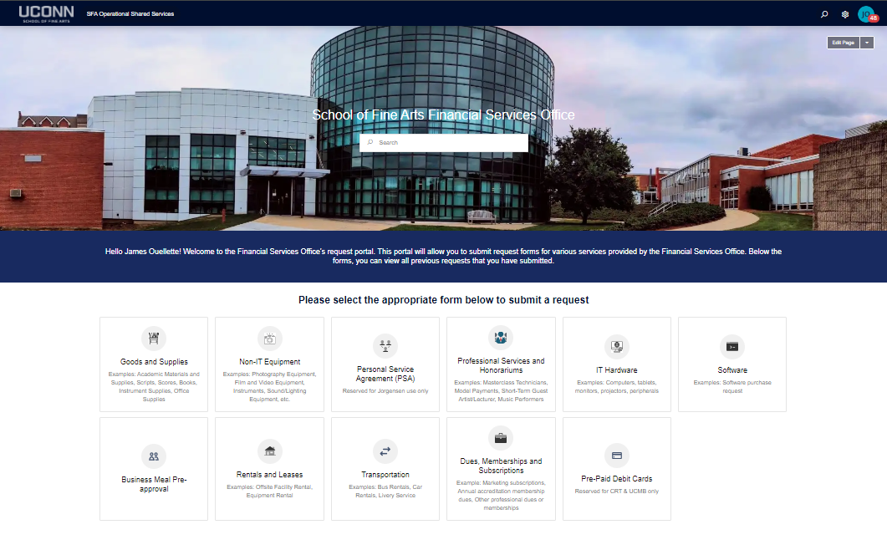
Financial Services Office Request Portal

Slide 4
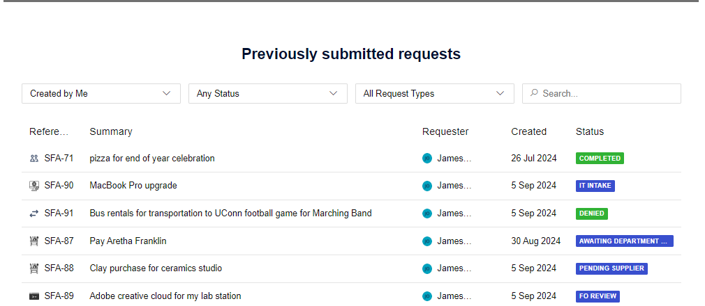
Previously Submitted Requests

Slide 5
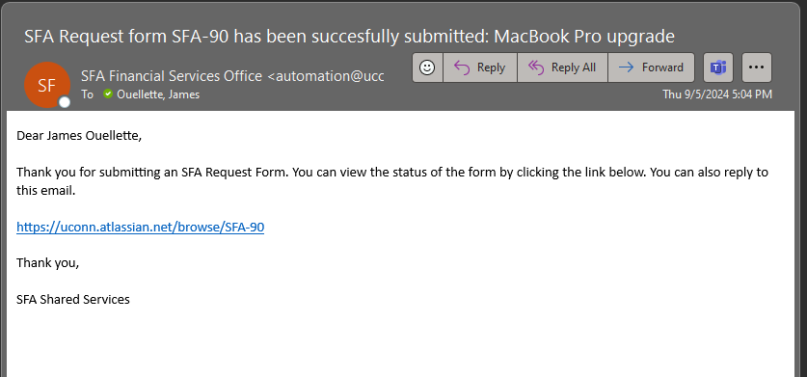
Email Notifications

Slide 6
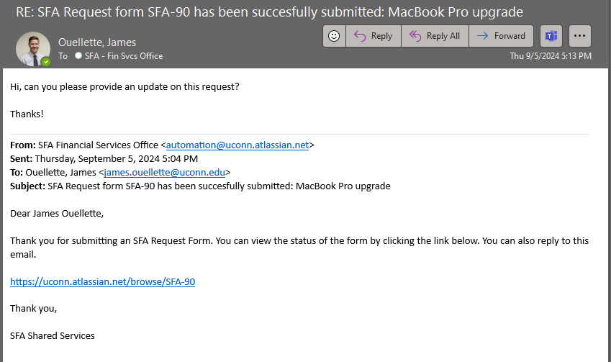
Email Replies

Slide 7
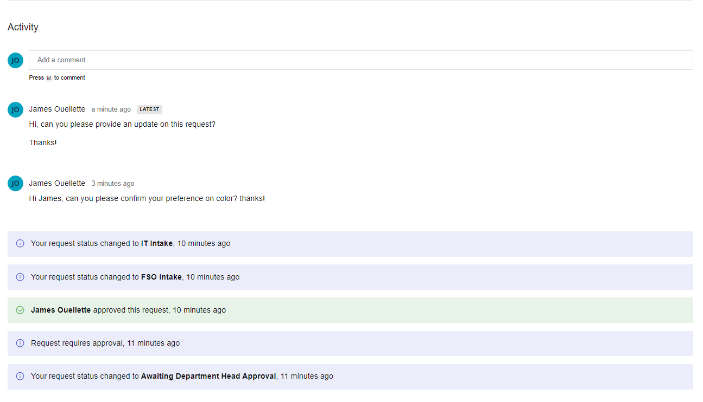
Viewing Status/Activity

