Slide 1
School of Fine Arts Faculty Orientation: Nexus Tips and Tricks
Amanda Wilde, Director of Advising, SFA
Notes:
-acknowledge the diversity of experiences in the audience today–welcome them to UConn; let them know our office’s role is focusing on undergraduate advising, but we will be sharing some tools and information that are useful to all new faculty at UConn.
-we’ll be sharing a lot, but also know that we will share these resources and links afterward.

Slide 2
Faculty Advising: Guidelines
Be accessible
Check in with all advisees regularly
Learn, know, and understand University requirements, school/college requirements, and major requirements in your field
Focus on student responsibility, learning, and growth.
Commit to growing your skills and practice
Notes:
A few faculty advising guidelines:
Be accessible on a regular basis, through office hours, email, or phone.
Check in with all advisees regularly but meet at least once per semester.
Learn, know, and understand University requirements, school/college requirements, and major requirements in your field
This often requires consultation with your school/college Advising Center and/or the Registrar.
Focus on student responsibility, learning, and growth.
Grow your skills and practice: Attend regular trainings and professional development opportunities provided by the Office of Undergraduate Advising, the Center for Excellence in Teaching and Learning (CETL), and other university offices. I will share specific training and development opportunities that are coming up later in this session.
I do want to stress that an advisor cannot know everything, especially for all majors–it’s about knowing the basics within your major, areas, but more importantly, knowing about the resources on campus to help support and connect students.

Slide 3
Nexus (nexus.uconn.edu)
Why should all advisors use Nexus?
Need help with Nexus?
Advising website: https://advising.uconn.edu/using-nexus/
Attend our faculty advising training on October 10
Registration Link
Website: nexus@uconn.edu
Notes:
Why should you be using Nexus?
Great for sharing tools and resources to allow students to gauge their academic progress, communicate with their advisors, and connect with their peers in academic pursuits
Also, it creates a common site for advisors to engage with student-level academic data
Provides advisors a common platform to keep regular notes on student meetings and interactions
Linking the advising community together as we seek to support students developmentally and holistically
It’s a great tool for time management
Ability to see student information holistically

Slide 4
Top 5 Nexus Tools for Faculty
Why use Nexus?
What are the most useful features of Nexus?
Student profile
Meeting notes
Advisee list
Batch emails/”Rolodex”
Advisor appointment scheduling
Student check-ins
Notes:
Why should you be using Nexus?
Great for sharing tools and resources to allow students to gauge their academic progress, communicate with their advisors, and connect with their peers in academic pursuits
Also, it creates a common site for advisors to engage with student-level academic data
Provides advisors a common platform to keep regular notes on student meetings and interactions
Linking the advising community together as we seek to support students developmentally and holistically
It’s a great tool for time management
Ability to see student information holistically

Slide 5
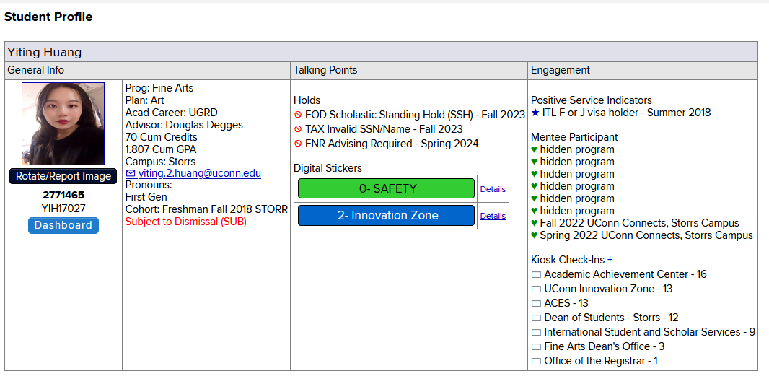
Nexus Features: Student Profile

Slide 6
FERPA and Advising Notes
Family Educational Rights and Privacy Act (FERPA) gives students the right to access any note that is considered part of the academic record
Nexus notes are part of a student’s academic record and are requestable by students, open records requests, and court subpoenas
IMPORTANT: This applies to both open and closed notes
Notes:
Lauren

Slide 7
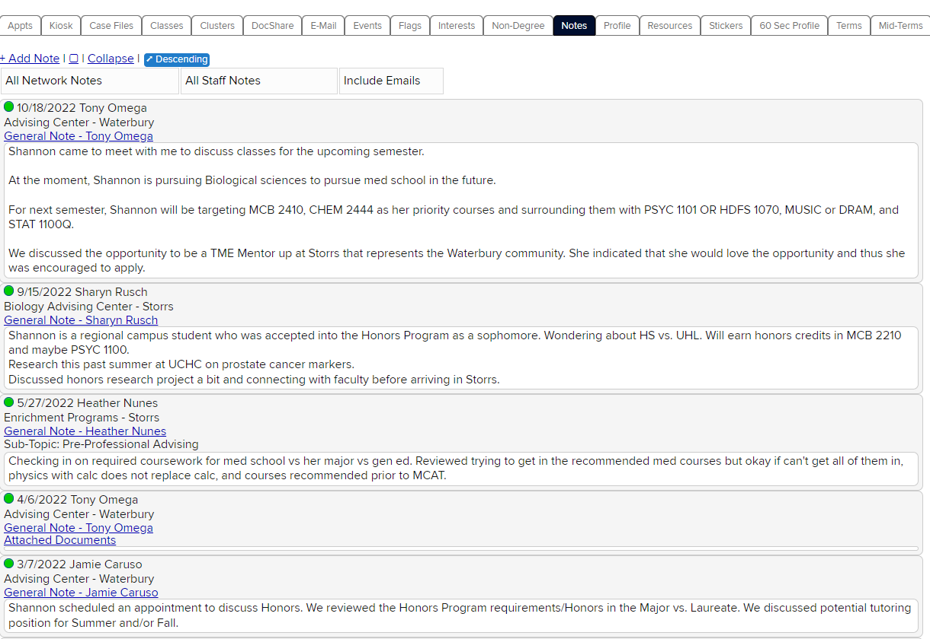
Nexus Example: Student Meeting Notes
Notes:
Erin

Slide 8
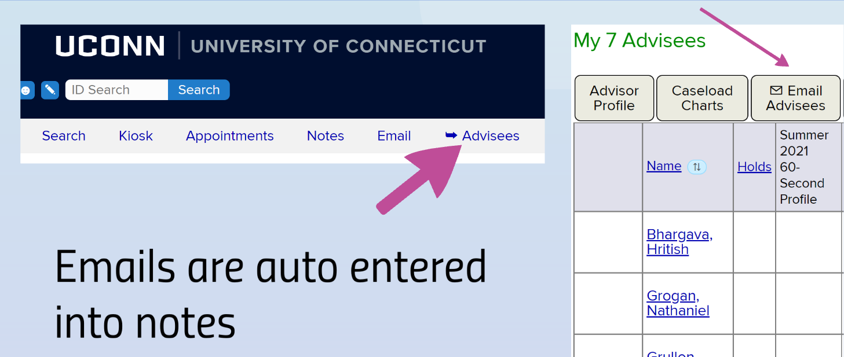
Nexus Features: Advisee List
Advisee List
Student Profile
Appointments and Check-ins
Batch Emails (to advisees, classes, or other groups)
Meeting Notes
Using Nexus Tutorial
Notes:
Most useful tools in Nexus:
Appointments and Check-ins
Student Profile
Advisee List
Meeting Notes
Batch Emails
We will have more in depth training for faculty advising in October, and how to use Nexus is a part of that training. In the meantime, you may review the Nexus tutorial linked here to get you started. If you need access to Nexus, reach out to me, and I can request that for you.

Slide 9
Advising Appointment Structure and Guidelines
Before the meeting:
Review Nexus Notes and Dashboard
Review current courses, previous grades, academic standing
Run advisement report
Check catalog year & concentration
Do they need course substitutions/exemptions?
Are there any missing courses/internships/independent studies?

Slide 10
Advising Appointment Structure and Guidelines
During the meeting:
Check the student into Nexus
Ask how the student is doing: inquire about current coursework, study abroad, research, grades, etc.
Note academic standing, potential difficult courses
Discuss notes from the prior semester/meetings

Slide 11
Advising Appointment Structure and Guidelines
During the meeting:
Ask student about the following:
Areas of interest, potential internships, undergraduate research opportunities, career potential
Course plan for the following semester; recommendations and considerations
Review account holds, lift advising hold/scholastic standing holds as appropriate
Provide appropriate resources
Will they need excess credit, permission numbers, etc.?

Slide 12
Advising Appointment Structure and Guidelines
After the meeting:
Enter meeting notes into Nexus
Follow up with student and refer as necessary
Notes:
Nick

