Slide 1
AI BREAKOUT-SESSION
What’s going on?

Slide 2
Yes, this image was generated by AI exploring the prompts: AI, Fine Arts School, Teaching & Learning.

Slide 4
NOVEMBER, 2022
Notes:
While AI programs had existed for several years before the release of ChatGPT, the quality and degree of sophistication of its outputs have sparked major academic integrity concerns about how students might use these tools inappropriately for university assessments.

Slide 6
AI AI AI AI AI AI AI AI AI AI
AI AI AI AI AI AI AI AI AI AI
AI AI AI AI AI AI AI AI AI AI
AI AI AI AI AI AI AI AI AI AI
AI AI AI AI AI AI AI AI AI AI
AI AI AI AI AI AI AI AI AI AI
AI AI AI AI AI AI AI AI AI AI AI AI AI AI AI AI AI AI AI AI

Slide 7
AI AI AI AI AI AI AI AI AI AI
AI AI AI AI AI AI AI AI AI AI
AI AI AI AI AI AI AI AI AI AI
AI AI AI AI AI AI AI AI AI AI
AI AI AI AI AI AI AI AI AI AI
AI AI AI AI AI AI AI AI AI AI
AI AI AI AI AI AI AI AI AI AI AI AI AI AI AI AI AI AI AI AI

Slide 8
AI AI AI AI AI AI AI AI AI AI
AI AI AI AI AI AI AI AI AI AI
AI AI AI AI AI AI AI AI AI AI
AI AI AI AI AI AI AI AI AI AI
AI AI AI AI AI AI AI AI AI AI
AI AI AI AI AI AI AI AI AI AI
AI AI AI AI AI AI AI AI AI AI AI AI AI AI AI AI AI AI AI AI

Slide 9
AI AI AI AI AI AI AI AI AI AI
AI AI AI AI AI AI AI AI AI AI
AI AI AI AI AI AI AI AI AI AI
AI AI AI AI AI AI AI AI AI AI
AI AI AI AI AI AI AI AI AI AI
AI AI AI AI AI AI AI AI AI AI
AI AI AI AI AI AI AI AI AI AI AI AI AI AI AI AI AI AI AI AI

Slide 10
AI

Slide 11
POPE IN PUFFER JACKET
March, 2023

Slide 12
PARIS COVER IN TRASH

Slide 13
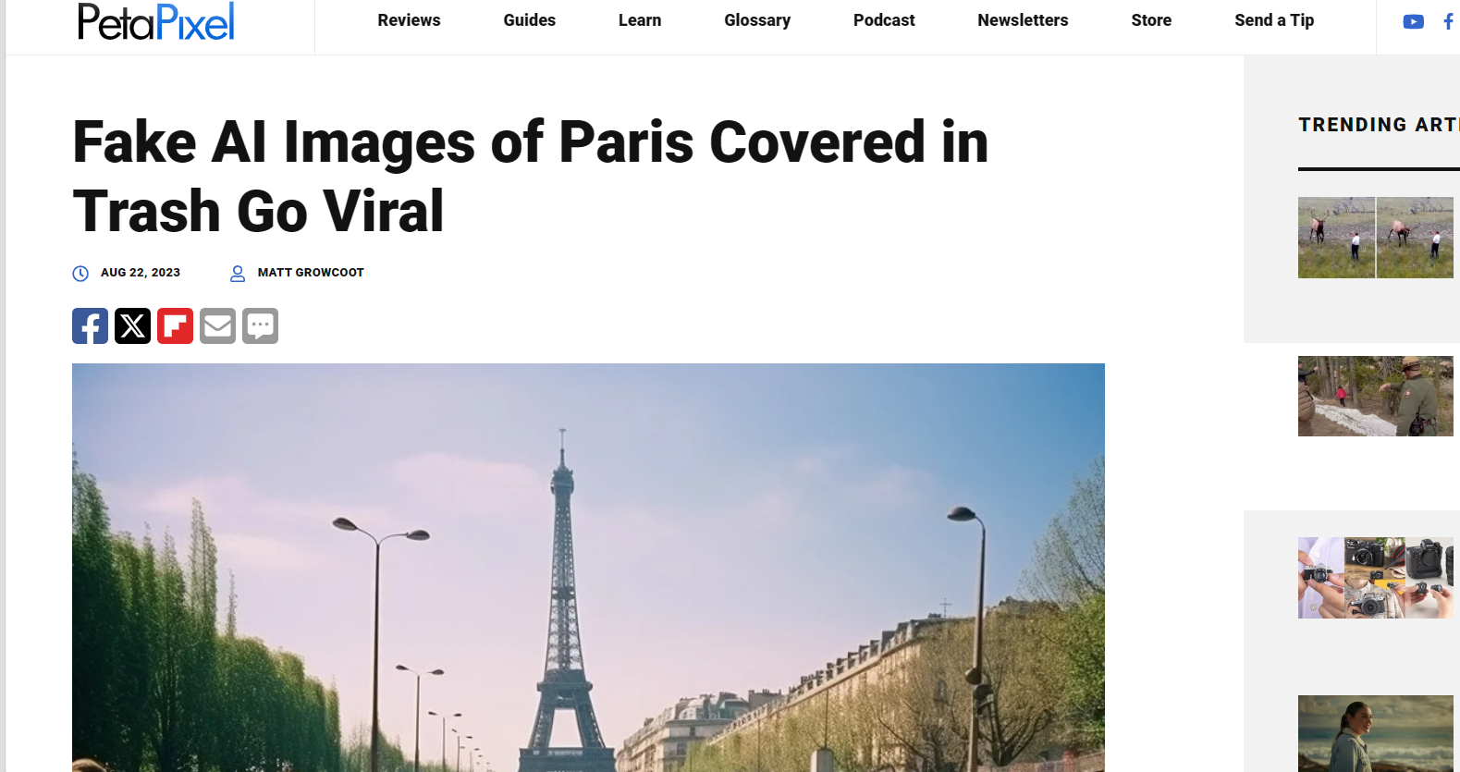

Slide 14
SONY WORLD PHOTOGRAPHY AWARD, 2023

Slide 15
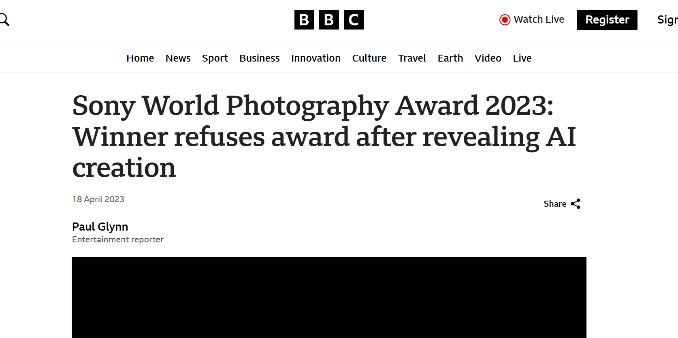
Sony World Photography Award 2023: Winner refuses award after revealing AI creation (bbc.com)

Slide 16
“AI FOMO”
AI Literacy: Bridging the AI Literacy Gap in Education | by Office of Ed Tech | Medium

Slide 17
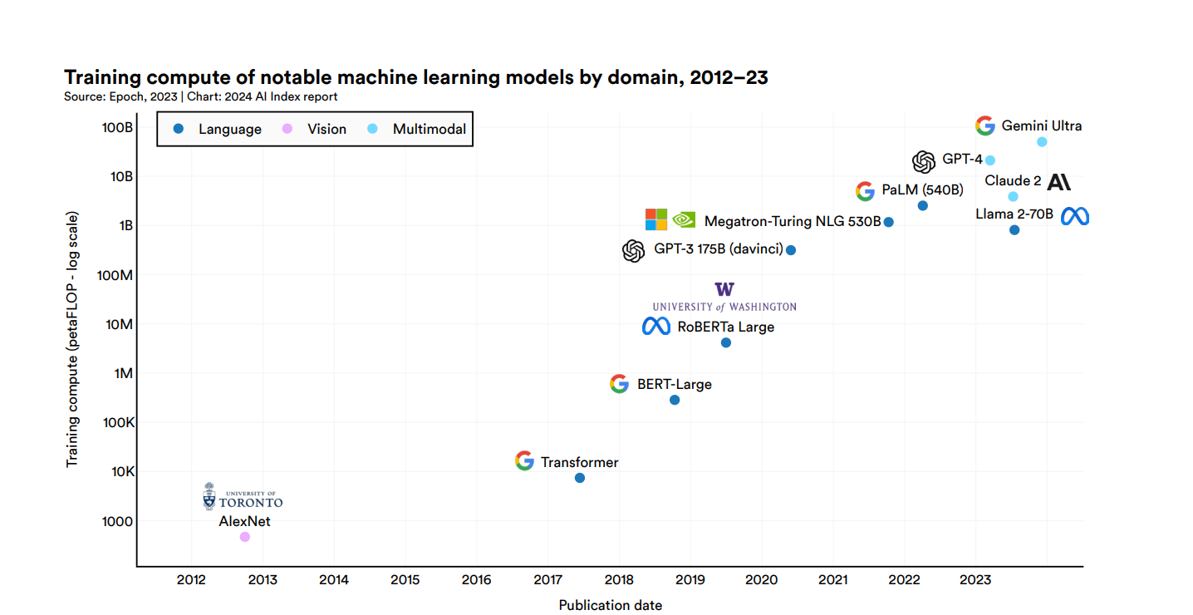
Source: Center for Security and Emerging Technology, 2023 | Chart: 2024 AI Index report

Slide 18
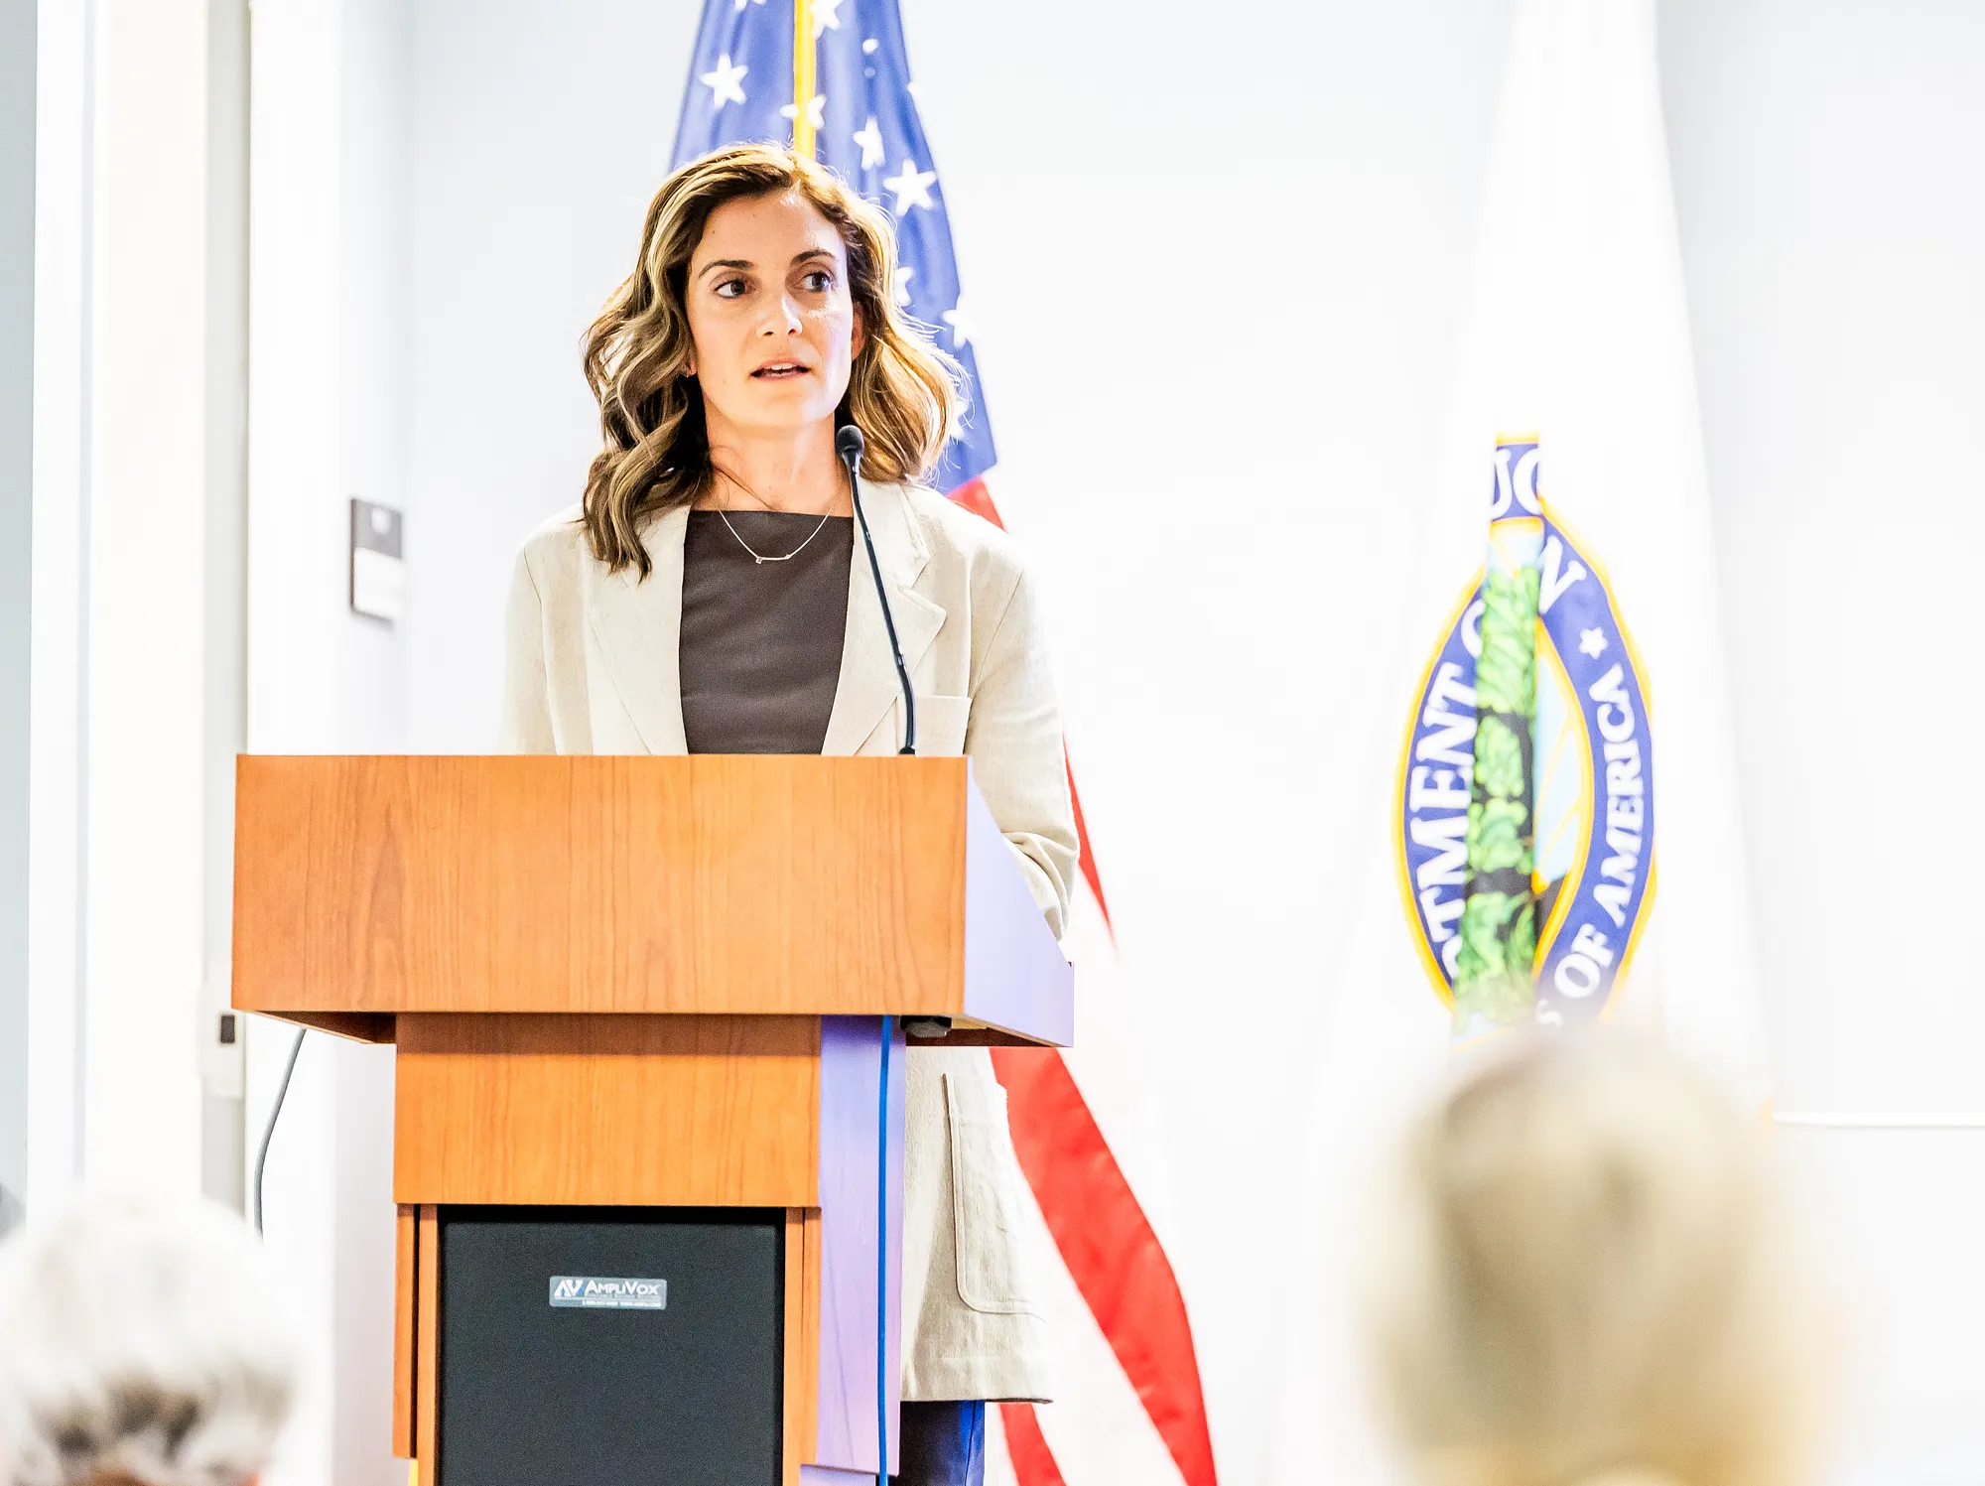
“THERE IS SO MUCH TO KNOW
AND NOT ENOUGH BRAIN SPACE
OR TIME TO LEARN IT.”
Vanessa Parli: Director of Research at HAI Stanford’s Institute for Human-Centered Artificial Intelligence (HAI)

Slide 19
“FATE OF POST-MODERN TIMES”
State of Crisis “Interregnum period”

Slide 20
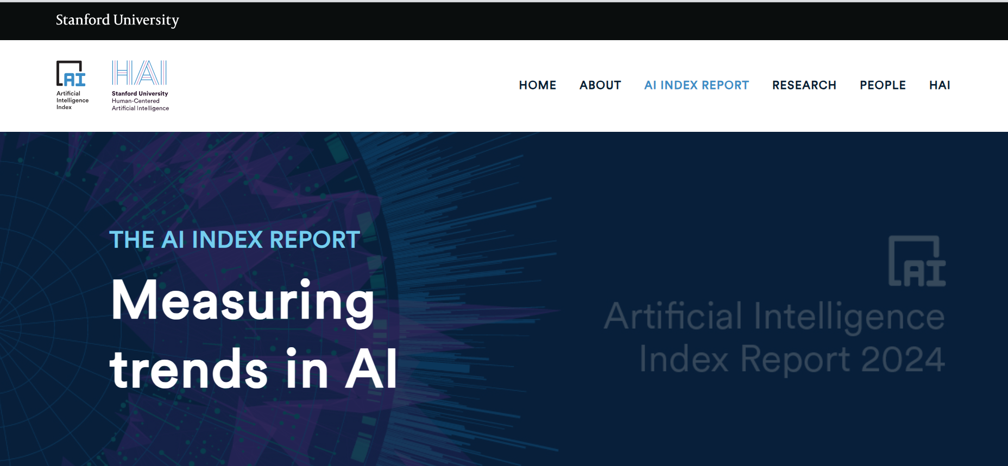
AI Index Report 2024 – Artificial Intelligence Index (stanford.edu)

Slide 21
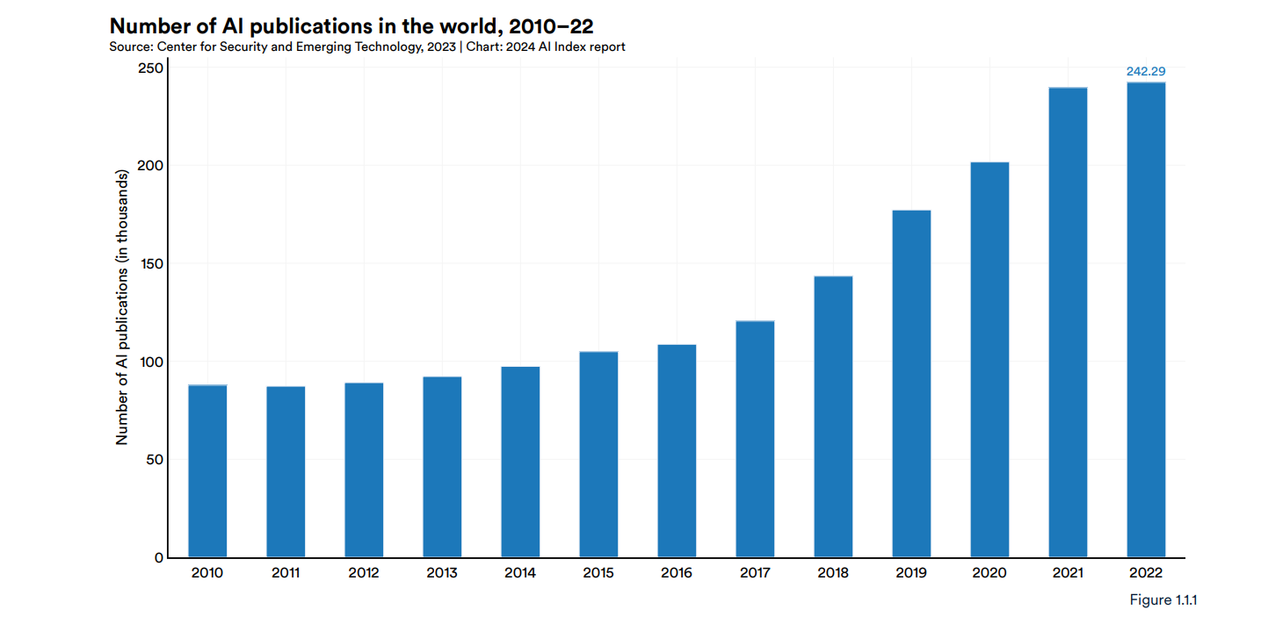
Global count of English-language AI publications
From 2010 to 2022 nearly tripled, reaching 240,000
Source: Center for Security and Emerging Technology, 2023 | Chart: 2024 AI Index report

Slide 22
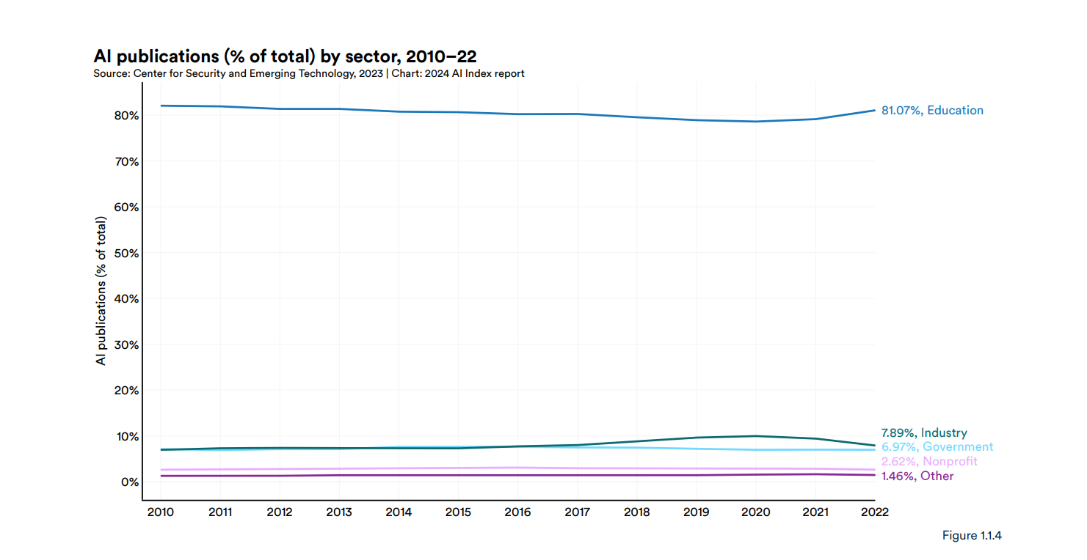
In 2022, the academic sector contributed the majority of AI publications (81.1%)
Source: Center for Security and Emerging Technology, 2023 | Chart: 2024 AI Index report

Slide 23
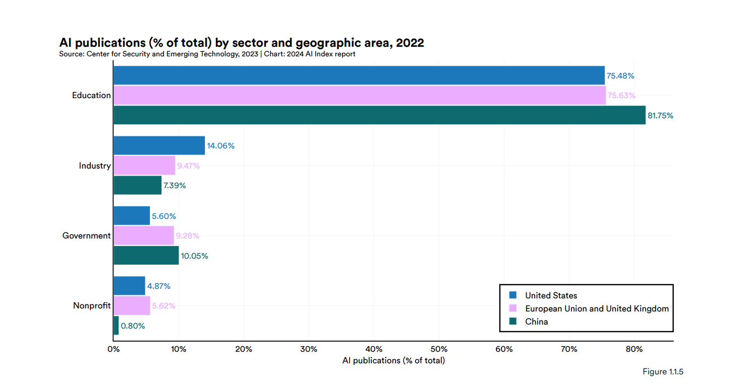
Distribution of AI research by geographic area in 2022:
United States, China, and the European Union leading
Source: Center for Security and Emerging Technology, 2023 | Chart: 2024 AI Index report

Slide 24
THERE IS A LOT GOING ON, BUT WE ARE STILL IN A MOMENT OF DISCOVERY AND EVALUATION.

Slide 25
A survey of over one thousand university students in January 2023 reported that over one-third were using ChatGPT for assessment writing. Of these students,
75% thought it counted as cheating but did so anyway (Intelligent, 2023).

Slide 26
In February 2024, Intelligent.com surveyed 588 college students and found 37% currently use ChatGPT:
96% of use ChatGPT for schoolwork; 80% use it for other tasks (e.g., communication, job searching)
Twelve percent of student ChatGPT users say using the AI technology is definitely cheating, while 64% believe it’s somewhat cheating. Twenty-four percent believe that using ChatGPT in school assignments is not cheating.
4 in 10 College Students Are Using ChatGPT On Assignments - Intelligent

Slide 27
SO, WHAT SHOULD WE DO AS ACADEMIC EDUCATORS?!??

Slide 28
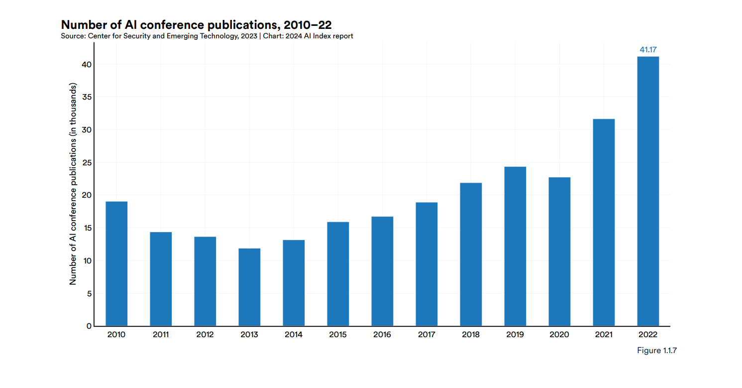
AI conference publications.
Over the last year alone, there was a 30.2% increase.
Source: Center for Security and Emerging Technology, 2023 | Chart: 2024 AI Index report

Slide 29
TALK – ENCOURAGE - ASSESS - ELABORATE

Slide 30
ACADEMIC EDUCATORS ARE SEEING AN OPPORTUNITY IN DOING THE CO-DESINING OF THINGS TOGETHER WITH STUDENTS AS WELL.
→ ITS KIND OF PUTTING ALL OF US TOGETHER, GOING THROUGH IT AS A SOCIETY IN-TRANSIT. THERE’S NO “ONE” SOURCE THAT CAN AND WILL DO EVERYTHING THAT NEEDS TO BE DONE ALONE.
Webinar: Responsible AI in Education: Release of the US Department of Education Office of Educational Technology’s New Guide for Developers, “Designing for Education with Artificial Intelligence”

Slide 31
HARVARD UNIVERSITY DRAFT POLICY:
Certain assignments in this course will permit or even encourage the use of generative artificial intelligence (GAI) tools such as ChatGPT. The default is that Any such use must be appropriately acknowledged and cited.
It is each student’s responsibility to assess the validity and applicability of any GAI output that is submitted; you bear the final responsibility. Violations of this policy will be considered academic misconduct. We draw your attention to the fact that different classes at Harvard could implement different AI policies, and it is the student’s responsibility to conform to expectations for each course.
AI Guidance & FAQs | Office of Undergraduate Education (harvard.edu)

Slide 32
UNIVERSITY OF PENNSYLVANIA POLICY DRAFT:
Within this class, you are welcome to use foundation models (ChatGPT, GPT, DALL-E, Stable Diffusion, Midjourney, GitHub Copilot, and anything after) in a totally unrestricted fashion, for any purpose, at no penalty. However, you should note that all large language models still have a tendency to make up incorrect facts and fake citations, code generation models have a tendency to produce inaccurate outputs, and image generation models can occasionally come up with highly offensive products.
You will be responsible for any inaccurate, biased, offensive, or otherwise unethical content you submit regardless of whether it originally comes from you or a foundation model. If you use a foundation model, its contribution must be acknowledged; you will be penalized for using a foundation model without acknowledgement. Having said all these disclaimers, the use of foundation models is encouraged, as it may make it possible for you to submit assignments with higher quality, in less time. The university's policy on plagiarism still applies to any uncited or improperly cited use of work by other human beings, or submission of work by other human beings as your own.
Syllabi Policies for AI Generative Tools - Google Docs

Slide 33
UNIVERSITY OF CONNECTICUT POLICY DRAFT:
You are welcome to use AI writing tools such as ChatGPT on most assignments (I’ll alert you when you can’t) but whenever you use them, you must include an acknowledgement statement that briefly shares that and how you used them. For example, “I used ChatGPT when I was struck at the start and retained substantial parts of what it produced, including X and Y ideas and most of the wording in paragraphs 3 and 4” or “After I wrote my first 2 paragraphs, I used GPT-3 playground to extend the text for another 200 words but then edited…” Please also note that all large language models still tend to make up incorrect facts and fake citations. You will be responsible for any inaccurate, biased, offensive, or otherwise unethical content you submit, regardless of whether it originally comes from you or an AI tool (these last 2 sentences adapted from the course policies of Ryan S. Baker.pdf.pdf, University of Pennsylvania).

Slide 34
OPEN TALK (you are welcome to…)
ENCOURAGE (it will be encouraged except…)
ASSESS (If so, cite/assess when using it…)
ELABORATE (You will be responsible if/ I will alert you when…)

Slide 35
THE KEY IS TO BE CLEAR ABOUT LEARNING GOALS AND OPEN TO SHARING EXAMPLES OF HOW GENERATIVE AI COULD BE USED IN WAYS THAT ALIGN WITH THOSE GOALS.

Slide 36
Open Dialogue With Students: Did you use AI/ChatGPT for this assignment? If so, why? Was the assignment hard to elaborate, not enough time?
Break Down In-Class Assignments & Submissions: Rather than straight forward ask for the final product, use class time for elaboration, as to write a first draft, introduction, justification, submitting by the end of the class.
Embraced it as any other emerging technology: focus on implementation, research, utilization, and ethical and legal considerations. Have students reflect on their method and how new information gained caused them to rethink prior knowledge or confirmed something they already knew.
ASSOCIATION OF COLLEGE AND UNIVERSITY EDUCATORS (ACUE)
Leveraging Artificial Intelligence for education:

Slide 37
LEVERAGING AI FOR EDUCATION :
MIT’S 2024 FESTIVAL OF LEARNING:
New state-of-the-art systems like GPT-4, Gemini, and Claude 3 are impressively multimodal: They can generate fluent text and audios in dozens of languages, benefiting international students' community.
Thinking about their way of thinking: Rethink/refine
AI prompts to produce better outputs.
Overall: MIT undergraduate and graduate students across different academic departments are leveraging generative AI for efficiency: creating presentations, summarizing notes, and quickly retrieving specific ideas
MIT faculty, instructors, students experiment with generative AI in teaching and learning | MIT News | Massachusetts Institute of Technology

Slide 38
LONGER STUDIO CRITIQUES (SIFT):
Stop: Take a moment to pause and critically evaluate the image before accepting it as real.
Investigate: Dig deeper into the image by examining its details, searching for any inconsistencies or unusual elements.
Find better coverage: Look for additional sources or related information that can provide more context about the image’s origin and authenticity.
Trace the original context: Trace the image back to its original source to verify its legitimacy and prevent the spread of misinformation.

Slide 39
“FATE OF POST-MODERN TIMES”
State of Crisis “Interregnum period”

Slide 40
TALK – ENCOURAGE - ASSESS - ELABORATE

Slide 42
Thank you!
THOUGHTS? SHARES?
Luiza.printes_dos_santos@uconn.edu

