Slide 1

Institute for Collaboration on Health, Intervention, and Policy
Grace Morris, M.A., Director of Research Training & Development
chip.uconn.edu

Slide 2
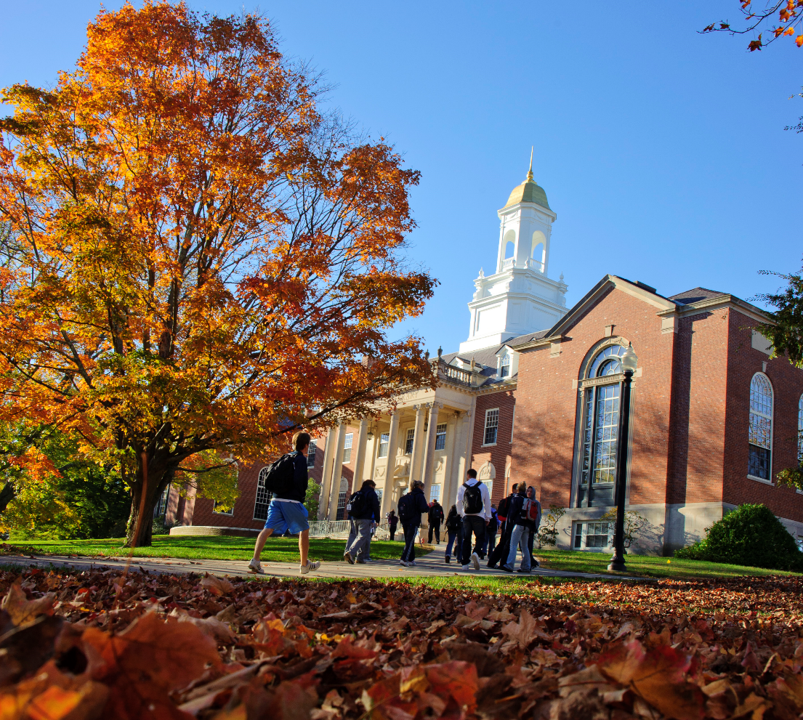
Mission
UConn’s Institute for Collaboration on Health, Intervention, and Policy (InCHIP) brings together individuals with diverse scientific, clinical, and methodological expertise and supports their evolution into collaborative investigators who conduct innovative interdisciplinary research that impacts public health and well-being.

Slide 3
Quick Definition of Health
“ Health is a state of complete physical, mental and social well-being and not merely the absence of disease or infirmity. “
From the WHO’s Constitution
Notes:
On the other hand “Illness”- conveys and is entangled with concepts like wickedness, depravity, immorality.
Health and illness are often entangled with concepts of stigma.

Slide 4
Health Domains
From A…
Alcohol and Substance Use
Autism
Cancer Prevention and Control
College Student Health
Complementary/Integrative Health
Diabetes
Digital/mHealth
Dissemination/Implementation Science
Exercise Science
Global Health
Health Communication
Health Disparities
Health Policy
HIV/STIs
Nutrition
Obesity
Reproductive Health
School and Child Health
Treatment Adherence
Weight Management
…To Almost Z

Slide 5




UConn Center for mHealth and Social Media
Director: Sherry Pagoto, PhD (Allied Health Sciences)
InCHIP Collaboratory on School and Child Health (CSCH)
Director: Sandra Chafouleas, PhD (Educational Psychology)
Advancing Research, Methods, and Scholarship in Gun Injury Prevention (ARMS)
Director: Kerri Raissian, PhD (Public Policy)
Rudd Center for Food Policy & Obesity
Director: Marlene Schwartz, PhD (HDFS)
InCHIP
Centers
Notes:
Can you add in center logos?

Slide 6
InCHIP Research Interest Groups
  Aging
  Chaired by Terry Berthelot
  Cancer
  Chaired by Crystal Park
  eHealth/mHealth
  Chaired by Sherry Pagoto
  Gun Violence Prevention
  Co-Chaired by Mary Bernstein, Kerri Raissian, and Jennifer Dineen
HIV
Chaired TBA
  Interprofessional Healthcare
  Chaired by Michelle Judge
  Mind-Body Health
  Chaired by Melissa Bray
  Obesity
  Co-Chaired by Kim Gans, Marlene Schwartz, and Amy Gorin
Notes:
Can you add in latest ones – GVP missing, anything else?

Slide 7

Harnessing the InCHIP Network:
Collaboration Development

Slide 8

Cross-UConn Faculty Collaborations
InCHIP provides a range of services dedicated to helping researchers build connections across UConn, and facilitating the development of innovative, interdisciplinary research programs.
List of prospective faculty collaborators
Feedback and templates for team management sections for grant proposals.
Guidance in best practices for collaboration.
Interested in this service? Contact us: grace.morris@uconn.edu

Slide 9
The Opportunity:
Science, Technology, Engineering, Art, & Medicine
According to NSF-what counts as science?
All the sciences you can think of (math, chemistry, physics, biology, etc)
Social Sciences (Cultural Anthropology, Archaeology, Sociology, Economics, Political Science)
Psychological Sciences

Slide 10

OVPR Funding:
STEAM Innovation Grant
The purpose of the program is to encourage innovative collaborations between the arts and STEM disciplines
Genuine integration of art and science, going beyond the simple application of well-established concepts or techniques from one domain to inform the other, and generating new approaches on both sides of the collaboration
Projects funded by this grant may result in:
  “publications, exhibitions, performances, academic symposia, or other research outcomes.

Slide 11

Existing UConn Collaborations:
Feel Your Best Self
Ballard Institute and Museum of Puppetry
Collaboratory on School and Child Health
“We were trying to adapt our workshops into a virtual environment, and we wanted to make sure to reach out to UConn’s school of education, to think about best practices…”

Slide 12


Existing UConn Collaborations:
VR-based
Substance Use &
Smoking Cessation
Robert Astur (Psychological Sciences)
Kenneth Thompson (Digital Game Design)
Crushing habits through VR

Slide 13
Possible Directions:
Adapting PhotoVoice:
How can we use photography, videography, or other visual mediums to encourage expressions of self, memory, or trauma?
Performance as Ritual:
How can we better understand the social, psychological, and physical effect of performance? How does this experience of collaboration impact our brains?
Art and
Healing:
How could dance, music, or other artistic expression help cancer survivors navigate their transition into their post-treatment life?

Slide 14

InCHIP
Internal Funding Opportunities
InCHIP Seed Grants for Faculty Affiliates | Fall (November) and Spring (March) Semester Deadlines
InCHIP Rolling Seed Grants to Develop Interdisciplinary Research Teams | Proposals accepted on a Rolling Basis)
Learn more at chip.uconn.edu/seed-grant-opportunities/

Slide 15

InCHIP’s Convergence Awards
Federal funding agencies are increasingly emphasizing the need for convergence research - work that is deeply interdisciplinary in nature and that addresses the most pressing problems facing society and the planet.
$25,000 in funding to help interdisciplinary UConn teams be competitive for convergence funding from NIH, NSF, etc.
Support for planning, outreach to strategic partners, and proof-of-concept research activities.
Applications are accepted on a rolling basis.
More information can be found at chip.uconn.edu/cap/
Notes:
To spark interdisciplinary collaborations, we have initiated a Convergence Awards Program.
These awards are reserved for newly forming teams who need support for planning, outreach to strategic partners, and proof-of-concept research activities that will ultimately make teams of UConn researchers more competitive for convergence research funding from NSF, NIH, and other external organizations.

Slide 16

Targeted Funding Searches
InCHIP can build lists of targeted external funding mechanisms and reports on previously funded grants in a research area.
Funding searches can be project-specific or can be based on broad research agendas or career development and training needs.
Faculty interested in understanding the funding landscape for their work, reach out: greidy.miralles@uconn.edu

Slide 17
Become an InCHIP Network Member!
Be the first to learn about services, opportunities, and events…
Application:
chip.uconn.edu/join-the-network/

Slide 18

Follow us on Social Media
    @UConn_InCHIP
    youtube.com/user/UConnCHIP
For announcements, events, news, and more.

Slide 19
Thank you
Grace Morris, MA | InCHIP Director of Research Training and Development
grace.morris@uconn.edu
Please feel free to reach out with any questions!

