Slide 1
We’re glad you’re here! Make yourself comfortable, we will begin shortly
WELCOME TO THE ALL-SFA FACULTY & STAFF RETREAT

Slide 2
Welcome from Interim Dean Alain Frogley

Slide 3
Welcome new faculty!
ENRIQUE FIGUEREDO Assistant Professor (Printmaking) Art + Art History
MICHAEL KAPLAN Assistant Professor (Voice & Speech) Dramatic Arts
JUSTIN MCMANUS Assistant Professor and Director of Athletic Bands/ Assistant Director of Wind Bands Music
JANIE COLE Assistant Professor (Musicology) Music
ZHENZHEN QI Assistant Professor (Web/Interactive Design) Digital Media & Design
PAUL MCSHEE Assistant Professor (Orchestra & Conducting) Music

Slide 4
Welcome new faculty!
LILLIAN RANSIJN Visiting Assistant Professor (Movement) Dramatic Arts
KALEIGH RUSGROVE BERRY Visiting Assistant Professor (Photography/Video) Art + Art History
CHRISTINA COREY Visiting Assistant Professor (Illustration/Animation) Art + Art History
HALEY BUESCHLEN Visiting Assistant Professor Art + Art History - Stamford
ALISON SAVINO-JAUREGUI Visiting Assistant Professor (Stage Management) Dramatic Arts

Slide 5
Welcome New Staff!
GINO COSTABILE Stage Properties Manager CRT
EMILY COLE Educational Program Assistant Music
CELESTE JACOBS Admissions Coordinator Office of the Dean
ROSSY PICHARDO Educational Program Assistant Digital Media & Design (Stamford)
MEREDITH FRIEDMAN Educational Program Coordinator Digital Media & Design
SHARAN SHARMA Financial Assistant Office of the Dean
LISA ST. LAURENT Financial Assistant Office of the Dean
ABIGAIL GOLEC Theater Operations Manager von der Mehden

Slide 6
Familiar faces in new roles!
PAUL SPIRITO Educational Program Assistant Krenicki Institute
DYLAN DELMASTRO Educational Program Assistant Office of the Dean
MATTHEW SORENSEN Visiting Assistant Professor (Puppet Arts) Dramatic Arts

Slide 7
Tenure and promotion!
EMILY LARNED Tenure and Promotion to Associate Professor Art + Art History
KATHRYN MOORE Tenure and Promotion to Associate Professor Art + Art History
JAMES COLTRAIN Tenure and Promotion to Associate Professor Digital Media & Design
MIAO GUO Tenure and Promotion to Associate Professor Digital Media & Design
ANNA LINDEMANN Tenure and Promotion to Associate Professor Digital Media & Design
TOM SCHEINFELDT Promotion to Professor Digital Media & Design

Slide 8
Welcome from Interim Dean Alain Frogley

Slide 9
Assistant Dean’S Updates Colleen K. Bridgeman

Slide 10
Operational Updates
Parking Impacts
Facility Upgrades
Technology Updates
Financial Services Office
Purchasing Requests
Travel/Concur Enhancements
2023 SFA Retreat
Colleen K. Bridgeman
Assistant Dean & Chief Operating Officer

Slide 11
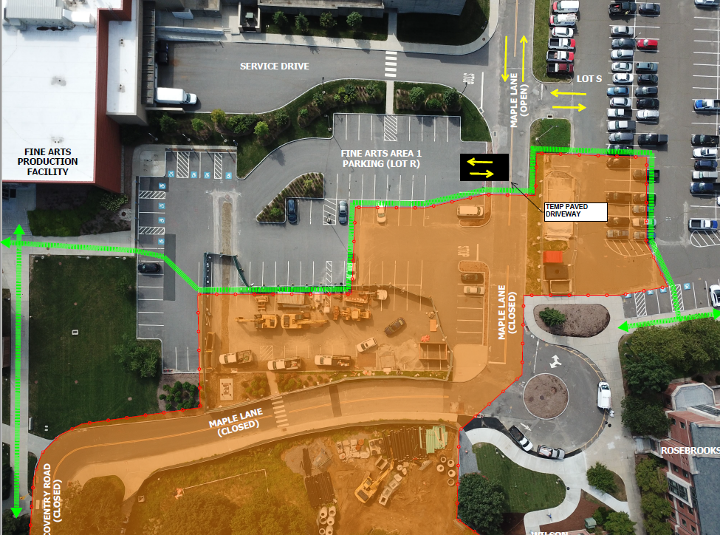
Parking impacts
Mid August – December 2023
Fine Arts Parking (Lot R) Reduced by 50%
Accessible Parking Spaces Maintained
Temp Paved Driveway Installed
Access to Lot R and S via Bolton Road Only
S Lot Reduced by 50% (mid-September)
Downtown Storrs Parking Garage Limited Spaces Available for SFA Employees ($31.60/month)
Pedestrian
Route
Construction
Area/Fencing
Temp Driveway
Entrance

Slide 12
Facility UPDATES
Acoustical Upgrades
Benton Museum Learning Space Redesign
Jorgensen Gallery & Event Space Refurbishments
Jorgensen Sound System Upgrade
General Maintenance & Upkeep
SFA Wayfinding Status

Slide 13
Technology updates
SUPPORT & RESOURCES
University ITS
http://techsupport.uconn.edu
http://kb.uconn.edu
School of Fine Arts IT
Visit http://sfa.uconn.edu
SFA website → Dean’s Office → SFA Technology Services
TECH UPDATES
Microsoft OneDrive
Instructional Technology
REMINDERS
Phishing Alerts

Slide 14
SFA Financial Services Office
At a Glance…
Budgeting, Forecasting
Internal/External Financial Reporting
Payroll Processing (All Payrolls)
Centralized Purchasing
Fiscal Surveys and Accreditation Documents
Grants and Contracts Administration
GL Financial Processing
Scholarship/Foundation Management
Travel Approval/Out of Pocket Reimbursements
All Receivables Activity, Cash Management, Internal Billings

Slide 15
SFA Financial Services Office AT A GLANCE
Total FY22 Financial Services Office Transactions by Category
Purchasing/
Reimbursement Actions
G/L Financial Processing
Cash Management
Internal Billings
Payroll Transactions
Foundation/ Scholarship Transactions
4,108
1,217
975
731

Slide 16
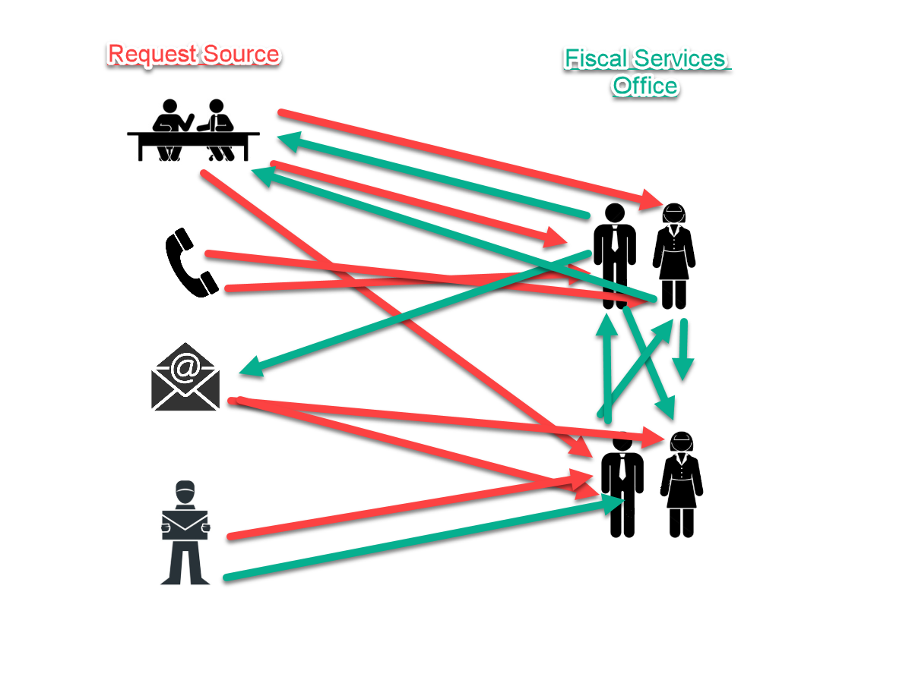
Purchasing Request Process & Update
Prior Purchasing Workflow
SFA Purchase Requests from a Variety of Sources:
In person
Over phone
Email
Inter-office mail
Post-It Notes

Slide 17
Purchasing Request Process & Update
Standardized & Efficient
Accurate & Reduced Duplication
Centralized Workflow
Business Continuity
Status Update & Tracking
Reporting
Benefits of a Purchase Request Form:

Slide 18
Purchasing Request Form Update
Implementing a New & Improved Form
Easier to Access & Use
Web-based Platform
Improved Workflow & Approval Process
Requestor Status Updates
Reporting & Metrics

Slide 19
Travel/Concur Enhancements

Slide 20
Advancement Updates Quoron Walker, Marketing Administrator and Lauren Prause, Senior Director of Development

Slide 21
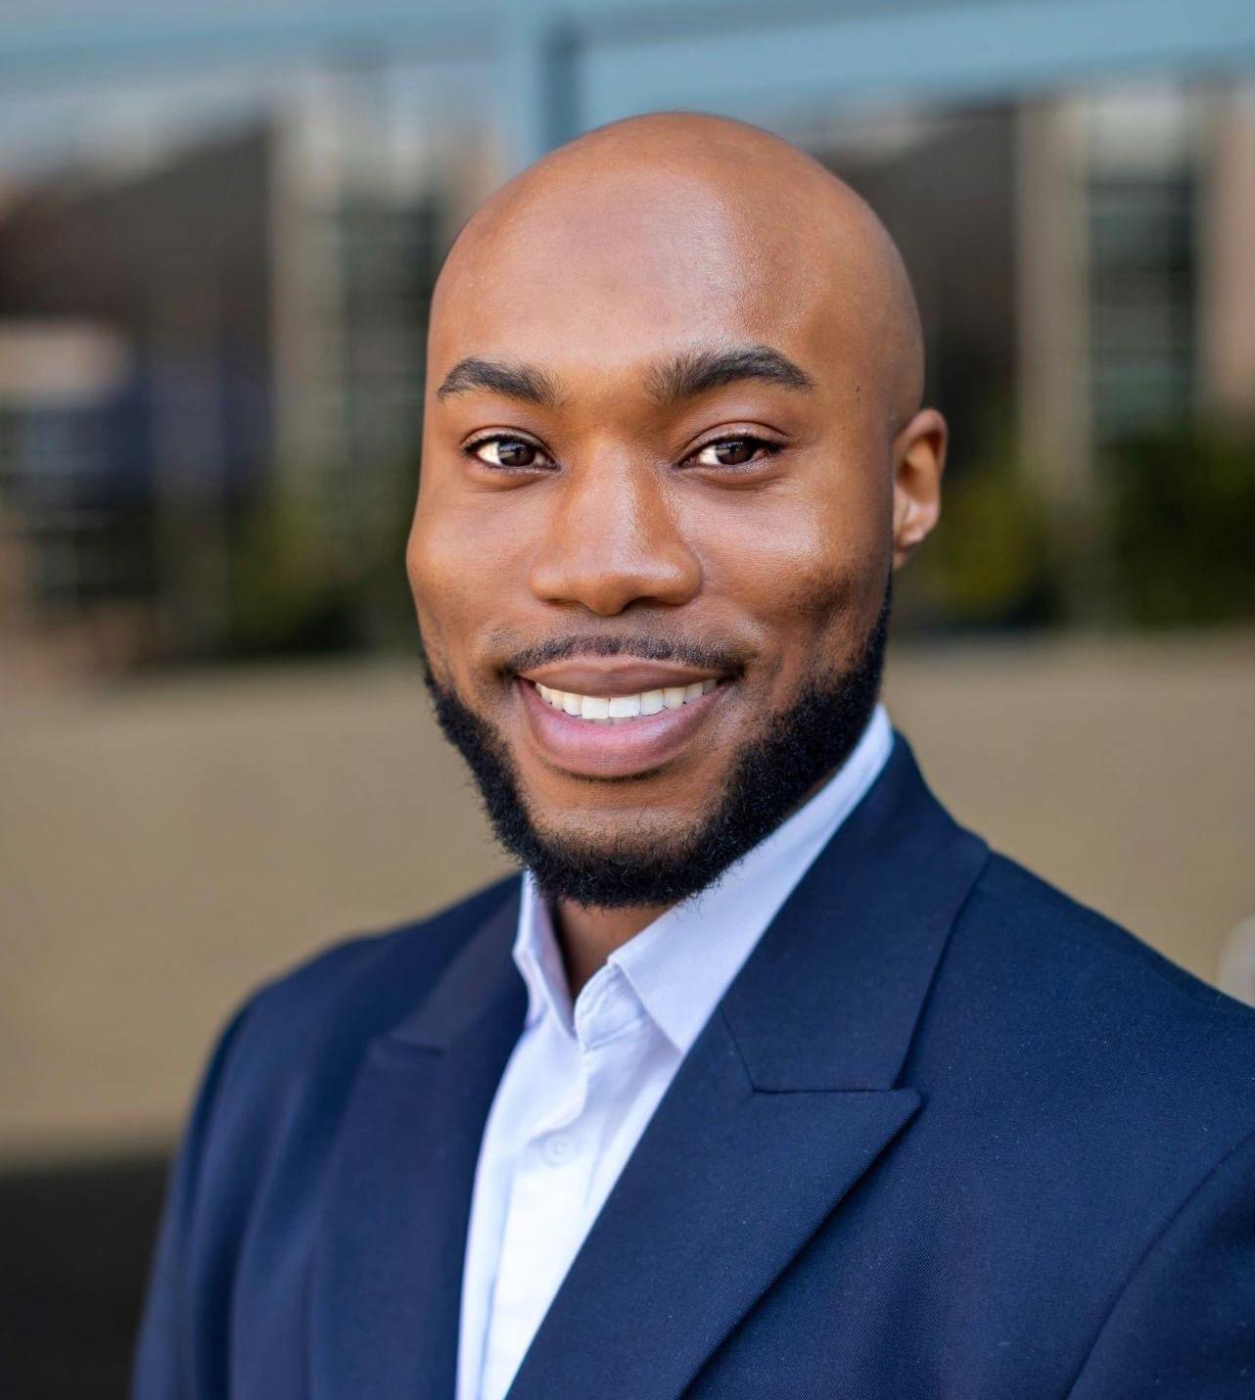
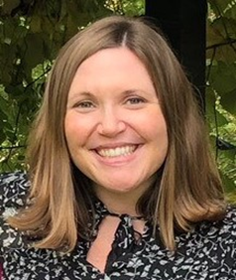
Advancement in the School of Fine Arts
Lauren Prause
Senior Director of Development,
Fine Arts & University Programs
Quoron Walker,
Marketing Administrator,
School of Fine Arts
Emily Auger Murray
Senior Director of Alumni Relations, Neag School of Education & School of Fine Arts

Slide 22
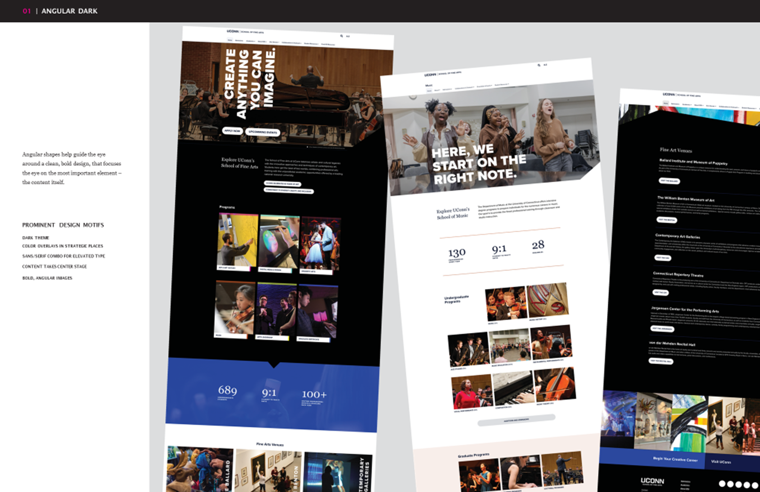
Website Update

Slide 23
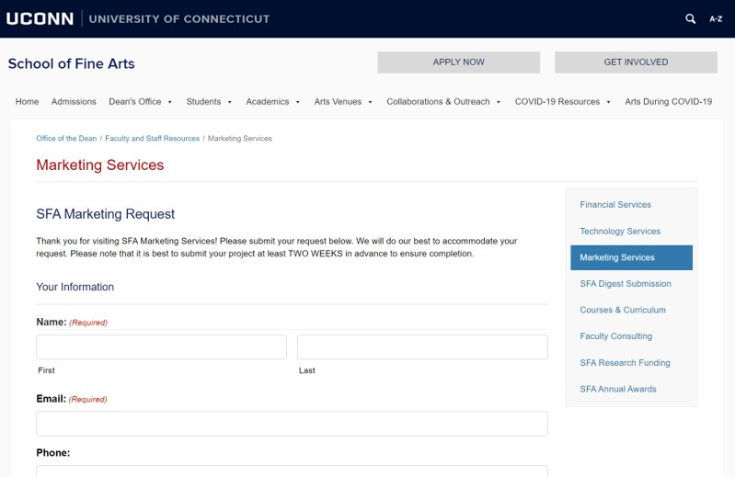
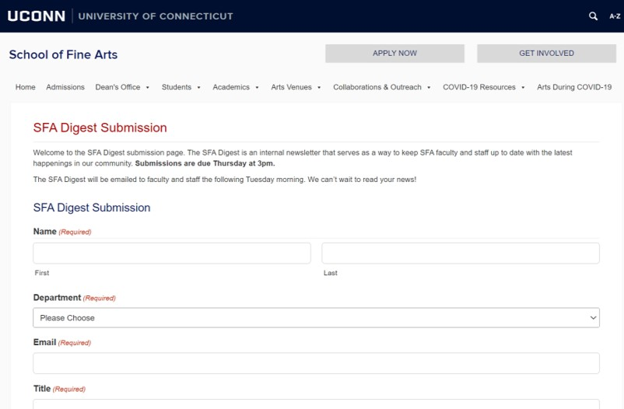
Marketing Forms

Slide 24
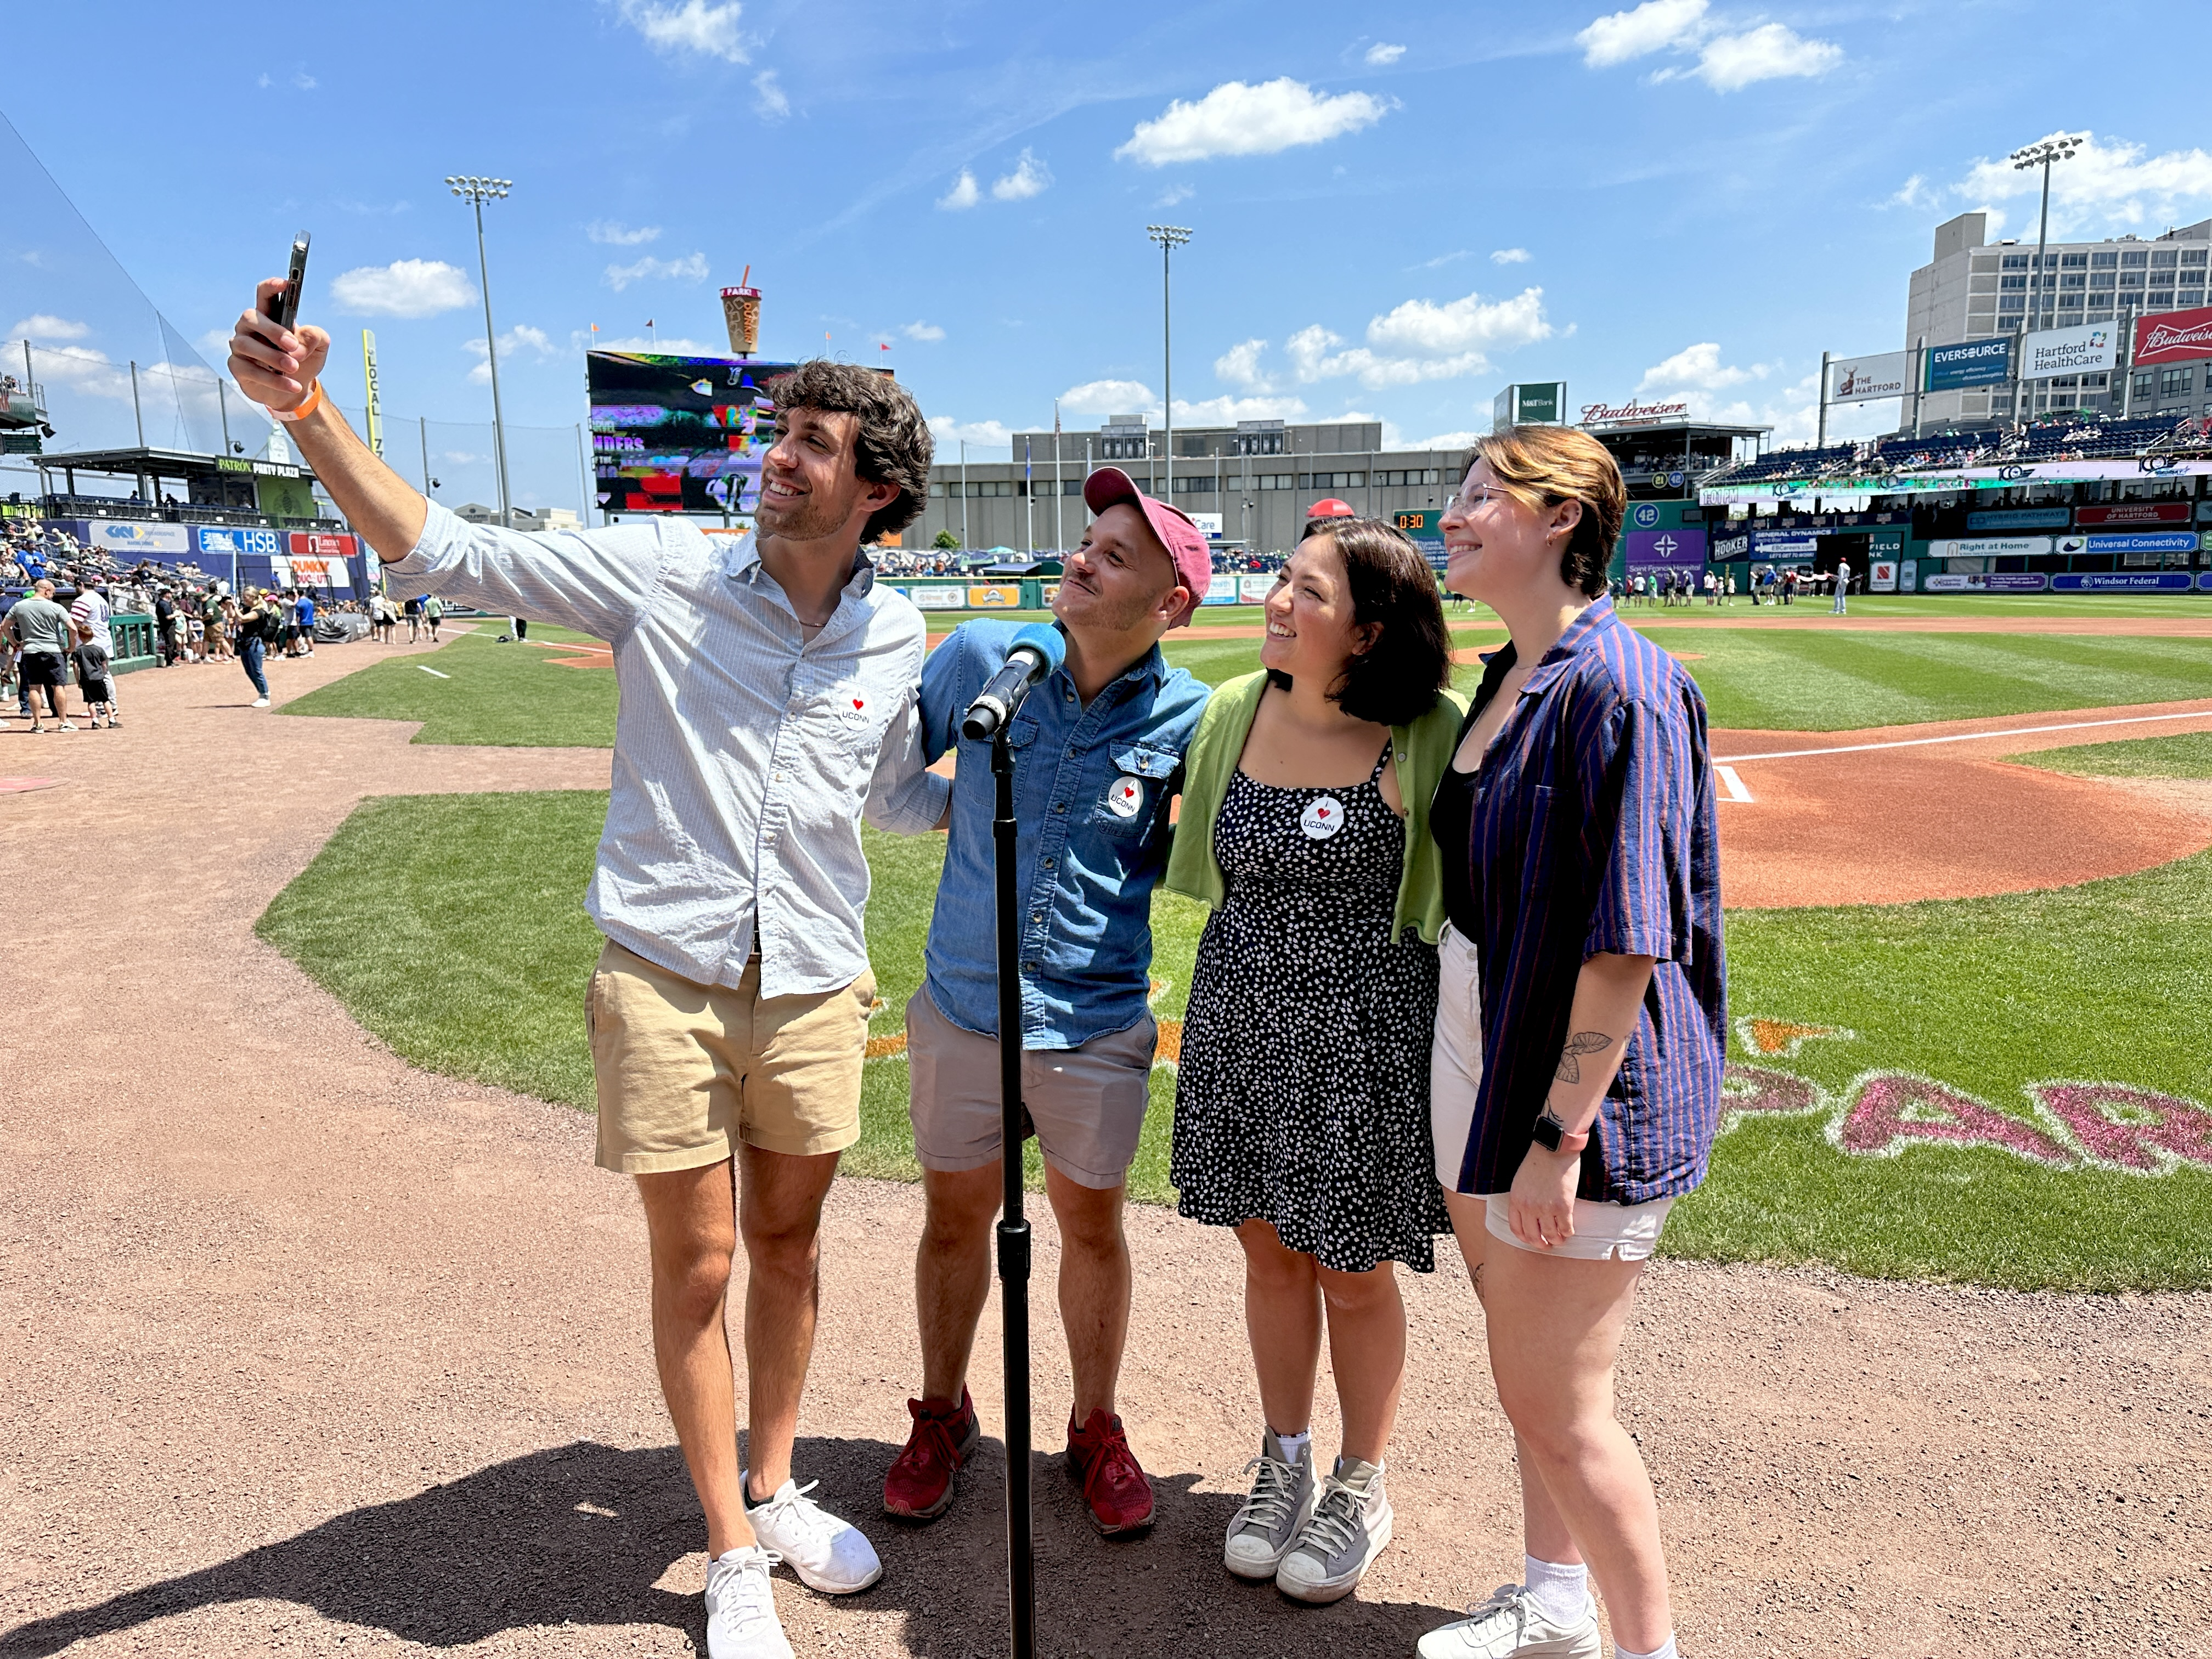
UConn Day – Yard Goats

Slide 25
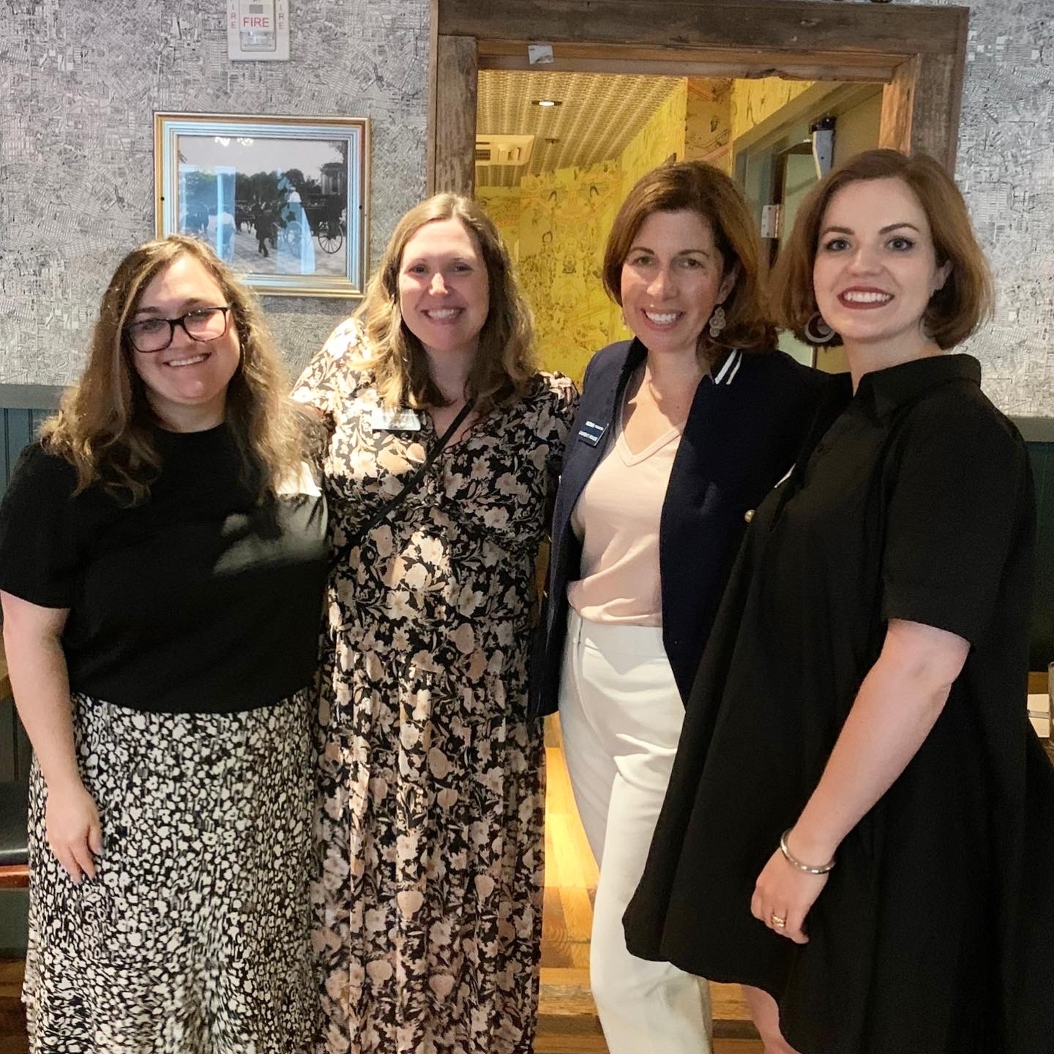
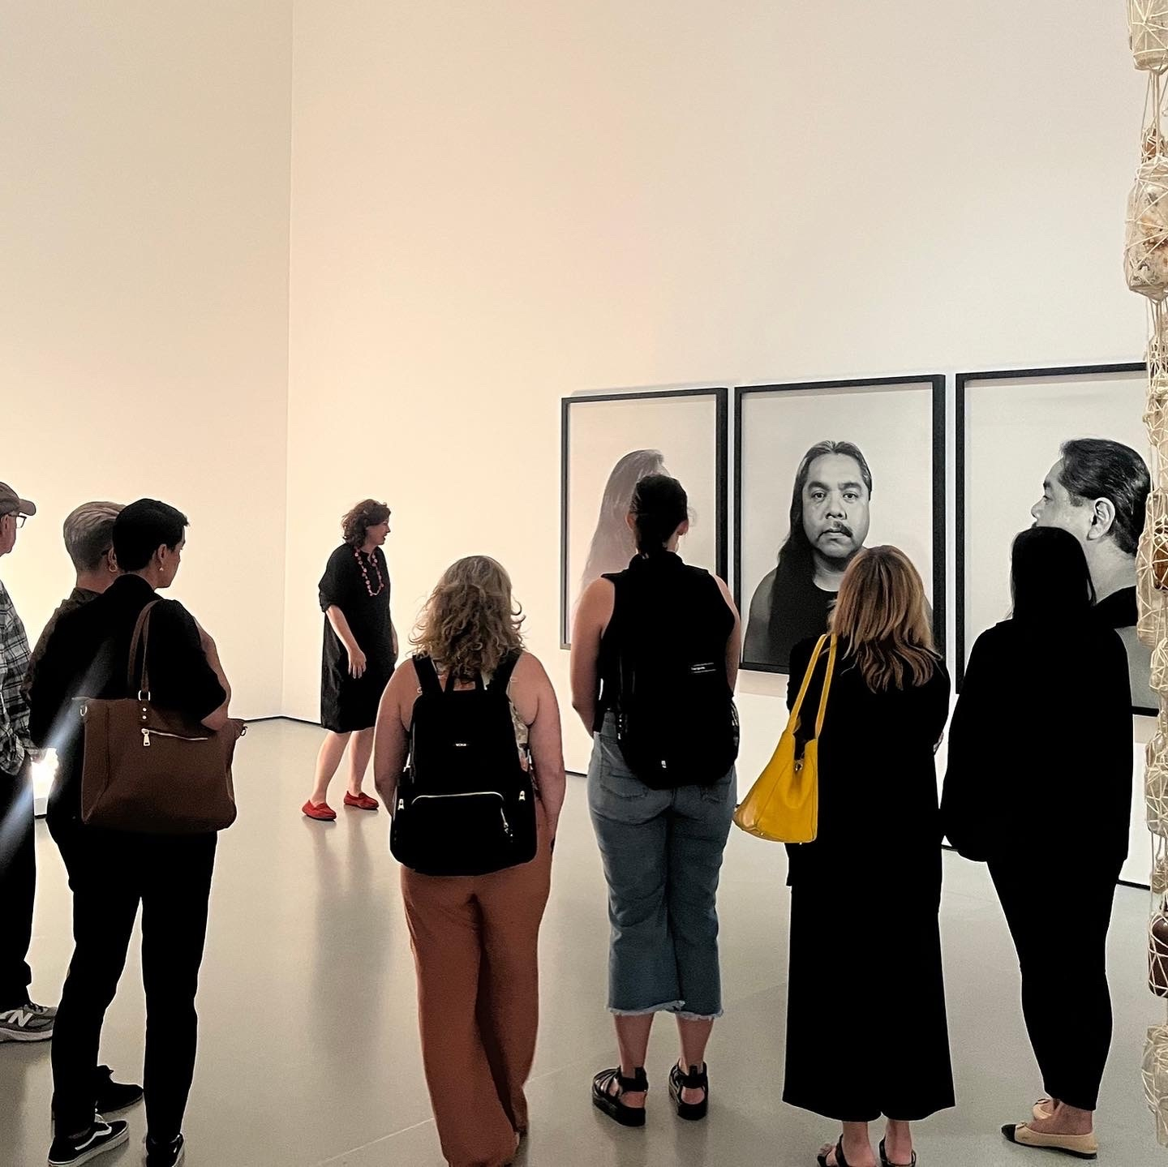
SFA at the MoMa

Slide 26
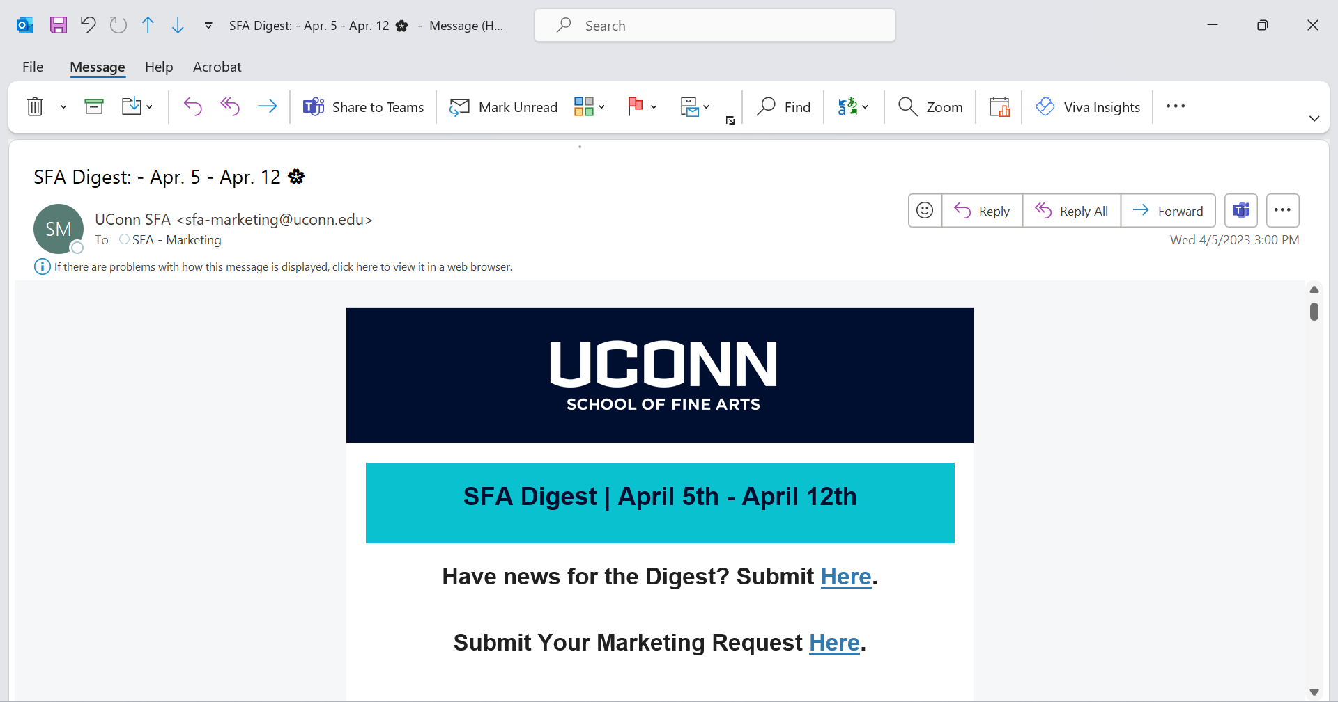
SFA Digest – Alumni Suggestions

Slide 27
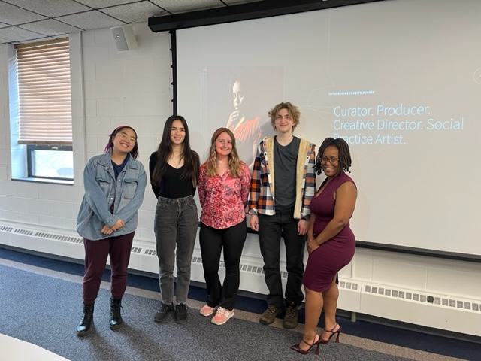
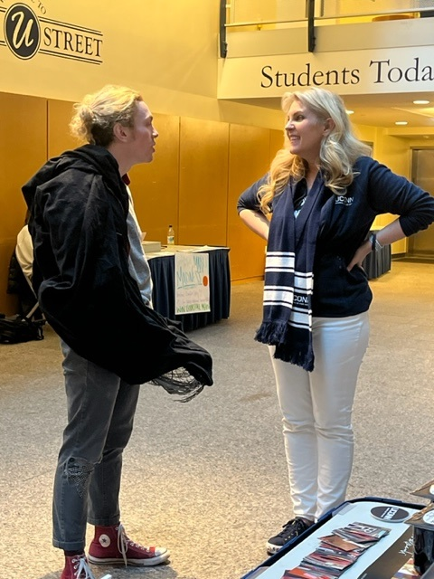
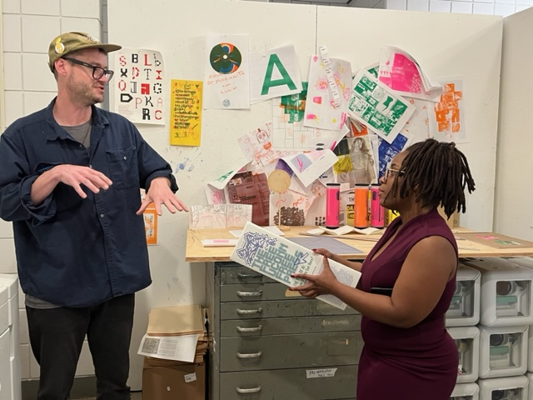
Engaging and Hosting SFA Alum

Slide 28
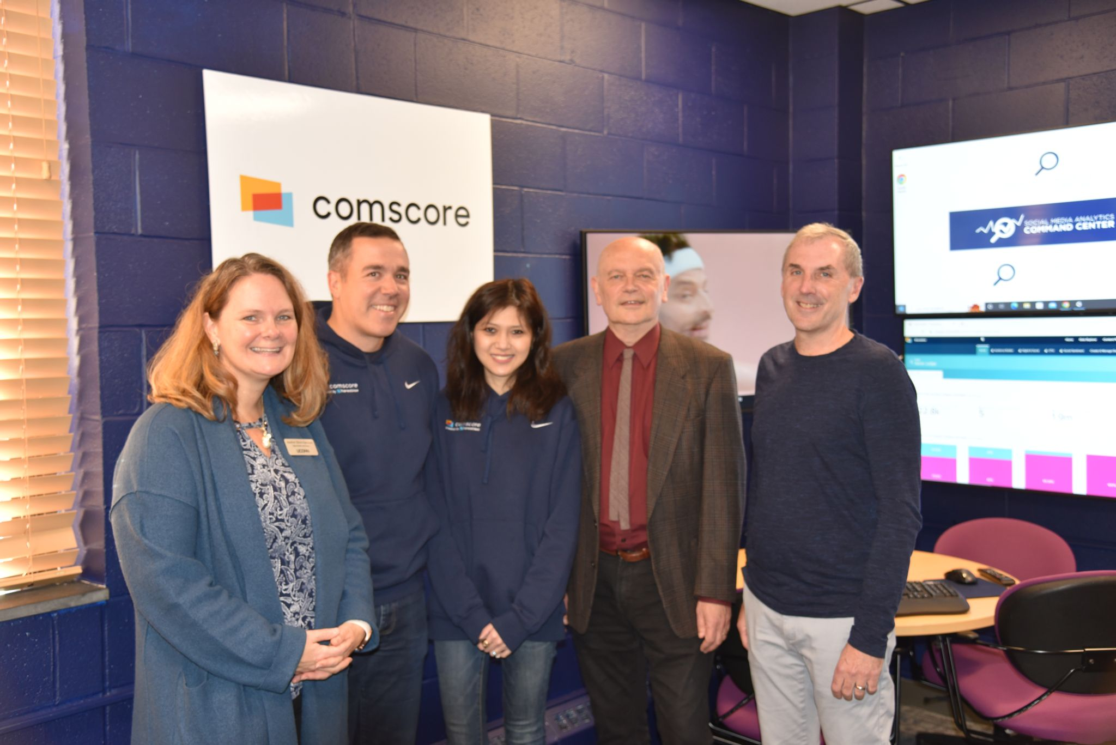
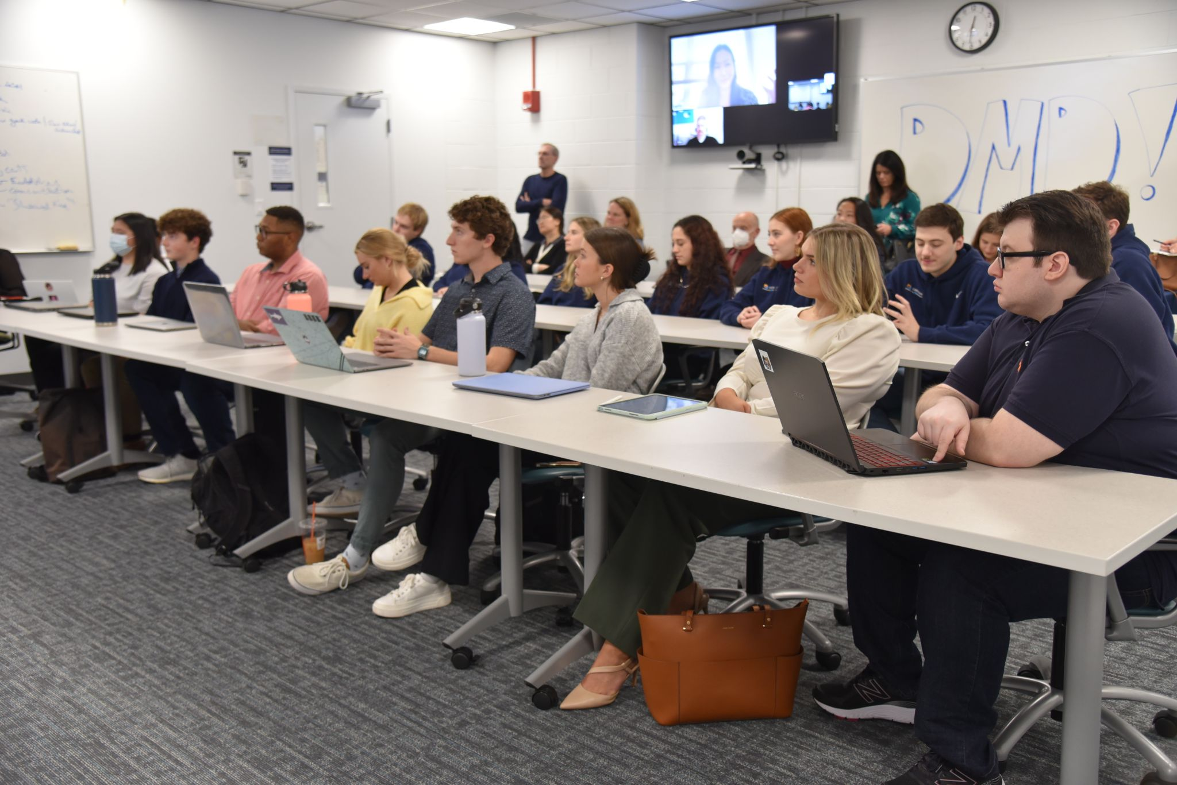
Strengthening Corporate Partnerships

Slide 29
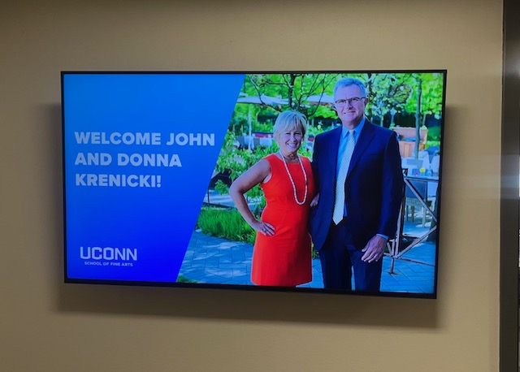
Thanking Donors and Highlighting Impact

Slide 30
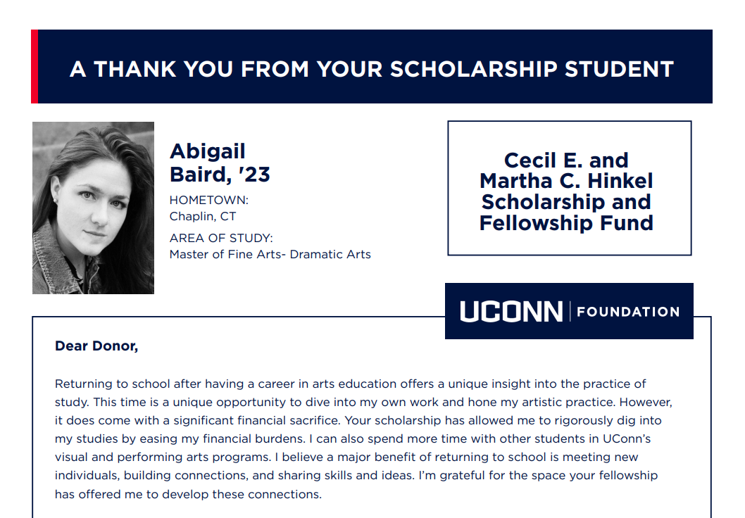
Scholarship Stewardship
Thank You Letters and Video

Slide 31
Admissions Updates Celeste Jacobs Admissions Coordinator

Slide 32
Admissions

Slide 33
1
Apply to UConn admissions.uconn.edu
via the Common Application or Apply Coalition with Scoir.

Slide 34
1
Apply to UConn admissions.uconn.edu
AAH, DMD, DRAMA
Submit a SlideRoom Portfolio uconnadmissions.slideroom.com
via the Common Application or Apply Coalition with Scoir.
2
MUSIC, ACTING, PUPPET ARTS
Schedule an Audition

Slide 35
Dates + Deadlines
OCTOBER 8 + 28
Fall Visit Days admissions.uconn.edu/open-house
NOVEMBER 1
Free Application Day
Connecticut Residents
DECEMBER 1
Merit + Honors Consideration Deadline

Slide 36
Dates + Deadlines
OCTOBER 8 + 28
Fall Visit Days admissions.uconn.edu/open-house
NOVEMBER 1
Free Application Day
Connecticut Residents
DECEMBER 1
Merit + Honors Consideration Deadline
DECEMBER - JANUARY
Auditions + Interviews
EARLY JANUARY
Slideroom Applications Due
EARLY MARCH
Decisions Released
APRIL 6 + 13 UConn Bound Days

Slide 37
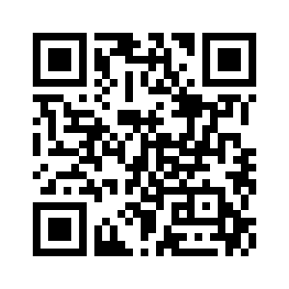
School of Fine Arts Tours connect.uconn.edu/portal/storrs

Slide 38
School of Fine Arts Tours connect.uconn.edu/portal/storrs
Celeste Jacobs
SFA Admissions Coordinator
celeste.jacobs@uconn.edu

Slide 39
Greetings from the Provost Anne D’Alleva

Slide 40
Take a 20-minute break!
Beverages and snacks available outside
Restrooms in lobby or across the way in the production facility

Slide 41
Maureen Armstrong
Associate Dean of Students /
Director, Dean of Students Office

Slide 42
UConn Dean of Students Office
Maureen Armstrong
Associate Dean of Students/Director, Dean of Students Office
August 24, 2023

Slide 43
Dean of Students Office Functions
Voluntary Separations AKA Leaving UConn
Title IX Support
Final Exam Rescheduling
Readmission
Financial Supports
Short Term Emergency Loans
Students First Fund
Uconn Swipes Program
Extension of Incompletes
Residency (In-State Tuition)

Slide 44
How We Help Students
Through one-on-one meetings, we assess the challenges and barriers which impact their academic success
Including but not limited to: Academic Achievement Center, Advisors, Center for Students with Disabilities, Faculty and Financial Aid
Referrals to campus resources
Individualized Support
Collaboratively we work to identify solutions and resources that students can manage
Navigating life issues
Getting back on track
Assist in getting back on track with academics, personal, and/or familial issues

Slide 45
Collaborative Processes
Faculty & Staff
Refer students to our office for help
Contact us directly asking for student follow-up
DOSO staff
Ask many questions of a student to get a clear picture of the situation
Seek exceptions when we believe a case is beyond an individual's control
Ask us to work together to support a student
Strive to be creative in problem solving

Slide 46
How we help students
It takes a coordinated effort on the part of many offices/staff/faculty at UConn
This does not happen in isolation
Each student case may have a different outcome
We provide support without judgement
Timing is key, the sooner we meet with a student, the more options we can possibly present for help​

Slide 47
What we do…
Support
Support students with academic, personal and other concerns
Help them look at issues and identify options
Refer
Create connections to resources on and off campus
Refer a student to class policies and review syllabi individuals to determine options
Advocate
Advocate for students in a variety of situations
Missed classes, incomplete grades
Interpret
Help students understand class expectations
We highlight when a request is unreasonable

Slide 48
Title IX Support
Provide resources & supportive measures to students involved in Title IX cases – both complainants & respondents
Academics
Contact professors, possible extensions, move sections, etc.
Res. Life
Emergency housing, room changes, etc.
Community Standards / Police
Safety planning / mutual no contact orders
Accompaniment / support
Health & Wellness
Medical assistance, counseling
Other
Work, outside resources, etc.

Slide 49
Title IX Support
A student does not need to make a formal complaint or participate in any investigation process in order to receive assistance and supportive measures

Slide 50
Final Exam Rescheduling
Students may request to move a final exam because of a “Bunched” schedule or due to extenuating circumstances
Bunched exams:
3 exams in one calendar day
4 exams in two calendar days
3 consecutive exams
If approved, middle exam will be moved
Extenuating Circumstances
Surgery
Illness
Court Date
Religious reason
Approval to reschedule an exam is provided by Dean of Students Office staff
Faculty determine when the make-up exam will be administered

Slide 51
Returning to UConn
Readmission
Anyone who previously attended UConn as an undergraduate and wants to return as a matriculated student must apply for Readmission
Application is online at https://dos.uconn.edu/returning-to-uconn/
Fall semester applications are due July 1
Spring semester applications are due December 1
Holistic review by Dean of Students Office staff
Academic review by schools/colleges - decision to approve or deny
DOSO staff communicate decision to the applicant

Slide 52
Emergency Support
UCONN Swipes Program
Initiative to help students struggling with food insecurity
Students meet with an Assistant Dean of Students to take a needs assessment
Based on outcome, they may receive a Community Meal plan
Assistant Dean will help identify additional resources as needed
Short Term Emergency Loan
The STELF is intended to help students facing financial emergencies (e.g. illness or other family emergency, car repairs, living expenses, books/supplies, etc.)
Loans are for a maximum of $500 and are expected to be repaid within one to three months
STELF cannot be used to pay an outstanding balance on your University fee bill

Slide 53
Inform.uconn.edu
Report Incidents. Get Support.
InForm lists all University reporting options in one central place.
The site also features a Form Finder tool to help the user find the best report for their situation
InForm can also help users find support. Browse offices and departments, or reach out to contacts for a specific report.
Once you submit a report, an office may follow up with you to provide support, resources, and options depending on your relationship to the incident(s).
Notes:
New website launched fall 2020
On stop for reporting, policy information
Developed in collaboration with campus partners and students

Slide 54
What is a Bias incident?
A bias-related incident is an incident that negatively targets, intimidates, or threatens an individual or group due to race, ethnicity, ancestry, national origin, religion, gender, sexual orientation, gender identity or expression, age, physical, mental, and intellectual disabilities, as well as past/present history of mental disorders.
This includes, but is not limited to, graffiti or images that harass or intimidate individuals or groups due to the above characteristics.

Slide 55
Bias Protocol
Why submit a report?
Informs the University of the incident
Staff can provide support to the impacted parties
University can take action to support greater campus community
Notes:
In conversations with students during the past year, there is a desire for broader education around these issues. This is a campus wide need
How can we move this to a sustainable model
Current focus is case by case with an aim to repair the harm and when possible bring people together.

Slide 56
Key Take Aways
The staff in the Dean of Students Office welcomes the chance to partner with faculty to help students
We encourage referrals from faculty and will reach out directly to students to try and engage them
We welcome the opportunity to consult about individual student concerns
We work to identify solutions the students can manage and make connections and referrals to resources
Notes:
Every student case is different and because of that, we will ensure that we review all resources the student has access to explore what options they make have.

Slide 57
Ways to Connect
Find Us
Hours: M-F 8:00-5:00pm
Reach Out
Call: 860-486-3426
Email: Dos@uconn.edu
Meet
Drop-Ins
Wilbur Cross, room 203
Live Chat: from dos.uconn.edu homepage
Virtual or In-Person Options
Schedule an appointment w/an Assistant Dean
Notes:
Meet
Drop-in schedule will be available at the start of the fall semester

Slide 58
2023 SFA Annual Awards

Slide 59
Outstanding Adjunct Award
Susan Tolis Dramatic Arts Krenicki Arts and Engineering Institute

Slide 60
Outstanding Adjunct Award
Erin Smith Art + Art History

Slide 61
Diversity, Equity, & Inclusion Leadership Award
Dramatic Arts DEI Committee Lindsay CummingS Alexander Woodward Jungmin Song Michelle Polgar Katelyn Trieu Siommara Hill

Slide 62
Outstanding Public Engagement Award
John Bell Ballard Institute and Museum of Puppetry

Slide 63
Outstanding Staff Award
John Parmelee Connecticut Repertory Theatre

Slide 64
Outstanding Staff Award
Karen Strobel Financial Services Office

Slide 65
Special Achievement Award
Emily Wicks Ballard Institute and Museum of Puppetry

Slide 66
Outstanding Teaching Award
Daniela Weiser Dramatic Arts

Slide 67
Outstanding Research & Creative Practice Award
Janet Pritchard Art + Art HIstory

Slide 68
Lifetime Achievement Award
Gary English Dramatic Arts

Slide 69
Years of service
(at UConn, as of February 1, 2023)

Slide 70
Five Years
AMANDA DOUBERLEY The Benton
HEATHER ELLIOTT-FAMULARO Digital Media & Design
JOHN MURPHY Digital Media & Design
ARIELLE HILL-MOSES Office of the Dean
JESSICA VON VILLAS DICKERSON Music
RICARDO BROWN Music
AMANDA WILDE Office of the Dean
DANIEL GOLDBERG Music
BRIAN DALEY Digital Media & Design

Slide 71
Ten Years
ALISON PAUL Art + Art History
LINDSAY CUMMINGS Dramatic Arts
JAMES OUELLETTE Office of the Dean
COLLEEN BRIDGEMAN Office of the Dean
JAMIE SPILLANE Music

Slide 72
Fifteen years
PAUL SPIRITO Krenicki Institute

Slide 73
Twenty years
KELLY DENNIS Digital Media & Design
RON SQUIBBS Music
JOHN PARMELEE Connecticut Repertory Theatre

Slide 74
Thirty Years!!!
MIKE VERTEFEUILLE Digital Media & Design

Slide 75
Congratulations to all!

Slide 76
Thank you for attending!
As you leave, please do not linger in the von der Mehden lobby – it’s a bottleneck!
Grab and Go lunches are in the Atrium
Please take your food and keep moving so others can receive their meals
The back of your nametag indicates which lunch you ordered
C = Caesar G = Greek M = Mesclun Special = go to separate table
? = Did not order - there will be extras available, but please hang back and allow those who ordered ahead to go first

