Slide 1
Procurement Services Discussion (Concur UI Streamlines)
John Sundt – University Director of Procurement Services
August 24th, 2022

Slide 2
3-Way Relationship
Travel & Payment Card Services
Concur
Concur
Accounts Payable
Anthony Travel (TMC)
Concur

Slide 3
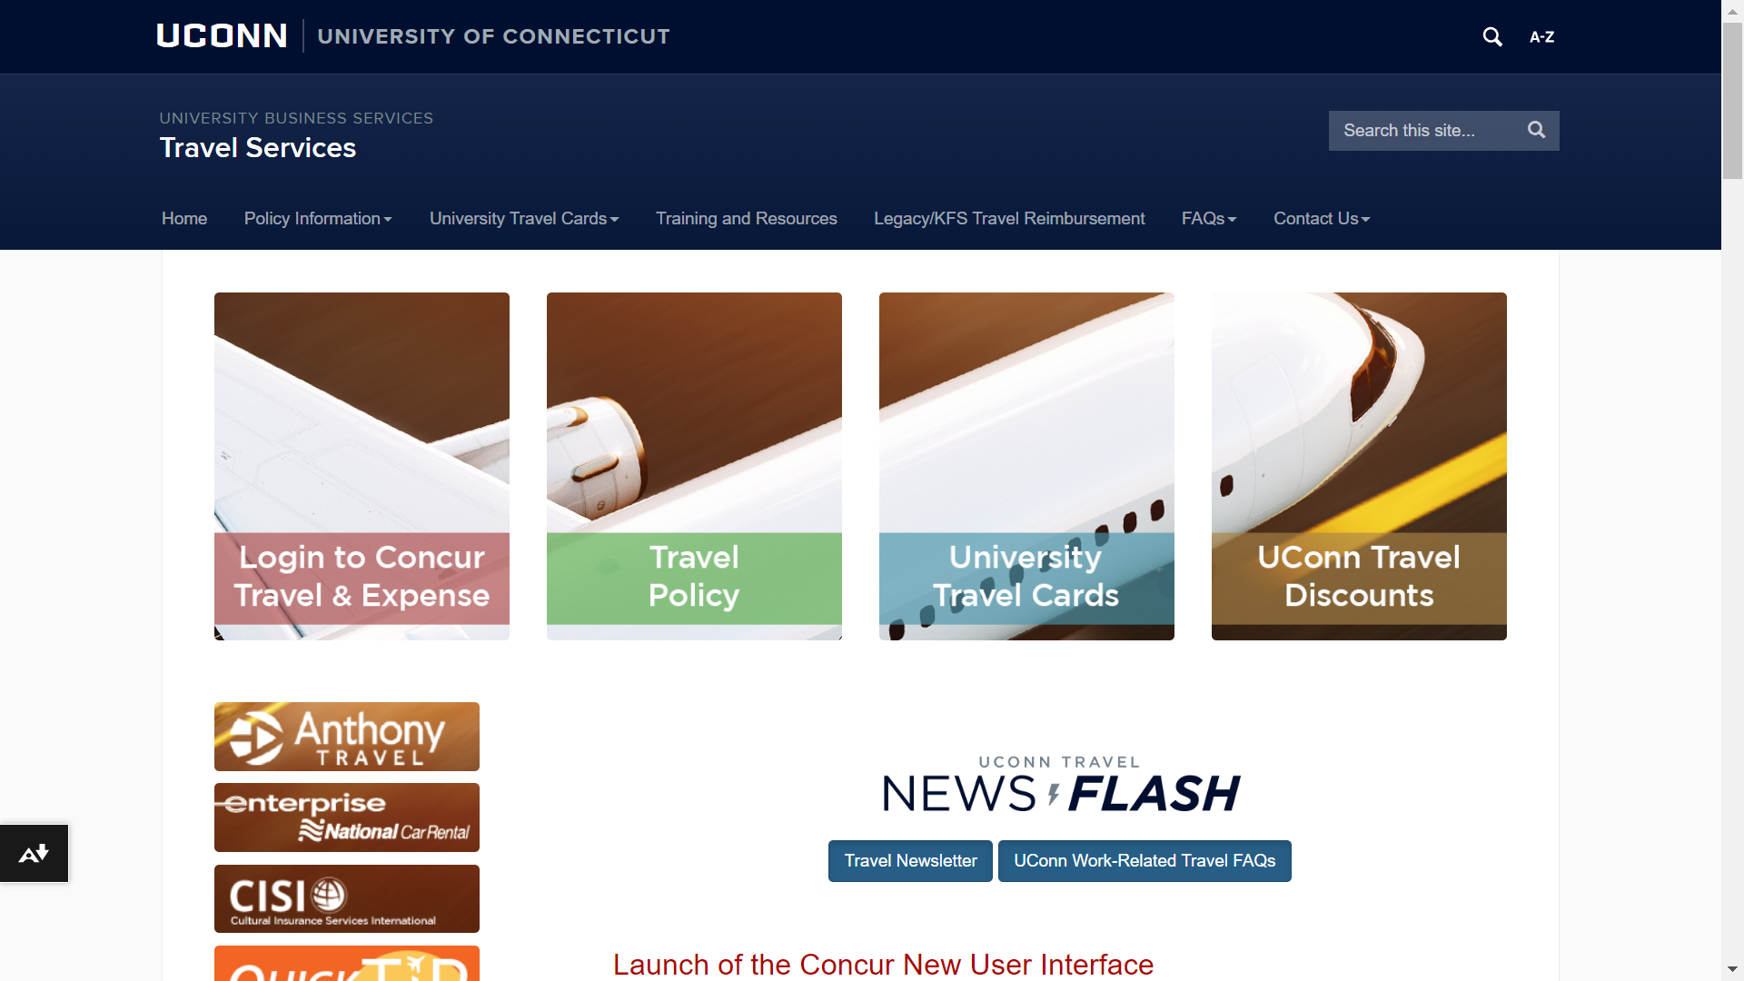
Home | Travel Services (travel.uconn.edu)

Slide 4
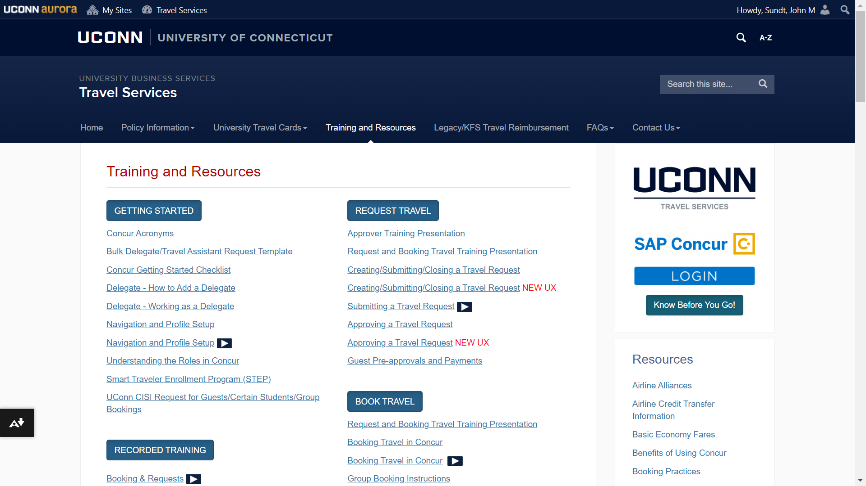
Training and Resources | Travel Services (uconn.edu)

Slide 5
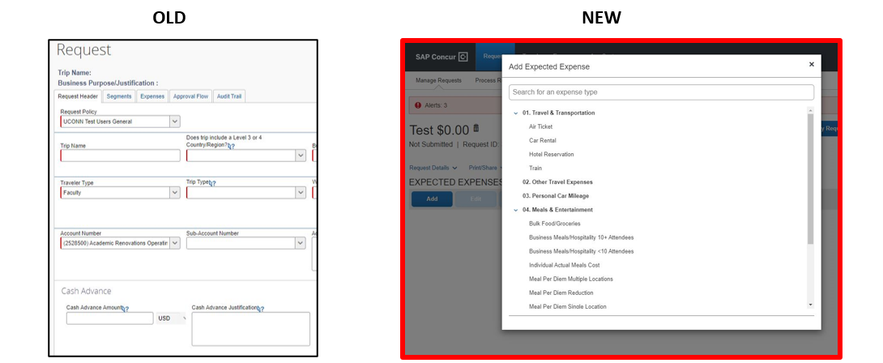
Travel Request Streamline - Reduces Tabs and individualized segment requirements - Allows sequential Expense Type Additions - No longer have to shift between tabs

Slide 6
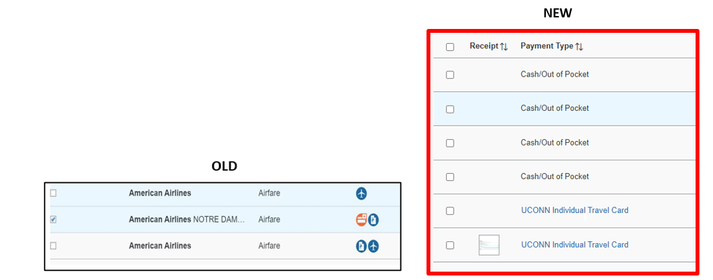
Expense Report Streamline - Icons have been replaced with clear wording indicating the payment type - Alerts and will display at the top of the report instead of on each individual expense line. *Clicking on the Alert will take you right to the area that needs to be corrected.

Slide 7
Job Aids Online
The job aids below contain step by step walkthroughs with screenshots on how to proceed in the new UI.
Linking an Approved Request: Please refer to page 5 Creating an Expense Report in the New UI
How to Add Receipts: Please refer to page 16 Creating an Expense Report in the New UI
How to Add Anticipated Expenses to a Request: Please refer to page 5 Creating a Request in the New UI
How to Itemize Expenses: Please refer to page 10 Creating an Expense Report in the New UI
How to Allocate Expenses: Please refer to page 12 Creating an Expense Report in the New UI
How to Start an Expense Report From an Approved Request: Please refer to page 2 Creating an Expense Report in the New UI

Slide 8
Purchasing & Travel Websites
Home | Purchasing Department (uconn.edu)
Procurement Card
Commodities
Forms
HuskyBuy
Travel Assistance:
travel@uconn.edu (primary contact email)
Help Desk 860-486-2289

