Slide 1
UConn Gives
UConn Gives 2022
7:00 a.m. March 30th until 7:00 p.m. March 31st
Record number of groups participating across the University

Slide 2
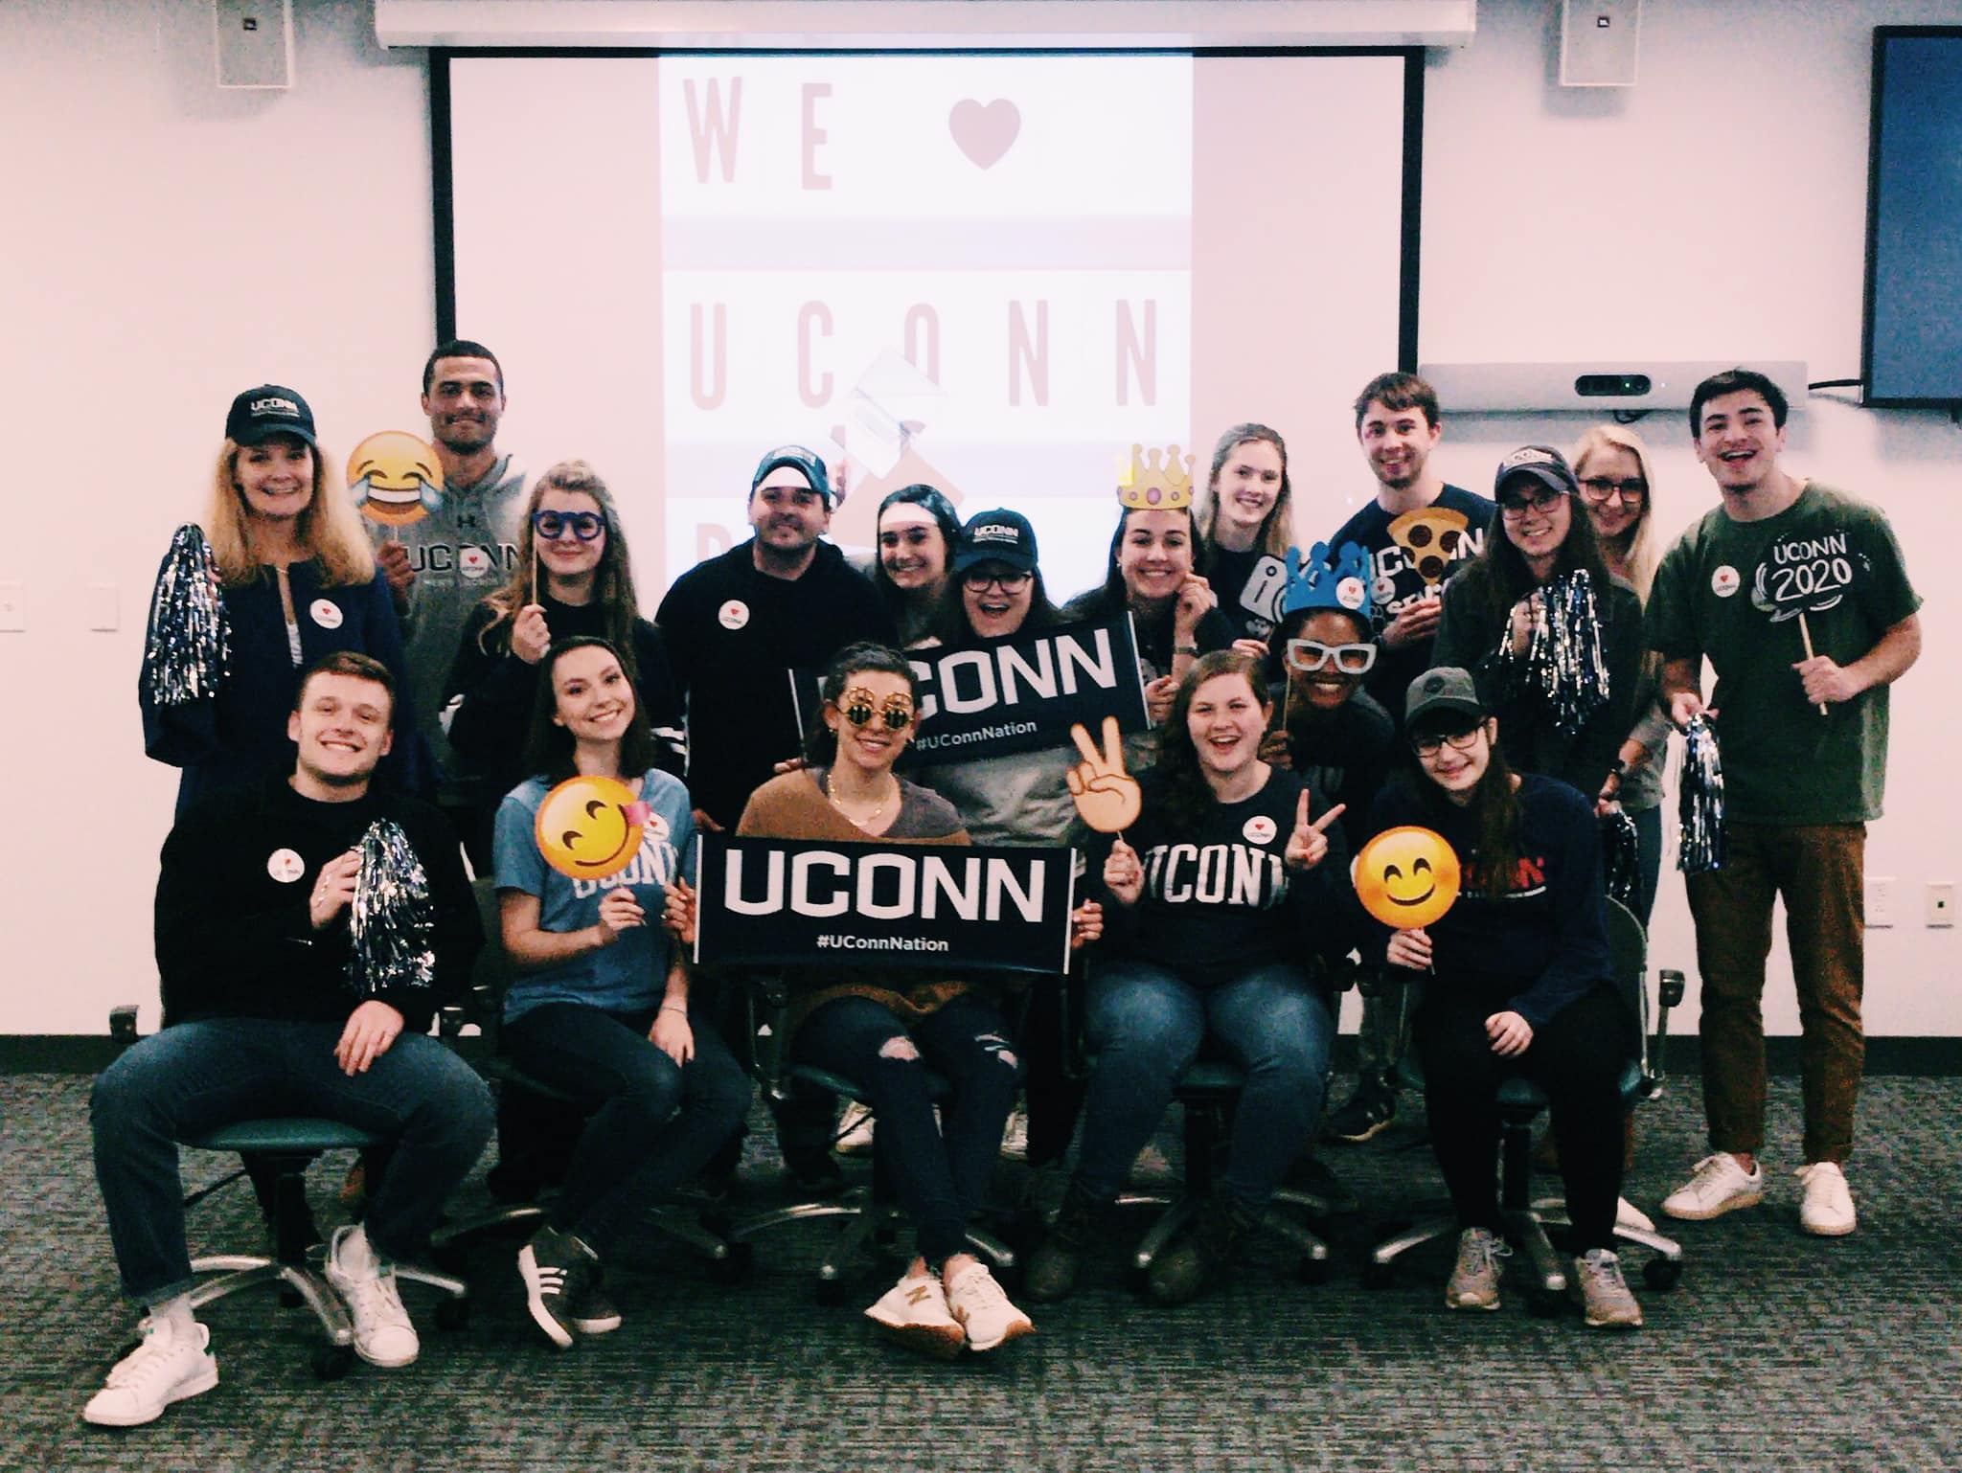
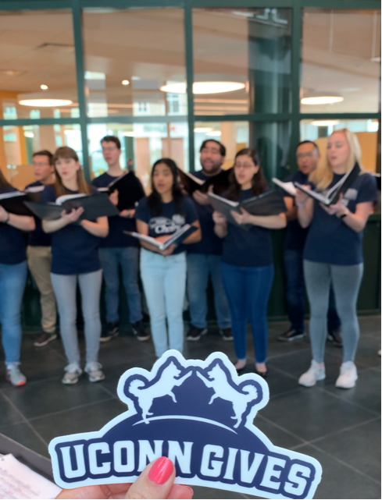
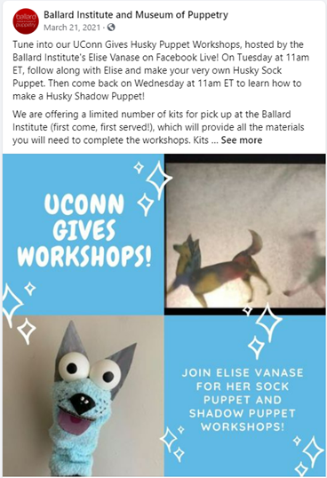
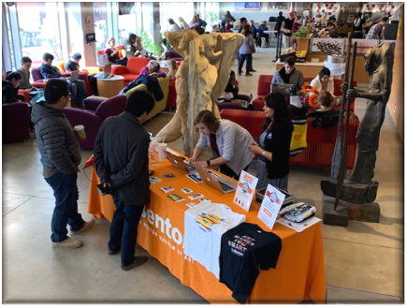
UConn Gives – Fine Arts Projects
Fine Arts Participants
Benton Museum - Directors Fund WBMA
Connecticut Repertory Theatre – Patrons Fund
Jorgensen - Jorgensen Outreach for Youth Program
Ballard - Ballard Institute and Museum of Puppetry Fund
UCMB - Dr. David L. Mills Marching & Pep Band Fund
Art and Art History
Professor Edvin Yegir Memorial Fund
Paul Zelanski Award of Excellence
Another Fund Pending
Digital Media and Design Program General Fund

Slide 3
Support your SFA!
Save the date!
Sign up to be a champion and ask others to sign up
Begin reaching out to possible donors/match donors
Give early!
Post and share on social media

Slide 4
Questions

