Slide 1
Facility Updates
February 2024 All-SFA Meeting
Colleen K. Bridgeman
Assistant Dean & COO
February 22, 2024

Slide 2
Agenda
Academic Renovation/UPDC Project Updates
Alumni & Student Exhibitions
SFA Student Mural Scholarship
Wayfinding Updates
Fire Evacuation Routes & Other Space Management Updates

Slide 3
Academic Renovation/UPDC Projects
Current Projects –
Acoustical Upgrades
Upcoming Projects –
von der Mehden Roof Project
Museum Collection Storage

Slide 4
Alumni & Student Exhibitions
Thoughts on SFA: “As I reflect back to when I was student at UCONN and in particular within the School of Fine Arts, I am reflective of my time studying as a Communication Design student in the department of Art + Art History. My current research and design practice has very much been informed by my undergraduate Senior thesis which was entitled “Black” and this laid the foundation for so much of what I am doing now. Outside of being in the art program, I was also a member of the UCONN Marching Band (shout out to the Clarinet section) and pretty much went to every football game. I am appreciative of the variety of creative experiences I had during my time in SFA.”
Kelly Walters – ’10
Profession: Designer and Professor
Major: Studio Art (Communication Design)
Department: Art & Art History
About Kelly: designer, educator and founder of the multidisciplinary design studio Bright Polka Dot. Her ongoing design research interrogates the complexities of identity formation, systems of value and the shared vernacular in and around Black visual culture. She has previously taught at the University of Bridgeport, California College of the Arts, Central Saint Martins and the University of Connecticut. Kelly is currently an Assistant Professor of Communication Design and the Associate Director of the BFA Communication Design Program in Parsons School of Design at The New School.

Slide 5
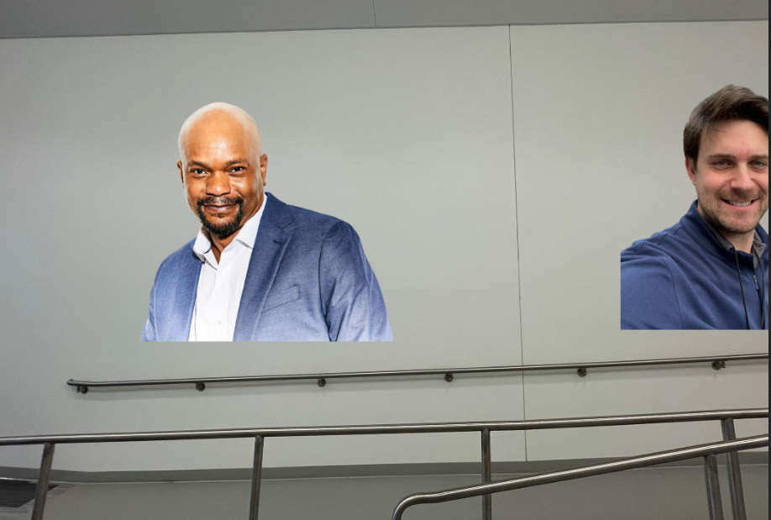
Alumni & Student Exhibitions
Thoughts on SFA: ““Eventually, I slipped in to play the piano – it was my refuge from the computer lab,” he says. “As a non-major, I eventually pursued private voice lessons, which required participation in choir. That’s how I came to the music department and the School of Fine Arts. There was a place for me even though it wasn’t my chosen field of study at the time.”.”
Forrest McClendon– ’89
Profession: Actor/Singer
Major BA Music
Department: Music
About Forest: Actor and singer nominated for a Tony Award for his Broadway debut in “The Scottsboro Boys.” .

Slide 6
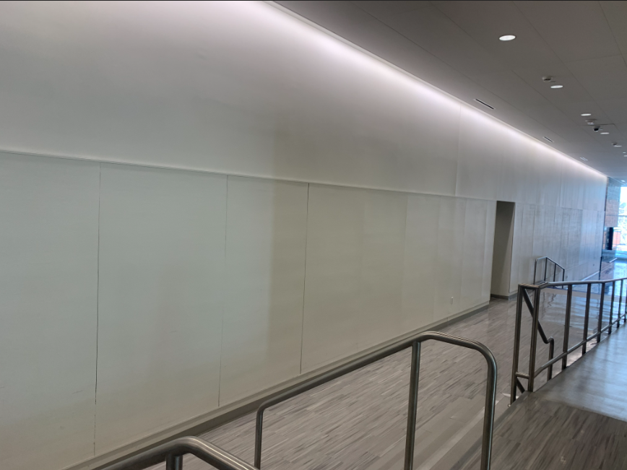
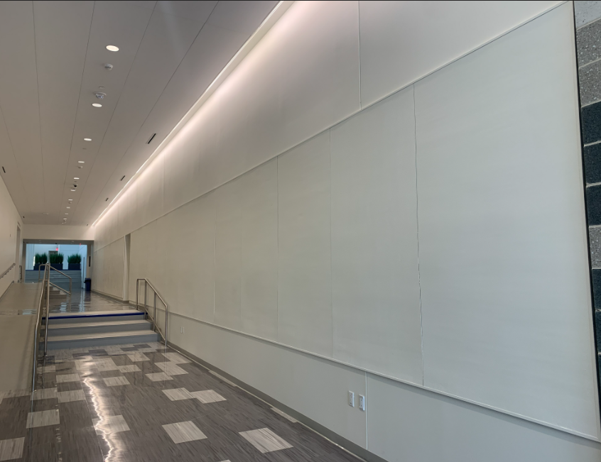
Alumni & Student Exhibitions

Slide 7
Other SFA Facility Projects
SFA Student Mural Scholarship
Wayfinding Updates
Fire Evacuation Routes
Space Management Documents & Reports

