Slide 1
Operational Updates
2022 SFA Faculty & Staff Retreat
Colleen K. Bridgeman
August 25, 2022

Slide 2
Facility Updates
Acoustical Study & Recommended Upgrades for Reaccreditation
Benton Reaccreditation Modifications
Harriet S. Jorgensen Theatre
Lobby Flooring Abatement and Renovation Effort
Rigging System Upgrade
Clear Comm System Upgrade

Slide 3
Facility Updates Cont.
Upper Jorgensen
Sound System Upgrade
Clear Comm System Upgrade
Freight Elevator Replacement
Kirby Mills Ventilation Solution
SFA Wayfinding Project
Interior Directory Signage & Building Names
All Academic Buildings

Slide 4
Technology Update & Reminders
Two-Factor Authentication Expanding
Duo App Verification
Email + Office 365 Applications Impacted
Enhances Safety and Reduces Risk
NETID Password Recovery
https://netid.uconn.edu
ITS Support Services
Knowledge Base → https://kb.uconn.edu
Tech Support → https://techsupport.uconn.edu
Suspicious Emails? → Do NOT Click! Forward to reportphishing@uconn.edu

Slide 5
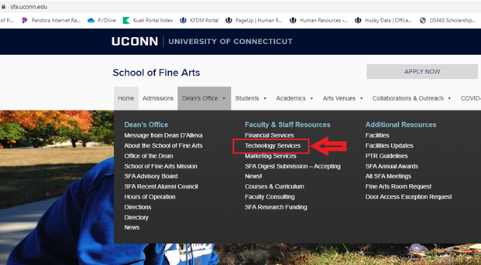
Technology Update & Reminders

Slide 6
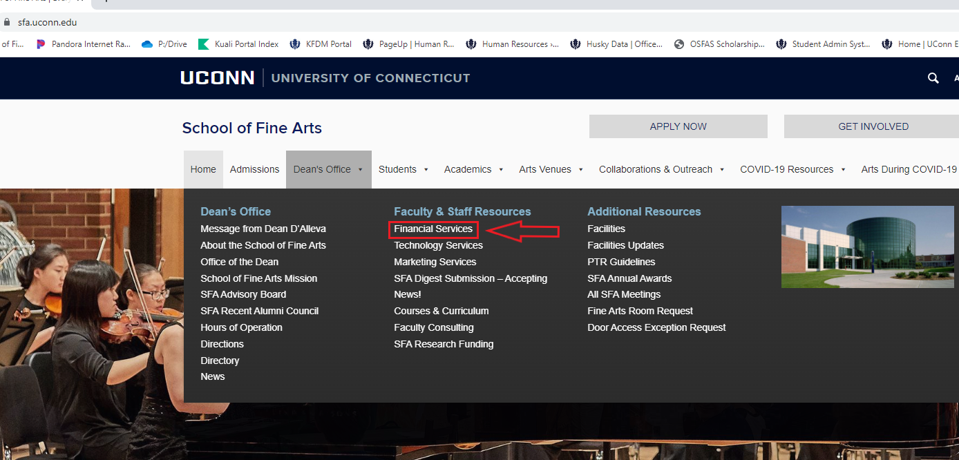
Financial Services Office

