Slide 1
OIE Overview: Responding, Reporting & Resources
August 25, 2022 – SFA Faculty & Staff
Sarah Chipman
Director of Investigations & Deputy Title IX Coordinator
Office of Institutional Equity

Slide 2
Office of Institutional Equity (OIE) www.equity.uconn.edu
OIE ensures the University's commitment and responsibility to foster equitable working and learning environments, as outlined in the Policy Against Discrimination, Harassment and Related Interpersonal Violence. Areas of focus include:

Slide 3
Access and Accommodations
www.accessibility.uconn.edu
Access
Reasonable Accommodations
A person with a disability must be ensured the same access to programs, opportunities, and activities at the University as all others.
Physical Access
Buildings, Sidewalks
Communications
Captioning, Interpreting
Digital Accessibility
Course Materials
Human Resources for employee requests
https://hr.uconn.edu/ada-compliance/
Center for Students with Disabilities for student accommodations
https://csd.uconn.edu/

Slide 4
Policy Against Discrimination, Harassment and Related Interpersonal Violence
Articulates University values and community conduct expectations around discrimination, harassment, and sexual misconduct.
Clarifies Employee Reporting Obligations.
Prohibits certain amorous relationships where power disparities are present.
Prohibited Conduct:
Discrimination
Discriminatory Harassment
Sexual or Gender-Based Harassment
Title IX Sexual Harassment
Sexual Assault
Intimate Partner Violence
Stalking
Sexual Exploitation
Retaliation
Complicity

Slide 5
Inappropriate Amorous Relationships
Amorous includes intimate, sexual, and/or any other type of amorous encounter or relationship, whether casual or serious, short-term or long-term.
Academic Context:
Prohibited with undergraduate students or with graduate students where authority relationship exists (ex. teaching; formal mentoring or advising; supervision of research)
Employment Context:
Prohibited where a supervisory relationship exists
*Party in position of authority must disclose to OIE

Slide 6
Protected Classes
Age
Ancestry
Color
Disability
Marital status
National origin
Race
Religion
Sex, including pregnancy and sexual harassment
Sexual orientation
Gender identity or expression
Veteran Status
*See Policy for full list

Slide 7
Prohibited Conduct
Discrimination:
Adverse action based on protected class
Includes failing to provide reasonable accommodation to persons with disabilities.
Discriminatory Harassment/Sexual Harassment:
Conduct based on protected class / unwelcome conduct of a sexual nature.
Quid Pro Quo: Submission to or rejection of unwelcome conduct is used as the basis for employment or academic decisions
Hostile Environment: So severe, persistent or pervasive that it unreasonably interferes with, limits, deprives, or alters the conditions of education, employment, or participation in a University program or activity.

Slide 8
Prohibited Conduct
Title IX Sexual Harassment
An employee conditioning the provision of an aid, benefit, or service on an individual’s participation in unwelcome sexual conduct; or Unwelcome conduct determined by a reasonable person to be so severe, pervasive, and objectively offensive that it effectively denies a person equal access to the University’s education program or activity in the United States; or Sexual assault (as defined by Clery Act), or “dating violence,” “domestic violence,” and “stalking” (as defined by the Violence Against Women Act).
(Non-Title IX) Sexual Harassment
Where submission to or rejection of unwelcome conduct is used as the basis for decisions affecting an individual’s education; employment; or participation in a University program or activity (i.e. quid pro quo); or Unwelcome conduct that is so severe, persistent or pervasive that it unreasonably interferes with, limits, deprives, or alters the conditions of education; employment; or participation in a University program or activity when viewed from both a subjective and objective perspective (i.e. hostile environment); or Acts of interpersonal violence (e.g. sexual assault, intimate partner violence, stalking) as defined by The Policy Against Discrimination, Harassment, and Related Interpersonal Violence.

Slide 9
Prohibited Conduct
Sexual Assault
Stalking
Sexual contact/intercourse without consent
understandable exchange of affirmative words or actions, which indicate a willingness to participate in mutually agreed upon sexual activity
course of conduct directed at a specific individual that would cause a reasonable person to fear for their safety or the safety of others, or for the individual to suffer substantial emotional distress

Slide 10
Prohibited Conduct
Intimate Partner Violence
Sexual Exploitation
any act of violence or threatened act of violence that occurs between individuals who are involved or have been involved in a sexual, dating, spousal, domestic, or other intimate relationship
taking advantage of a person due to their sex and/or gender identity for personal gain or gratification; abuse of a position of vulnerability, differential power, or trust for sexual purposes
Includes but is not limited to recording, photographing, disseminating, and/or posting images of private sexual activity and/or a person’s intimate parts without consent

Slide 11
Non-Retaliation Policy
Retaliation means any adverse action taken against a person for making a good faith report of Prohibited Conduct or participating in any proceeding under the Policy Against Discrimination, Harassment, and Related Interpersonal Violence
Retaliation includes threatening, intimidating, harassing, coercing or any other conduct that would discourage a reasonable person from engaging in activity protected under The Policy.
Retaliation may be present even where there is a finding of “no responsibility” on the allegations of Prohibited Conduct

Slide 12
Reporting
Responsible Employee Reporting Obligations*
All relevant details (obtained directly or indirectly) about incidents involving students:
Sexual Assault
Intimate Partner Violence
Stalking
www.titleix.uconn.edu
*Exceptions: course assignments; IRB research, public speak-out events
What if…
The incident occurred off-campus?
The incident occurred prior to the student coming to UConn?
The other party is not affiliated with UConn?
I don’t know who the other party is?
The student asked me to keep it confidential?

Slide 13
Reporting
Dean/Department Head Expanded Reporting Obligations
All relevant details about incidents of Prohibited Conduct (including but not limited to discrimination, discriminatory harassment, sexual harassment, and retaliation) involving employees
equity@uconn.edu
860-486-2943
https://equity.uconn.edu/reporting-form/
What if…
I have only heard rumors?
I don’t know the identities of everyone involved?
The concerns are about me?
The person who told me about the issue asked me to keep it confidential?

Slide 14
Responding to Disclosures: The Basics
STEP 1: CARE​ Care for the individual​
Listen without interruption ​ Let the individual disclosing set the pace and tone​ Withhold judgment ​ Avoid questions or statements that imply fault​
“Thank you for sharing this with me. I’m sorry that this happened. How can I help?”

Slide 15
Responding to Disclosures: Balancing Care and Compassion with Reporting Obligations
STEP 2: INFORM & CONTACT​
Inform the individual of your reporting responsibilities at an appropriate time Explain the purpose of your reporting responsibility Inform the individual that they may receive outreach from a university administrator containing resources and reporting information, and it is their choice to respond Call (860)486-2943 or complete OIE’s online reporting form at https://equity.uconn.edu/reporting-form/ Be prepared to share all details about the incident, including names, dates, and location.
"I have a responsibility to share what you have shared with me with the Office of Institutional Equity (OIE). This information sharing is meant to ensure that you will receive the appropriate level of assistance, support, and/or university resources, should you wish. Please know that you ultimately get to decide how much or how little you want to engage with any follow up you may receive." ​

Slide 16
Supporting Impacted Individuals
Do Not:
Pry for more information
Define their experience
Tell them what to do
Do:
Listen attentively
Withhold judgment
Offer them choices
Address any medical/safety concerns

Slide 17
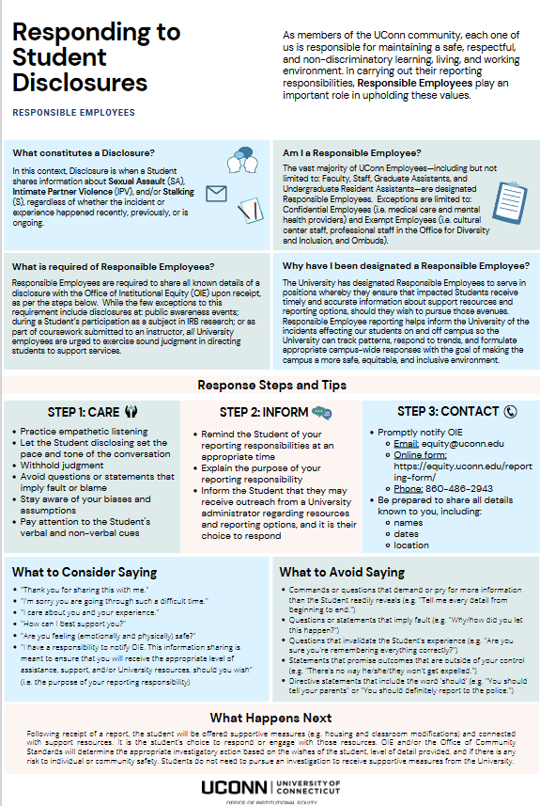
Responding to Student Disclosures Resource Guide
"I have a responsibility to share what you have shared with me with the Office of Institutional Equity (OIE). This information sharing is meant to ensure that you will receive the appropriate level of assistance, support, and/or university resources, should you wish. Please know that you ultimately get to decide how much or how little you want to engage with any follow up you may receive." ​

Slide 18
Case Study # 1
You notice that Abby seems unusually quiet and withdrawn, and she looks tired. You ask her to meet with you privately to check in with her. During your meeting, Abby shares the following:
Abby attended a party last weekend. She had a couple drinks with someone at the party and soon began to feel tired. The person from the party offered to accompany her back to her room. Abby woke up alone the next morning with no clothes on and felt physical discomfort. She had no recollection of what occurred after she got to her room.
Abby tells you she has had difficulty concentrating in class, has not felt like eating and is not sleeping well. She is not sure what occurred and does not want you to tell anyone what she shared with you.

Slide 19
Case Study # 2
Ben approaches you to ask for advice, and shares the following:
Ben connected with Casey through a dating app. Last week, they decided to meet up off-campus for coffee. Although Casey seemed nice, Ben was not interested in a dating relationship and sent Casey a text saying, “It was nice meeting you. Thanks for the coffee.” Casey responded with a series of messages about how they felt a strong connection with Ben, complimenting Ben’s personality and appearance, and asking when they can get together again. Ben replied, “I had a nice time meeting you, but I just don’t think we have a connection.” Casey responded with a series of additional messages asking Ben to reconsider. Ben did not reply.
A couple days later, Ben received a text message from Casey that included a screenshot of a picture Ben posted on Instagram. Ben did not respond, but blocked Casey from all his social media. Yesterday, Ben found flowers and a handwritten note saying, “Can’t stop thinking of you,” on the windshield of his car.
Ben feels uneasy about the situation and is uncertain what to do.

Slide 20
What Happens After I Report?
Outreach to impacted party/individual who disclosed (from OIE, Community Standards, Dean of Students Office)
Provide information about resources, supportive measures, and investigation options
Next steps may include:
Investigation if UConn-affiliated respondent (defer to complainant’s wishes with some exceptions)
OIE: Employee-respondents
Community Standards: Student-respondents
Other responsive action (i.e., provision of supportive measures, referral, education)

Slide 21
Resources & Supportive Measures
Non-Confidential Resources
Dean of Students Office/ Graduate School
Residential Life
Supportive measures (for both complainants and respondents) include, but are not limited to:
Counseling
Extensions of deadlines
Scheduling modifications
Changes to on-campus housing
Leaves of absence
Increased security
Monitoring of certain areas of campus
Mutual no contact directives
Confidential Resources
Student Health and Wellness
Medical Care & Mental Health
Off campus advocacy organizations
Alliance to End Sexual Violence
Coalition Against Domestic Violence
Exempt Employees
5 Cultural Centers (including Women’s Center)
Ombuds
Investigations
Community Standards / OIE
Police

Slide 22
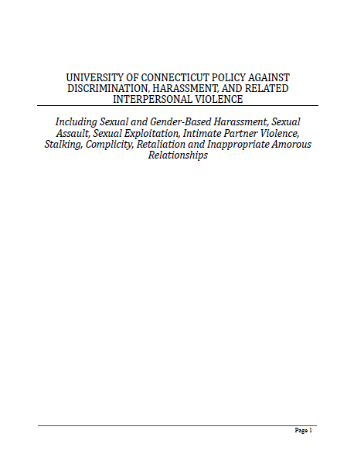
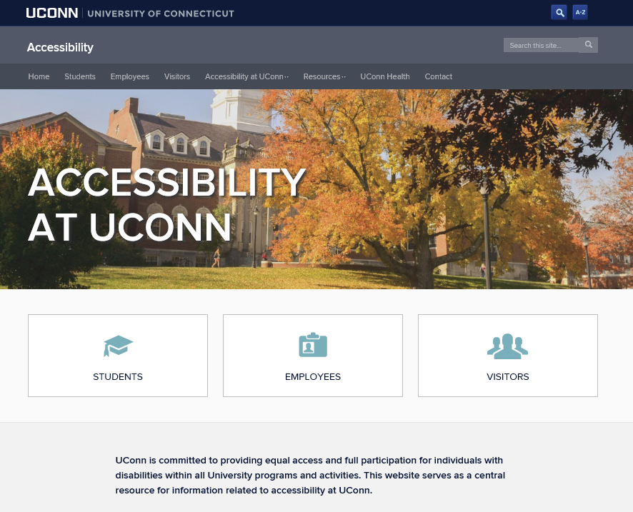
Resources
titleix.uconn.edu

Slide 23
What if….
I am concerned about “harassment” in the workplace or academic environment, but I do not think it is because of my or someone’s protected classification(s) – instead, it feels more like general incivility, bullying, and/or inappropriate or unprofessional conduct. Is that covered? Is there anything I can do about that?

Slide 24
Additional Reporting
Reportline
1-888-685-2637
https://compliance.uconn.edu/reporting-concerns/reporting-overview/
InForm
https://inform.uconn.edu/

Slide 25
InForm.uconn.edu

Slide 26
Office of Institutional Equity
www.equity.uconn.edu
www.titleix.uconn.edu
www.accessibility.uconn.edu
equity@uconn.edu
860-486-2943

