Slide 1
Welcome to the All-SFA Faculty & Staff Retreat!
You should have received two blank stickers when you came in.
One is a nametag; please write:
Your Name
Your Department
Your Pronouns (if you choose)
Hold onto the other, and write if you choose:
A well-wish to colleagues for the year

Slide 2
Interim Dean Alain Frogley
Welcome from

Slide 3
Welcome New Faculty and Staff!
Mollie Sixsmith, The Benton
Michael Beschta, Dramatic Arts
Monty Heon, Financial Services Office
Kelly Crossen, Art + Art History
Macushla Robinson, Contemporary Art Galleries
Janet Kim, Music

Slide 4
Welcome New Faculty and Staff!
Michelle Polgar, Connecticut Repertory Theatre
Dmitry Glivinskiy, Music
Amanda Wilde, Office of the Dean
Sarita Fellows, Dramatic Arts
Sandi Carroll, Dramatic Arts
Laurel Pehmoeller, Digital Media & Design

Slide 5
Welcome New Faculty and Staff!
Dylan DelMastro, Dramatic Arts
Elizabeth Salinger, Music
Scott Fisher, Jorgensen Center for the Performing Arts
Abigail Golec, von der Mehden Recital Hall
Courtney Ferguson, Dramatic Arts
Jeanne Ciravolo, Alexey von Schlippe Gallery

Slide 6
Interim Dean Alain Frogley
Welcome from

Slide 7
OIE Director of Investigations and Title IX Coordinator Sarah Chipman
Welcome

Slide 8
Take a Break!
Coffee, Seltzer, and Snacks Available Outside

Slide 9
InCHIP Director of Research, Training and Development Grace Morris
Welcome

Slide 10
Interim Provost Anne D’Alleva
Welcome

Slide 11
Take a Break!
Coffee, Seltzer, and Snacks Available Outside

Slide 12
2022 SFA Annual Awards and Years of Service

Slide 13
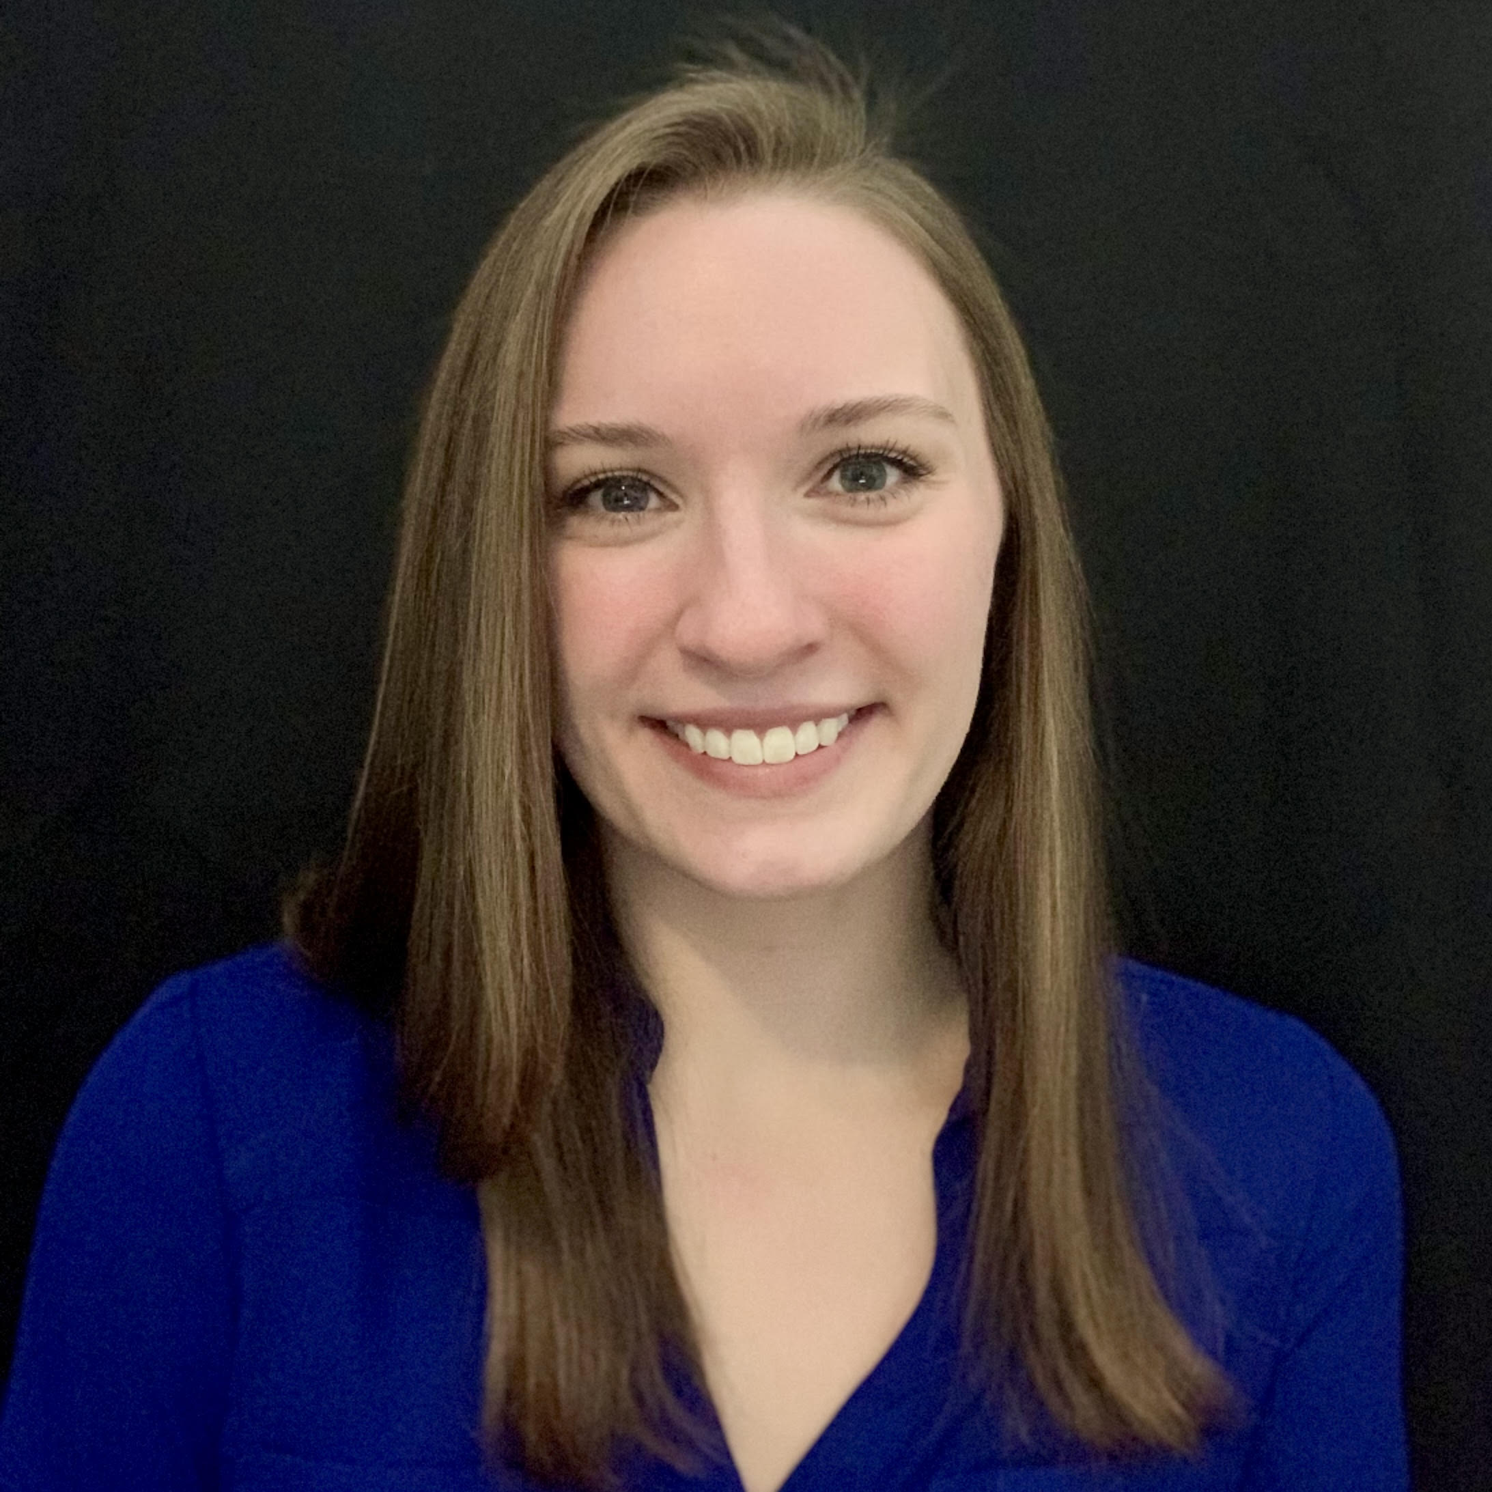
Outstanding Teaching Assistant
TA
Megan Lyons Music

Slide 14
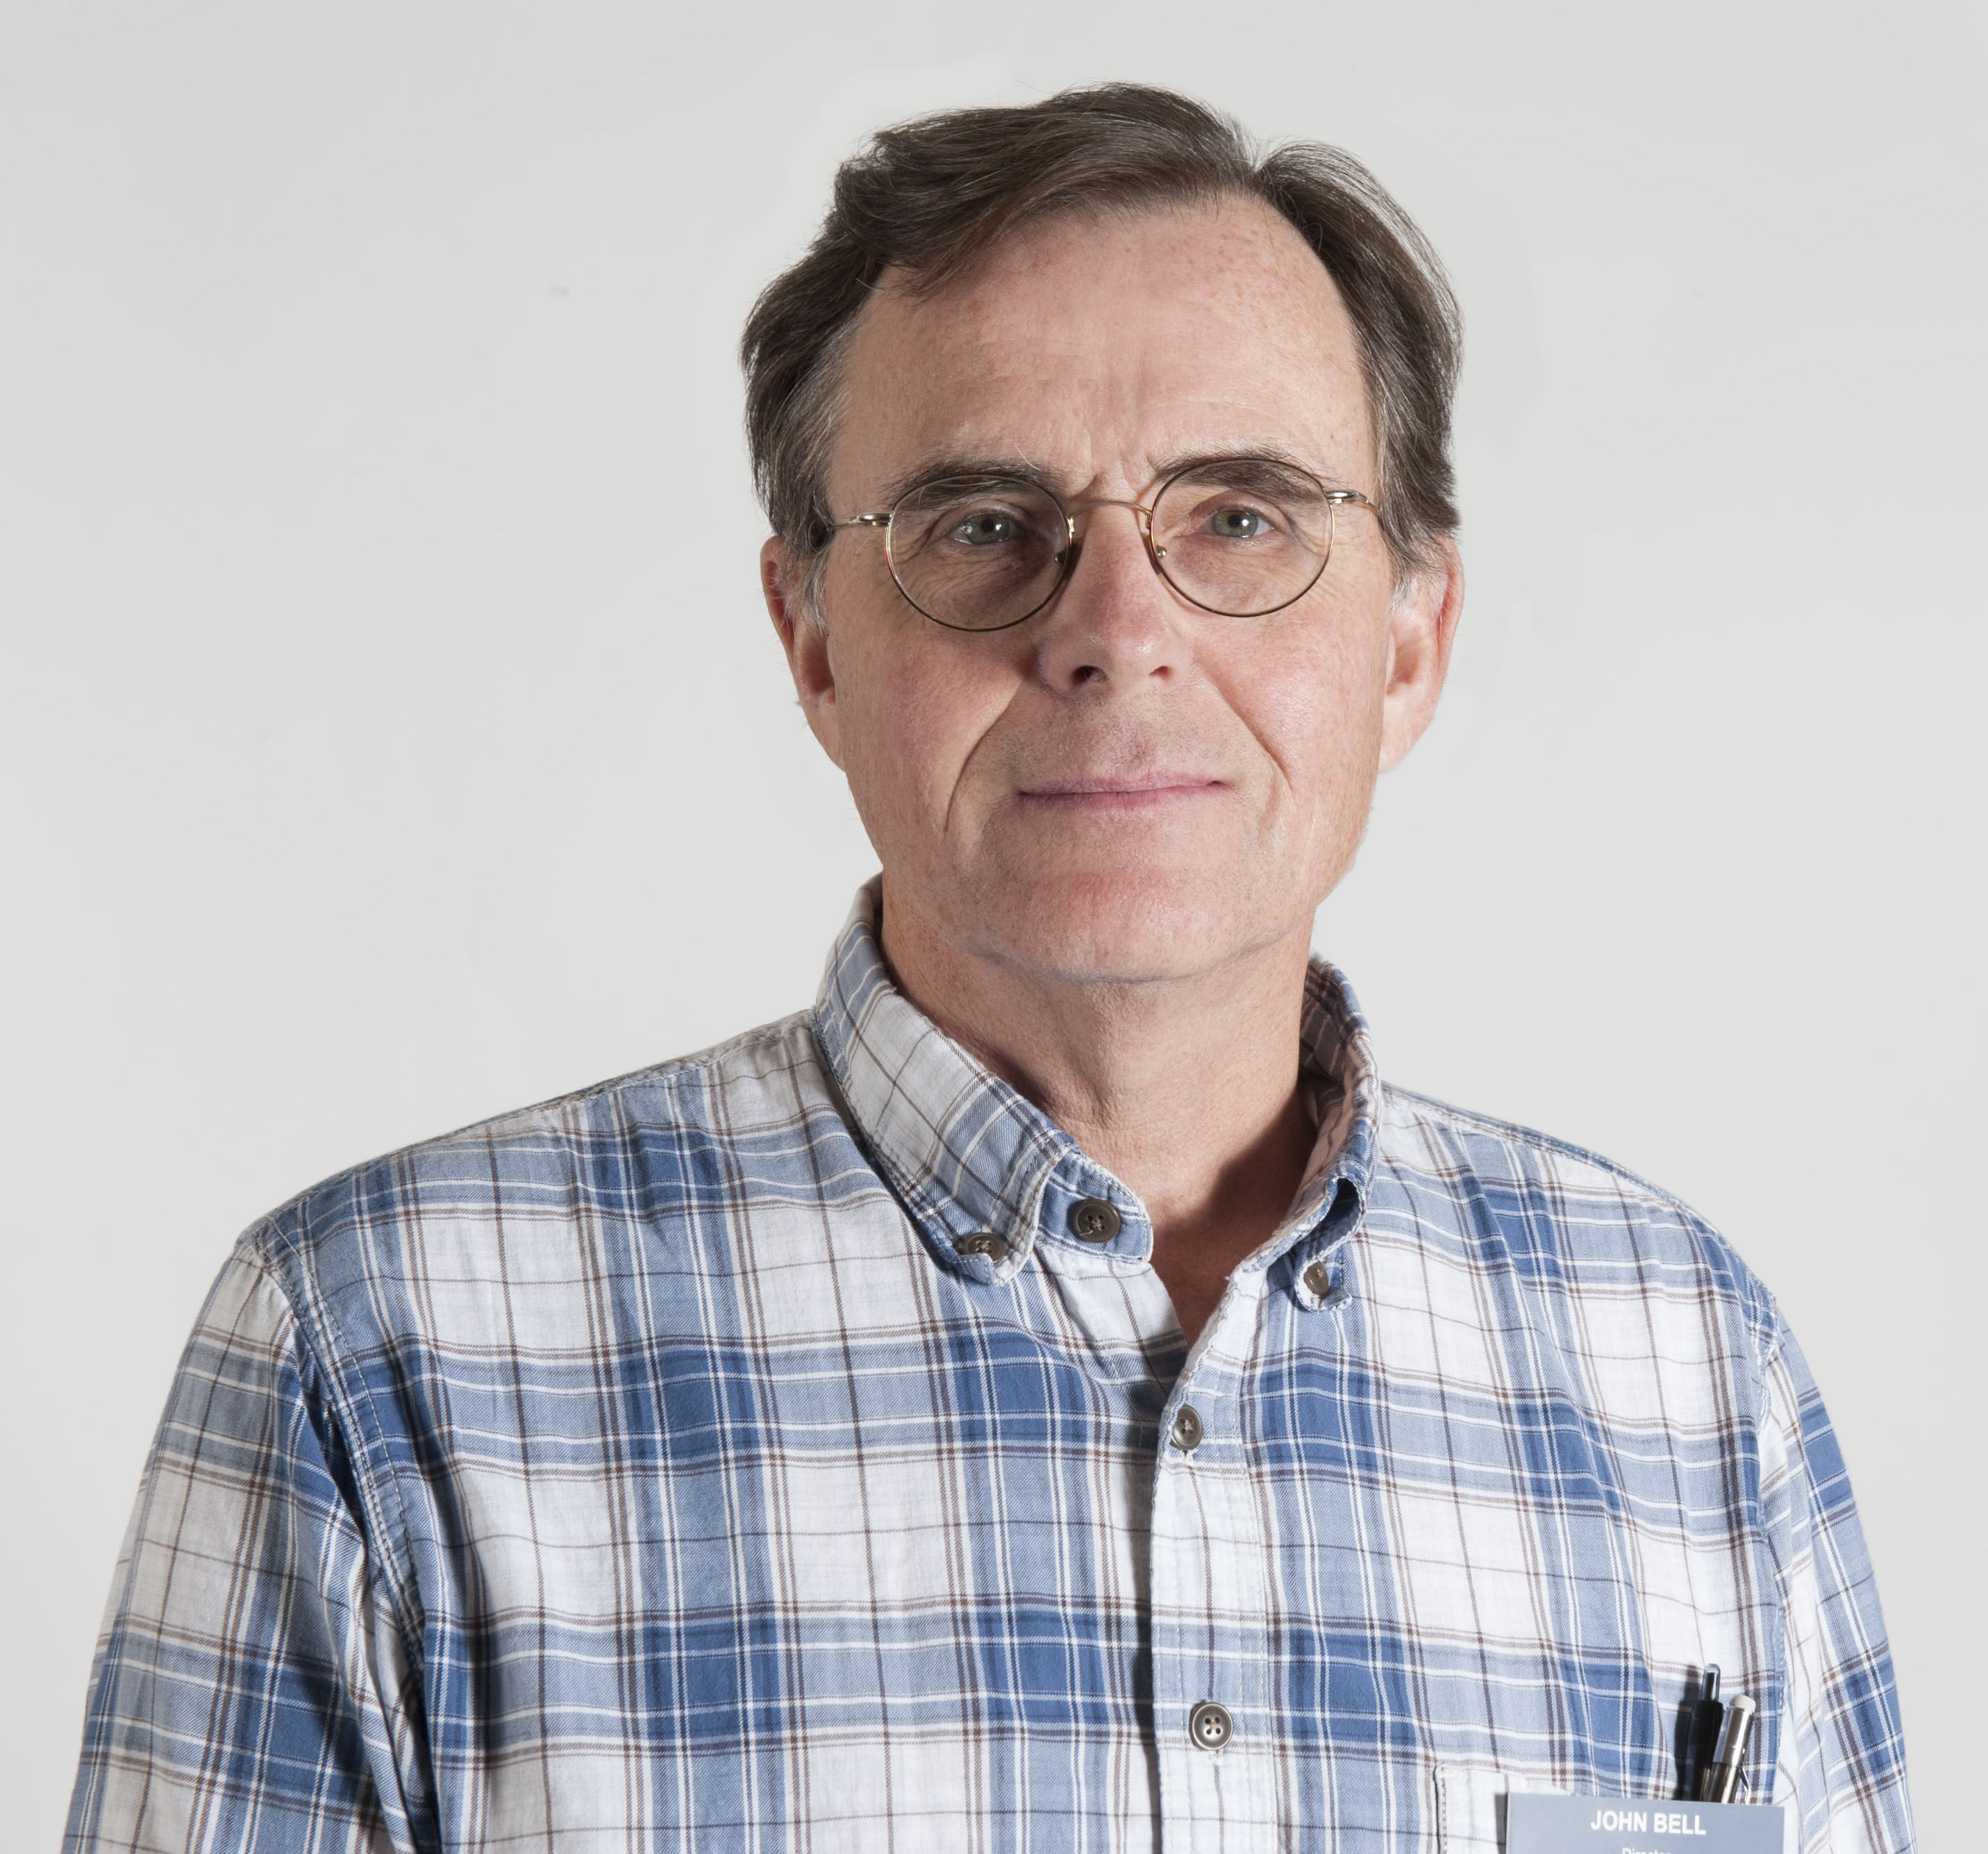
Diversity, Equity & Inclusion Leadership Award
DEI
John Bell Ballard Institute and Museum of Puppetry

Slide 15
Lifetime Achievement Award
Eva Gorbants Office of the Dean

Slide 16
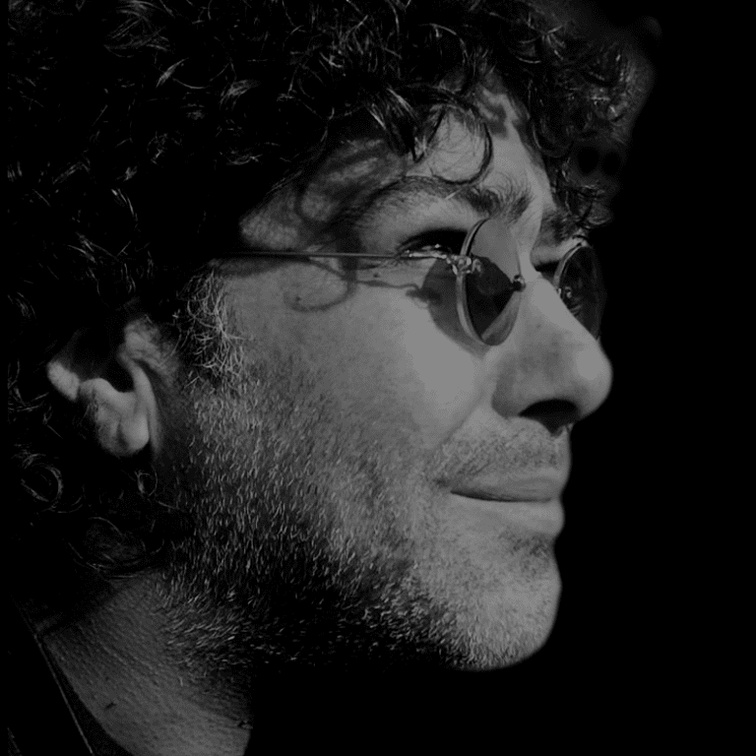
Lifetime Achievement Award
Edvin Yegir Art + Art History

Slide 17
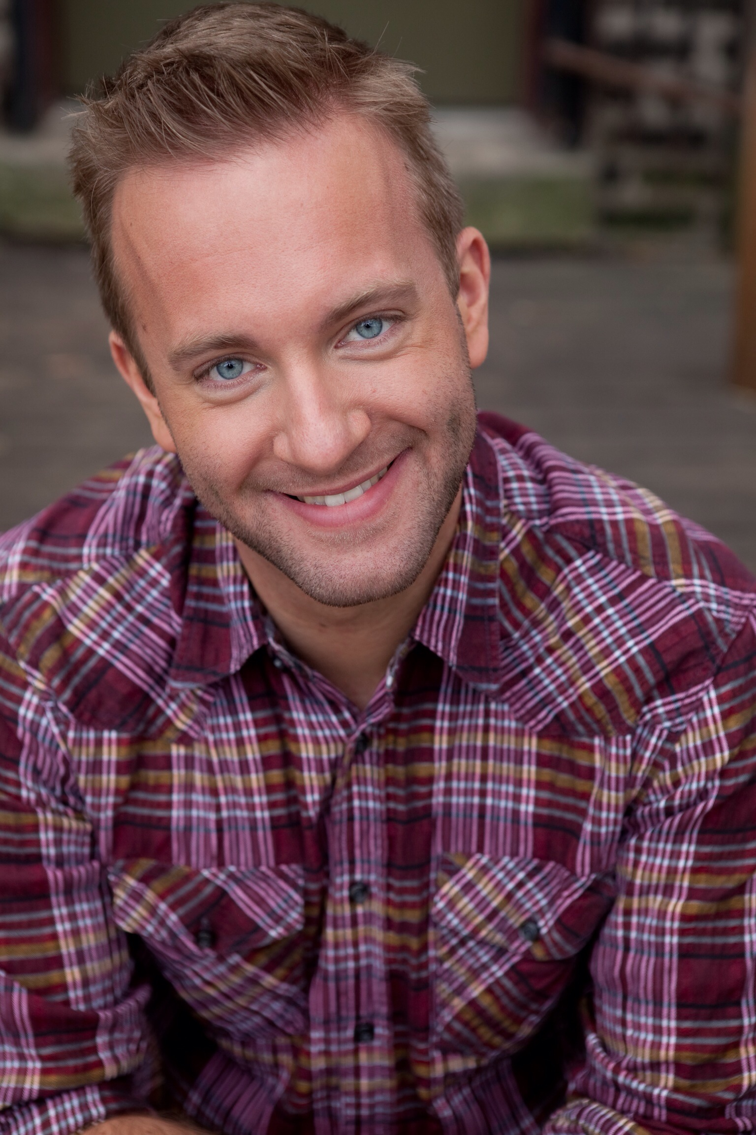
Outstanding Adjunct
Nick Roesler Dramatic Arts

Slide 18
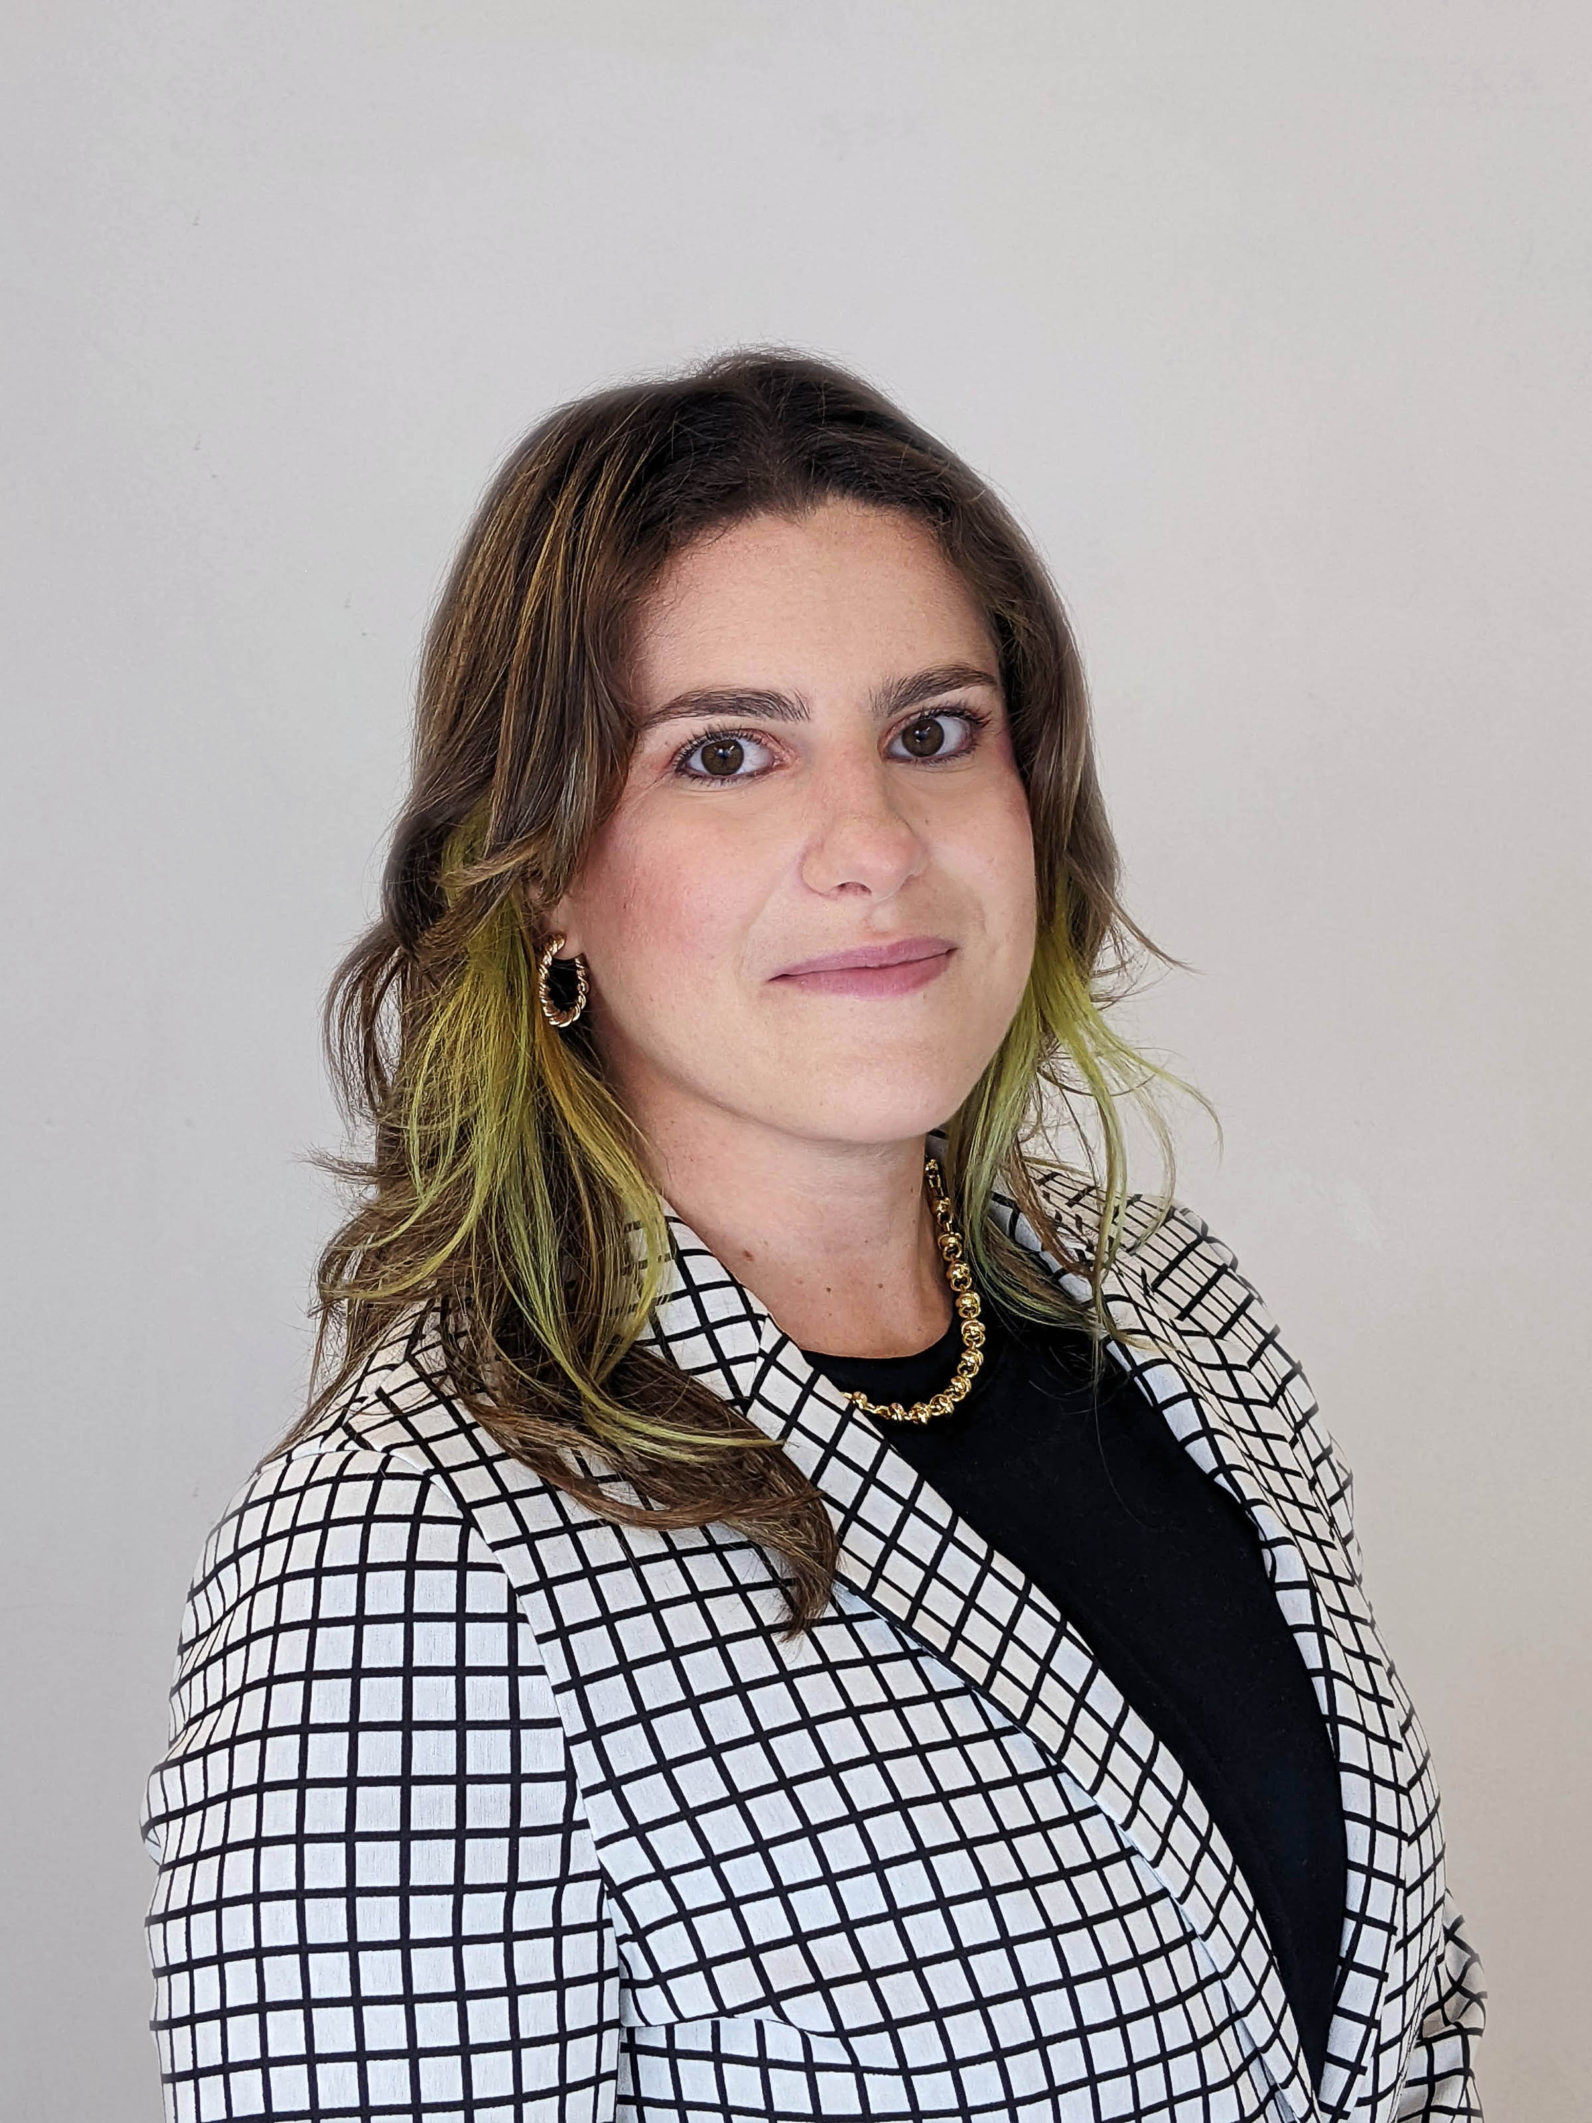
Outstanding Adjunct
Catherine Solari Art + Art History

Slide 19
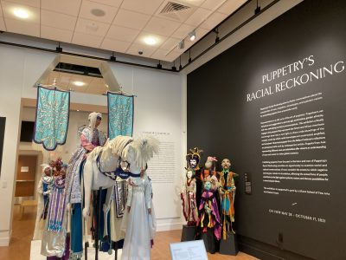
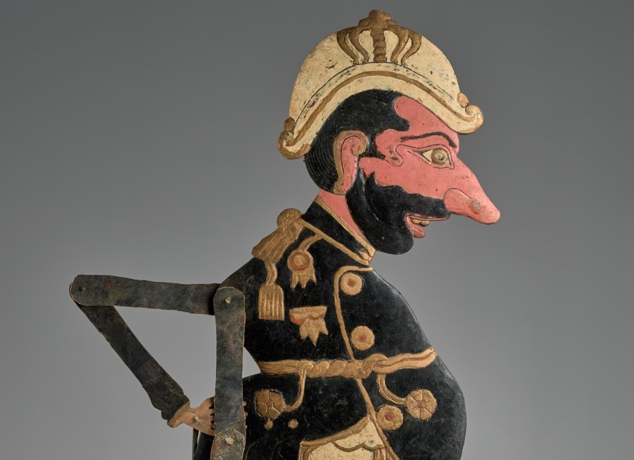
Special Achievement Award
John Bell, Matthew Cohen, Jungmin Song, and Emily Wicks Ballard Institute and Museum of Puppetry

Slide 20
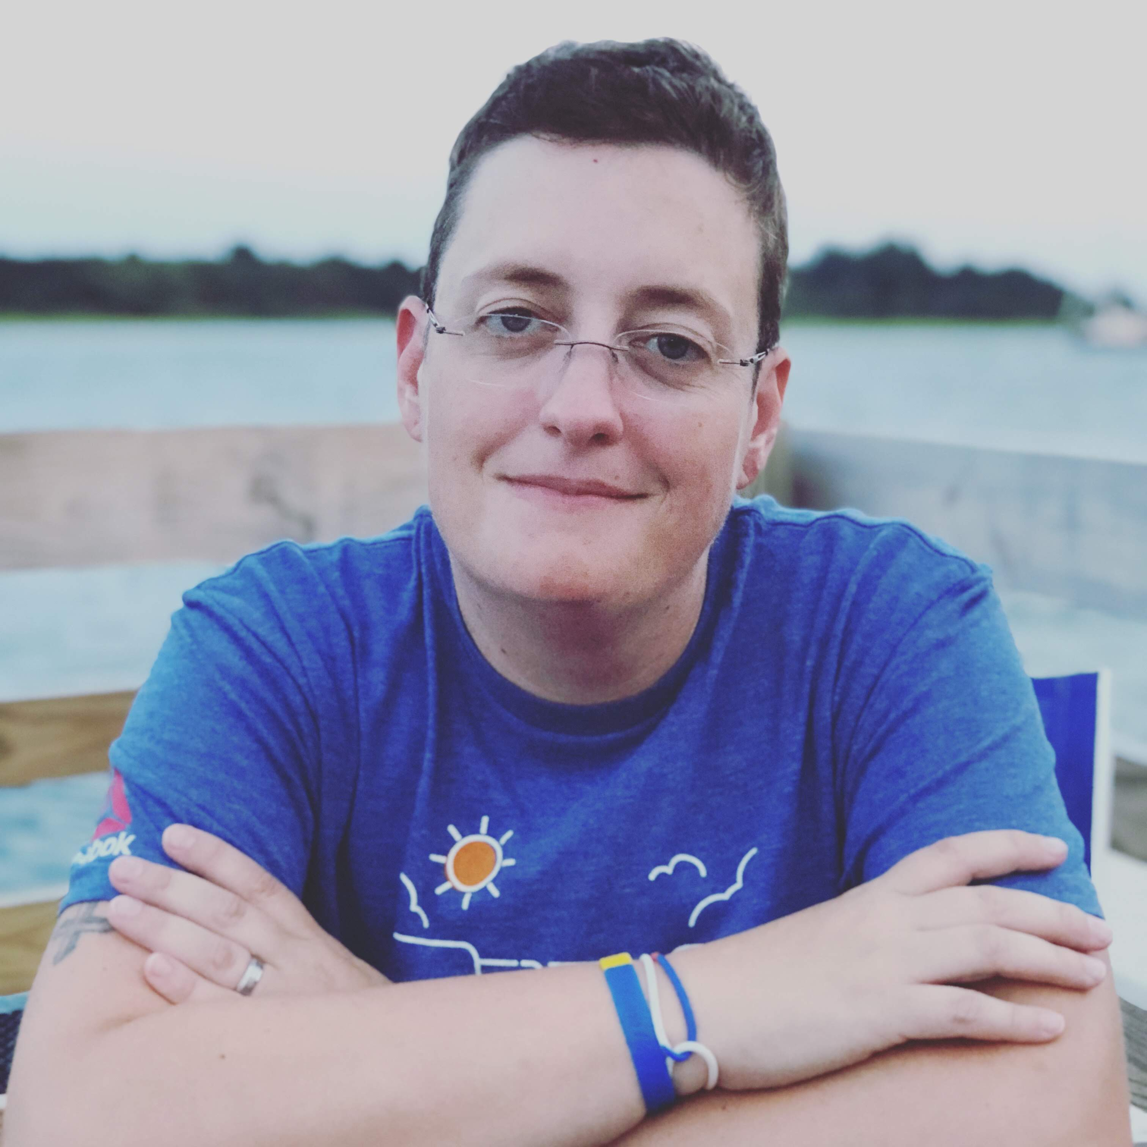
Outstanding Staff
Jess Reed
Financial Services Office

Slide 21
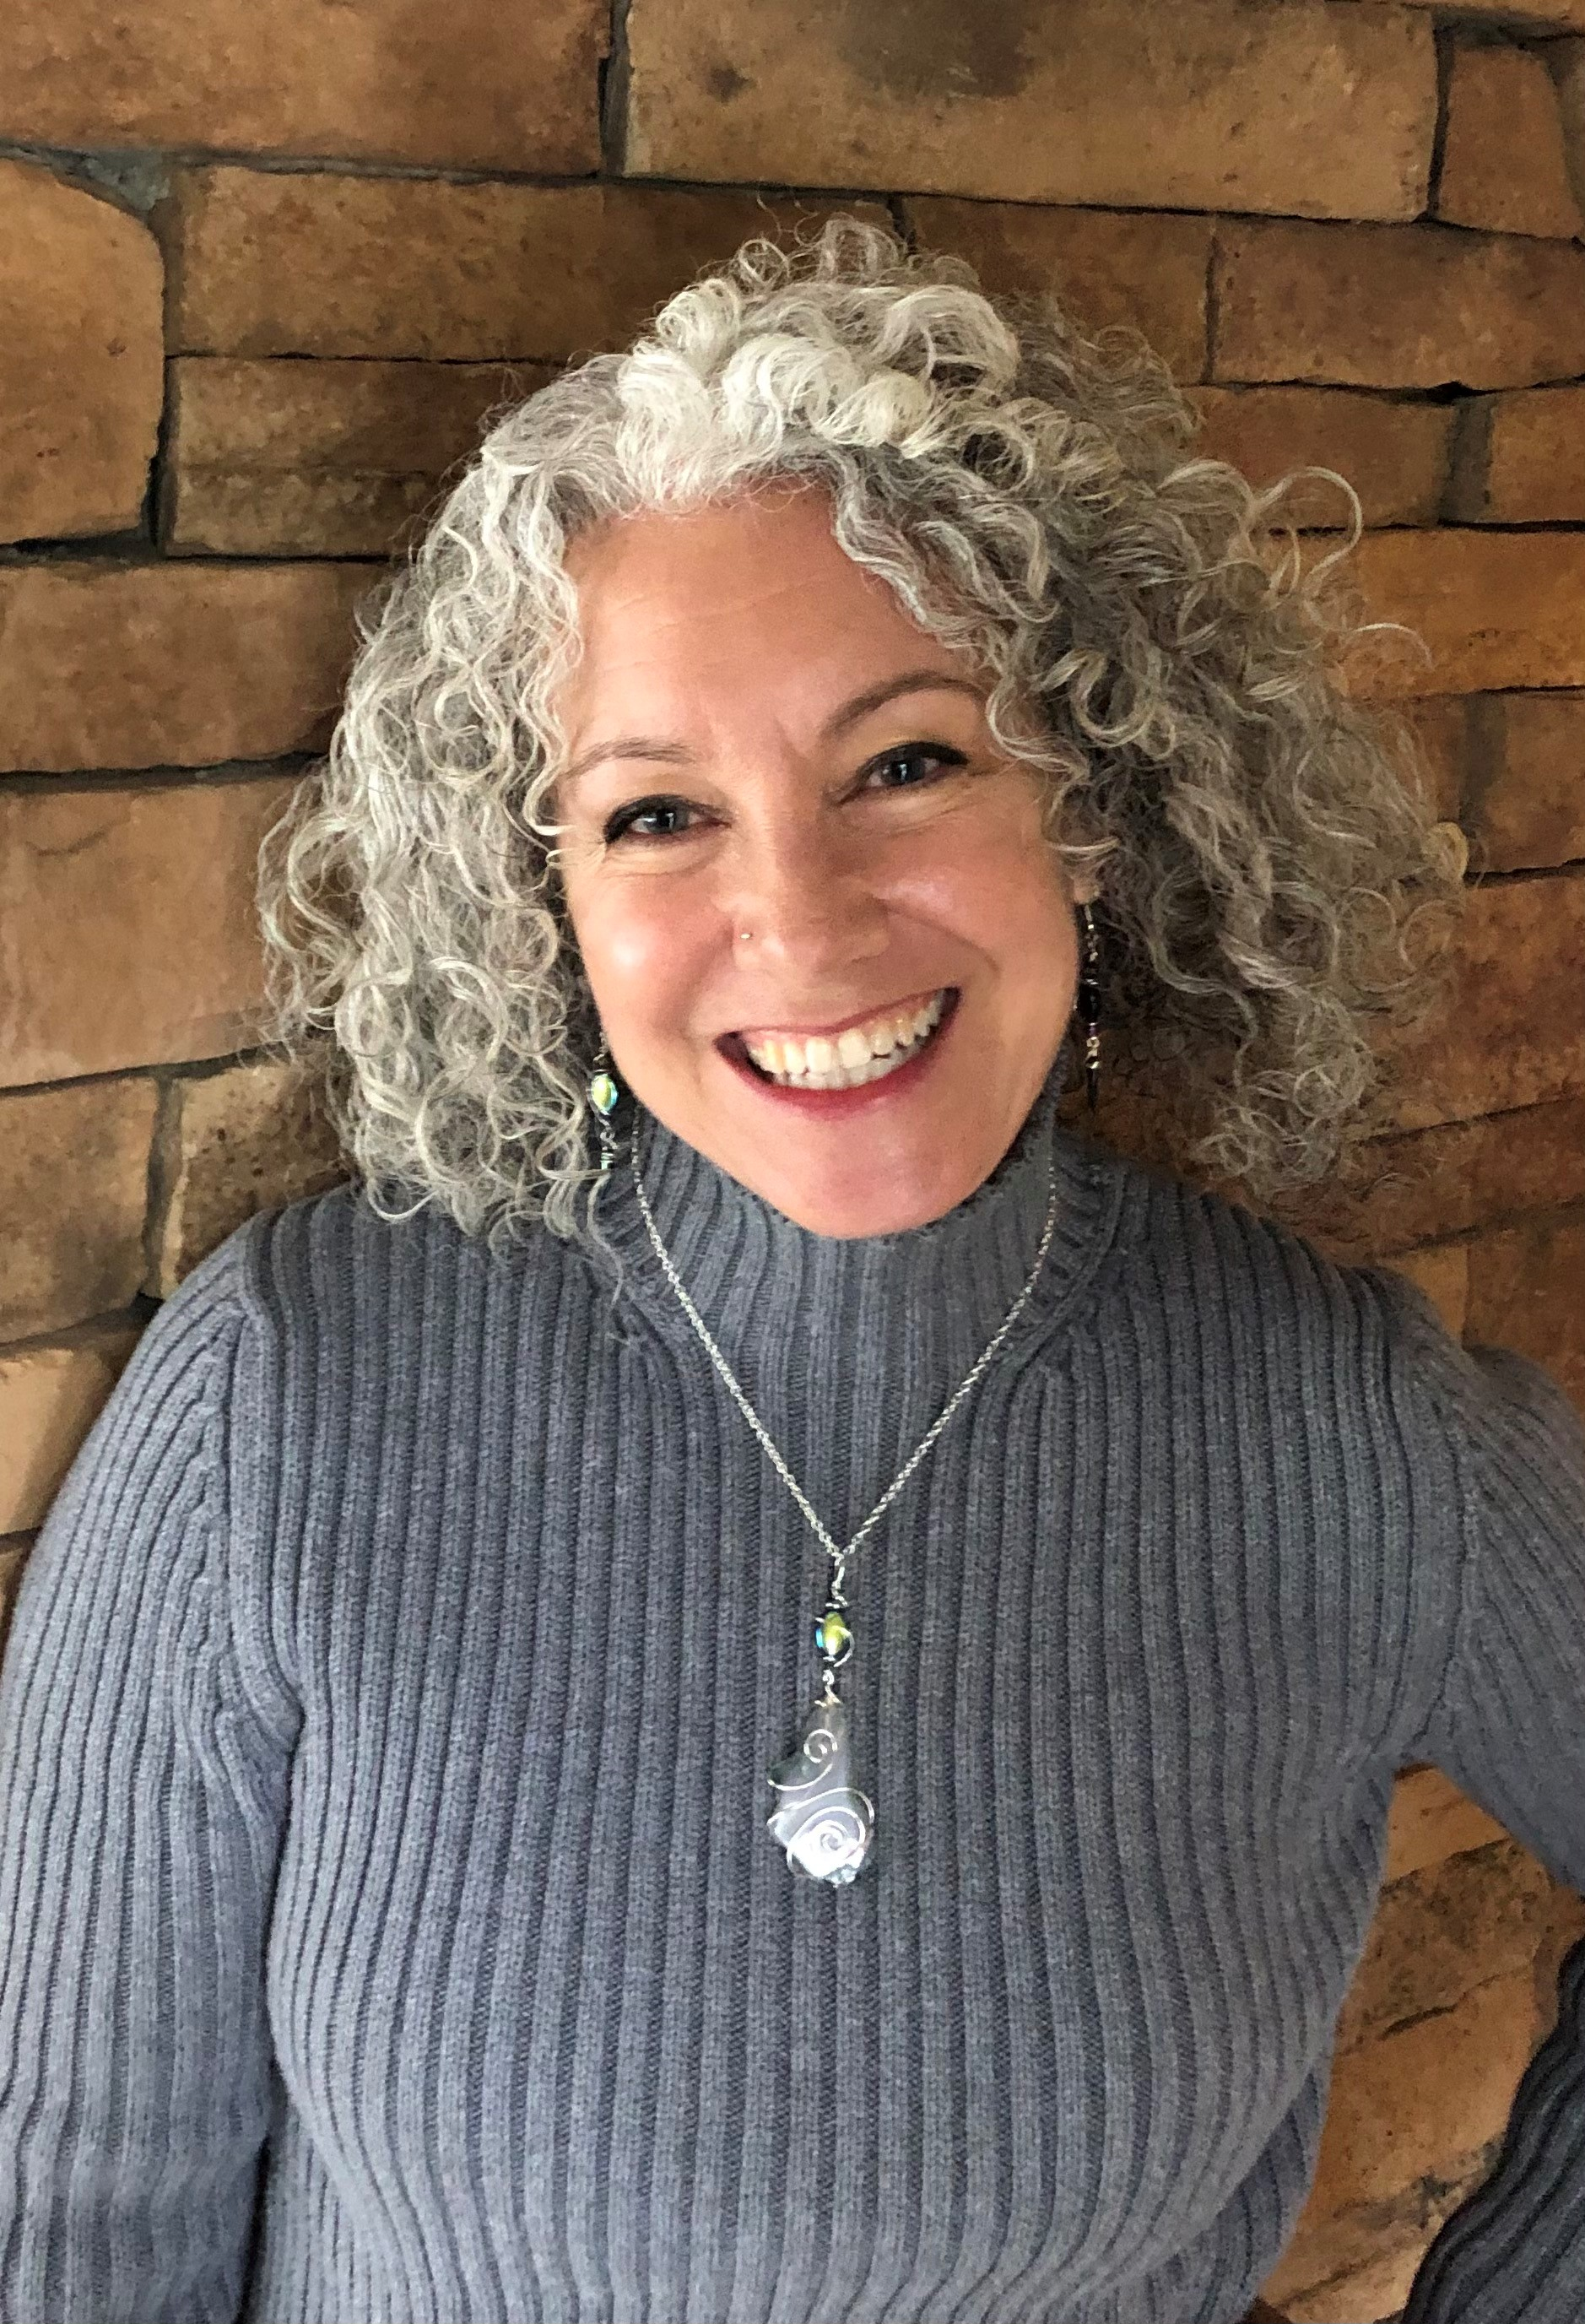
Outstanding Staff
Susan Tolis
Dramatic Arts and
Connecticut Repertory Theatre

Slide 22
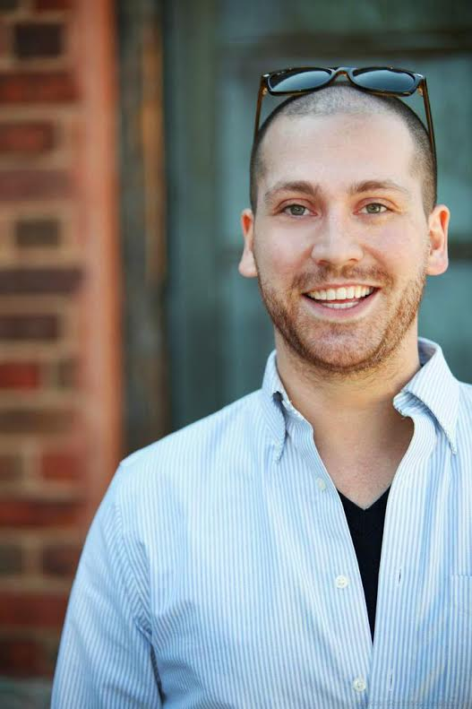
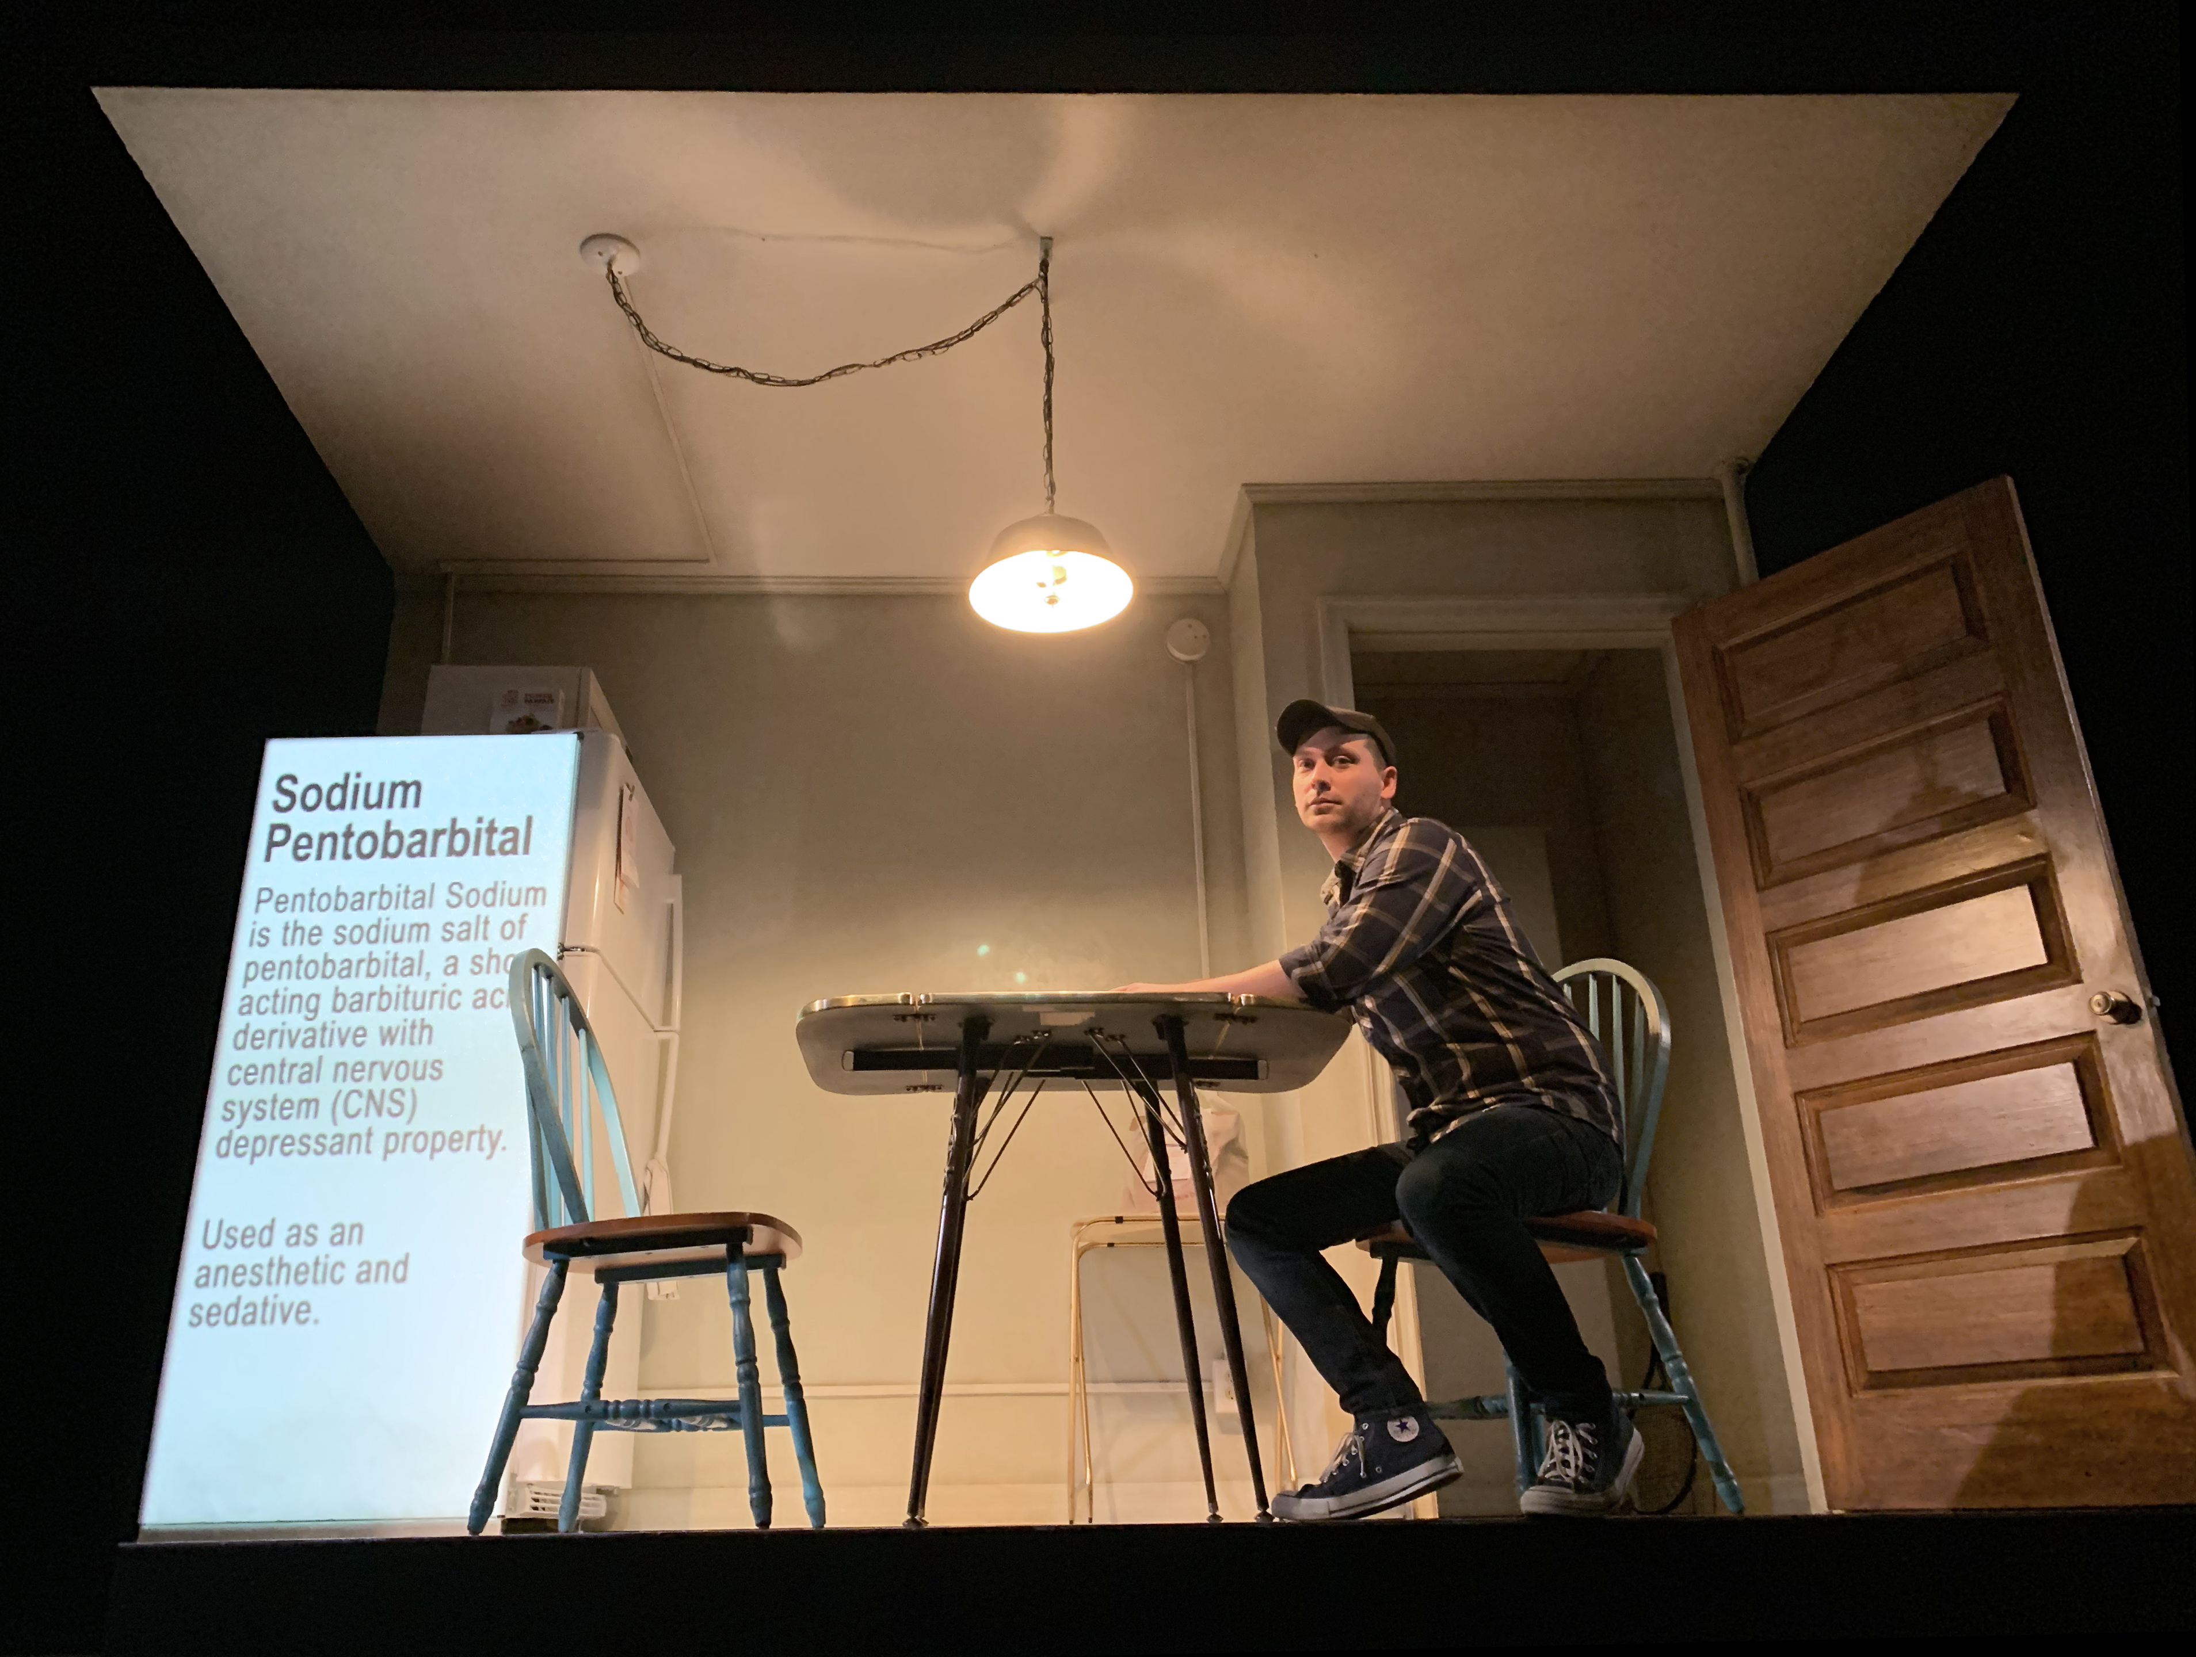
Outstanding Research & Creative Practice
Alexander Woodward Dramatic Arts

Slide 23
Years of Service
(as of February 1, 2022)

Slide 24
Ten Years
10
Michael Chybowski, Dramatic Arts
Daniela Weiser, Dramatic Arts

Slide 25
Fifteen Years
15
Greg Webster, Dramatic Arts

Slide 26
Twenty Years
20
Bob Copley, Connecticut Repertory Theatre
Constance Rock, Music
Janet Pritchard, Art + Art History
Judith Thorpe, Art + Art History
Mark Zurolo, Art + Art History

Slide 27
Monica Bock Art + Art History
25
Twenty-Five Years

Slide 28
Congratulations to All!

Slide 29
Thank you for attending!
SFA
As you leave…
Please stick your nametag and well-wishes on the butcher paper on the back wall
Please do not linger in the lobby – it’s a bottleneck
Lunch!
Grab and go lunches are in the Atrium
Please take your food and keep moving so others can receive their meals
You can stick around with colleagues outside, or head off on your own as you wish

