Slide 1
SFA Facility Updates
2023 All SFA Faculty & Staff Meeting
Colleen K. Bridgeman
February 23, 2023

Slide 2
SFA Facility Updates
Acoustical Upgrades
Harriet S. Jorgensen Theatre
Lobby Flooring Abatement and Renovation Effort
Fire Safety Curtain
Upper Jorgensen
Sound System Upgrade

Slide 3
SFA Facility Updates
Benton Museum Learning Space Redesign
Jorgensen Gallery & Event Space Refurbishments
Bishop Center Enhancements
SFA Wayfinding Status

Slide 4
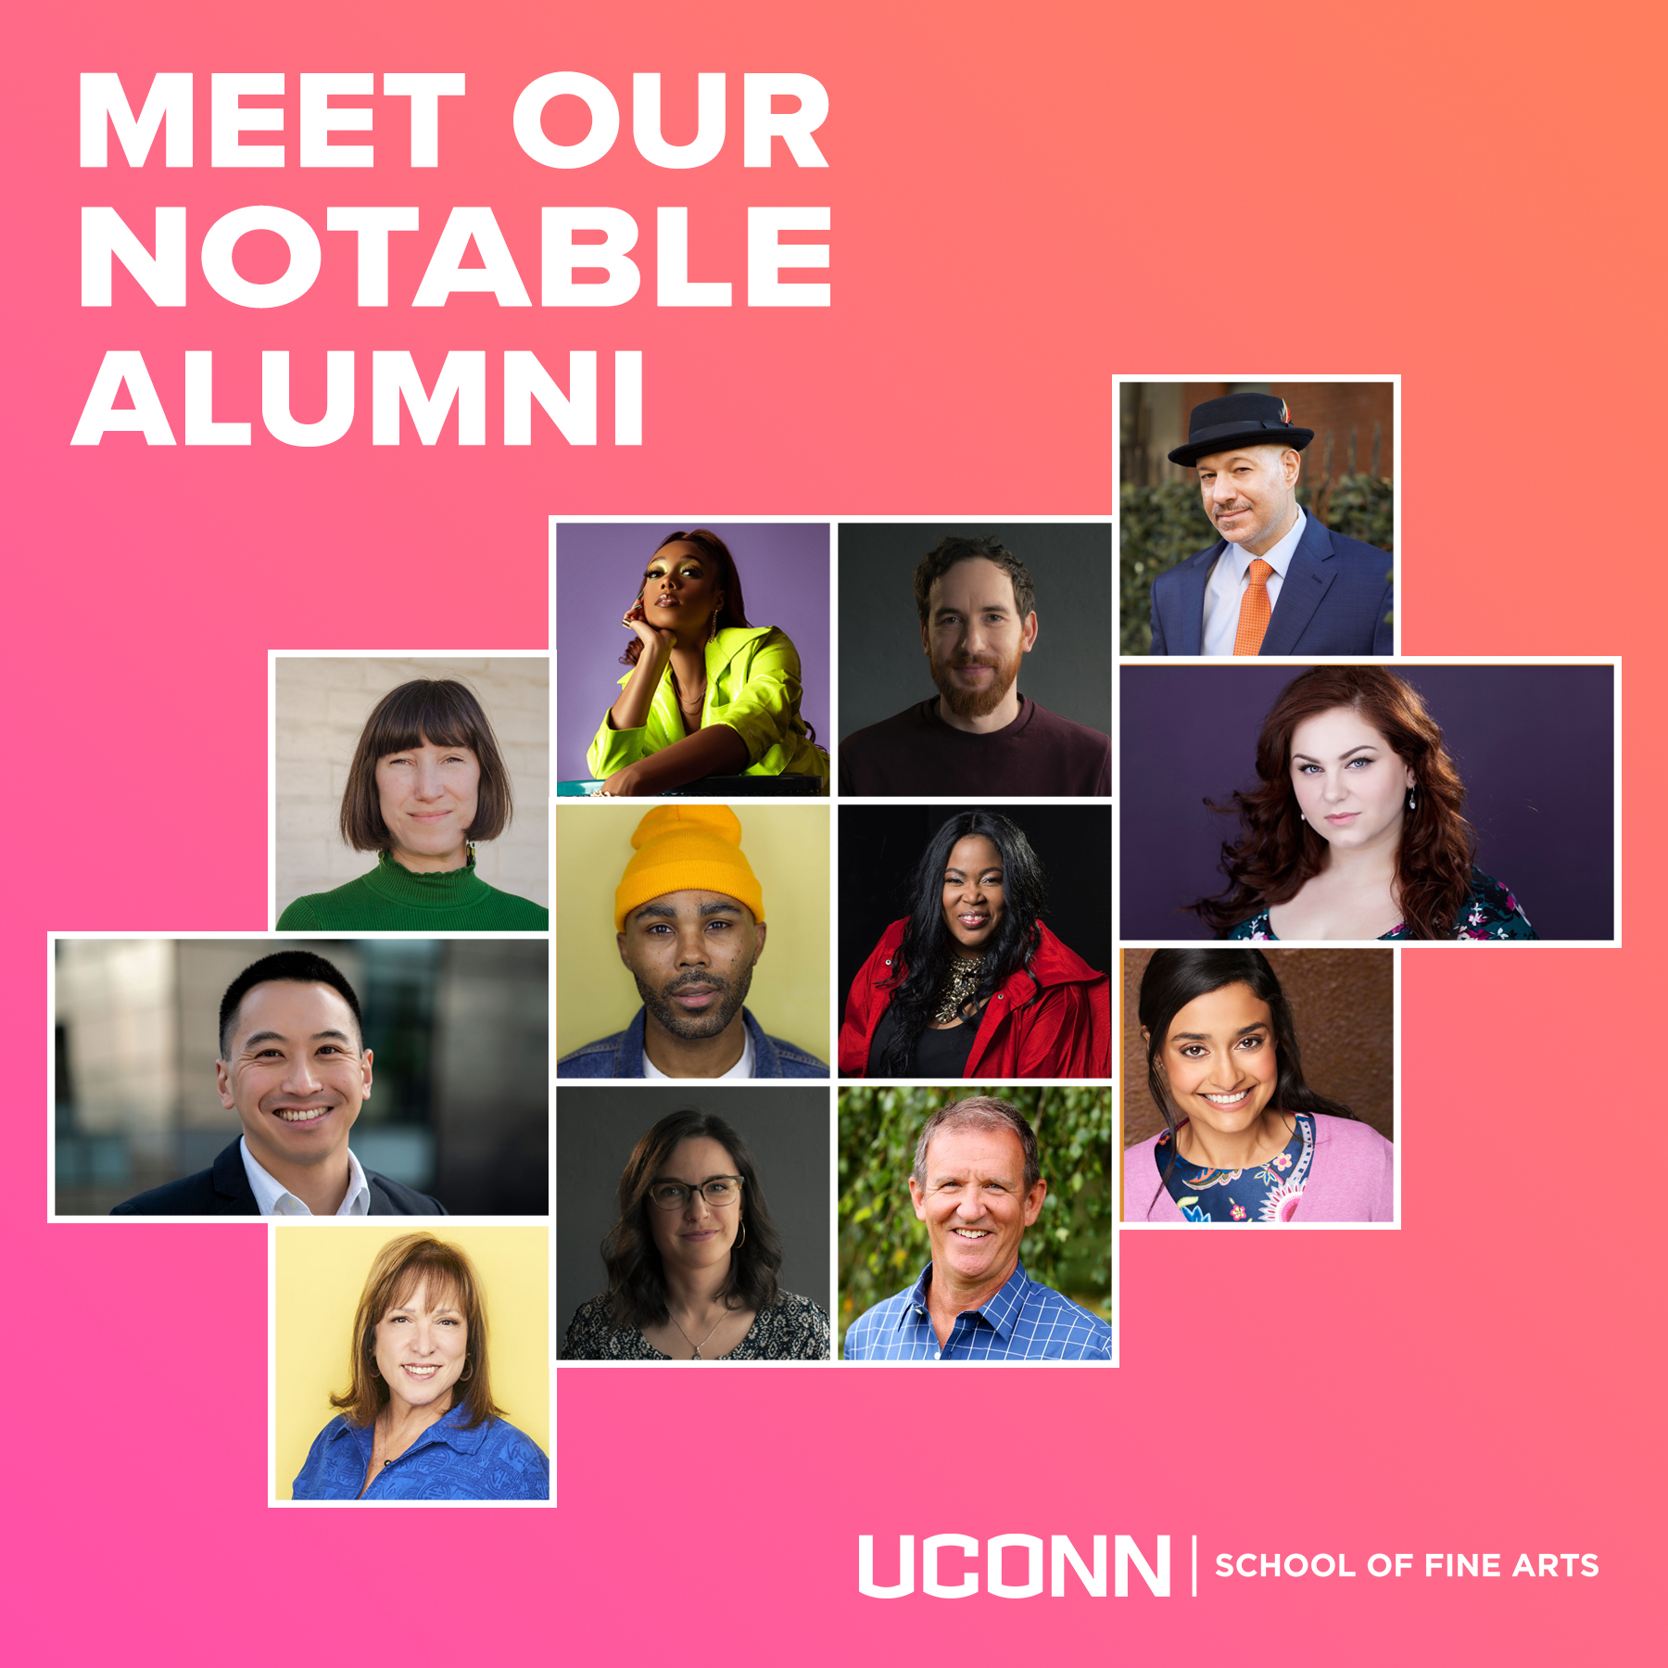
Communications/Marketing Updates
Social Media Analytics
Marketing Forms, SFA Digest
Meltwater
60th Anniversary Campaign ends
Notable News

Slide 5
Social Media Analytics (Official SFA Pages)
Facebook - 1.6k
Instagram - 1.5k
Twitter ~ 800
LinkedIn - 247
Growth = 9.8% since Aug. 2022

Slide 6
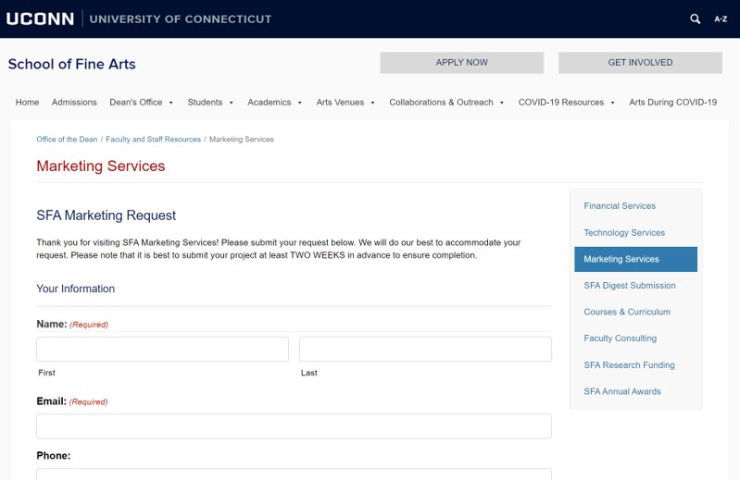
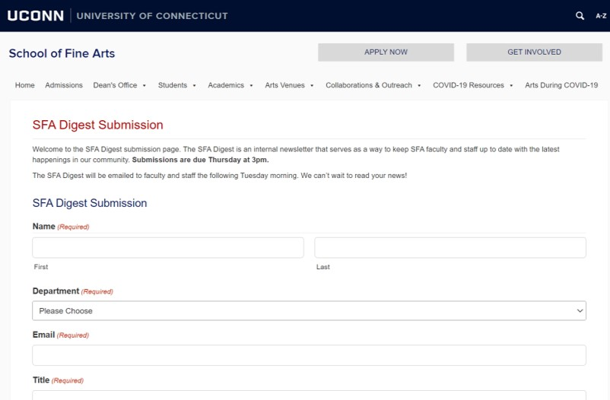
Marketing Forms

Slide 7
Notable Alumni
60th Anniversary ends
Thank you notes
Inspiration to Colleges
Notable Alumni
Suggestions
SFA Advancement Team

Slide 8
SFA in the News
Ping Chong Residency
‘Raid the Archive’
John Bell in Turkey
Over 30 stories in UConn Today since Aug. 2022
Meltwater
Alumni Workshops

Slide 9
Building Support for the Arts at UConn

Slide 10
The Mission
The University of Connecticut Foundation, Inc. mission is to solicit, receive, invest and administer gifts and financial resources from private sources for the benefit of all campuses and programs of the University of Connecticut.
The Foundation operates exclusively to promote the educational, scientific, cultural, research and recreational objectives of the University of Connecticut. As the primary fundraising vehicle to solicit and administer private gifts and grants to enhance the University's mission, the Foundation supports the University's pursuit of excellence in teaching, research, and public service.

Slide 11
UConn Foundation SFA Team
Lauren Prause
Senior Director of Development, Fine Arts & University Programs
Emily Auger Murray
Senior Director of Alumni Relations, Neag School of Education & Fine Arts

Slide 12
Advancement Team Roles
Telling our story
Volunteer pipeline development
Alumni and donor engagement
Uncovering donor passions and connecting them to University needs/priorities
Engagement and Investment

Slide 13
Your Unique Qualifications
Storyteller: You know the strengths of the School and your program! You know faculty and students who are benefitting from philanthropy because of a scholarship as well as the visiting artist whose trip is supported by philanthropy.
Connector: You are personally familiar with current students and their families; graduates, recent and not-so-recent; and alumni who are out there doing amazing things!
Steward: These funds are utilized in your areas. You can be a partner in making sure our donors have a rewarding experience giving to your areas.

Slide 14
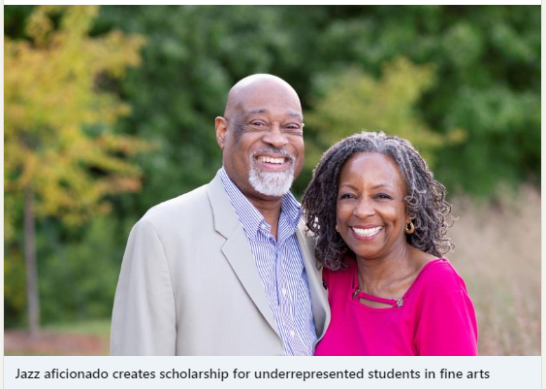
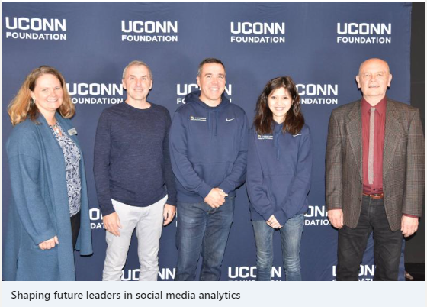
Best Practices: Collaborate
Coordinate
Collaborate
Be Positive

Slide 15
Best Practices: Spark Joy!
Engage
Listen
Be Patient

Slide 16
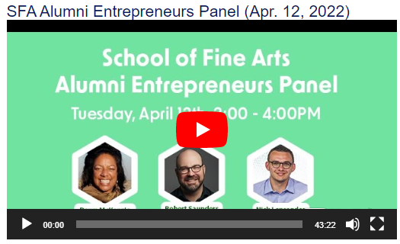
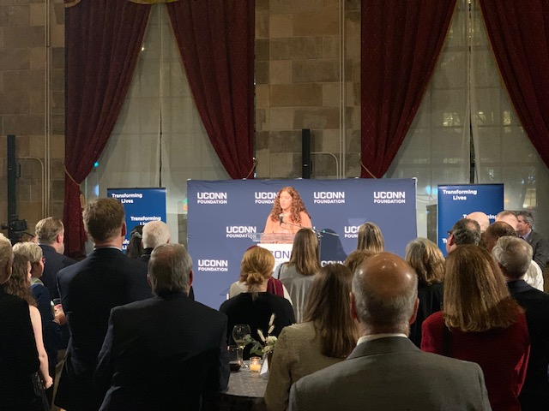
Call(s) to Action
Recommend alumni and make introductions
Share advance invitations to key events
Thank a donor (or help a student scholarship recipient thank a donor: http://s.uconn.edu/thankdonors

Slide 17
Call(s) to Action
Participate in UConn Gives March 8 -9
Become a champion for UConn Gives:
https://givingday.uconn.edu
Filter by “School of Fine Arts” to select a project/projects to support!

Slide 18
UConn Gives (Site demo)

Slide 19
THANK YOU!

